Slide 1
Environmental Hazards and Toxicology
Chapter 6 Learning Objectives
After completing this chapter, you will be able to:
Describe the various types of environmental hazards.
Explain the causes for hazards and how biota respond to changes
in ecosystems.
Differentiate natural and anthropogenic hazards with examples.
Explain the differences among various types of environmental
hazards.
Explain the most common natural and man-made hazards in the
state of Louisiana.

Slide 2
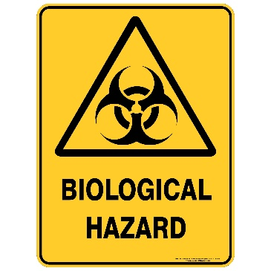
Types of Environmental Hazards
Biological hazards are caused by a variety of organisms belonging to the Six Kingdoms, from microbes to large animals. They are associated with interactions occurring among organisms, such as competition, biodiversity, food habits, and disease.
Most commonly, bacteria (Escherichia coli), viruses (COVID-19, Ebola, Flue, etc.), fungi (molds, yeast, mildew, smuts, rusts, etc.), spores (bacterial and fungal), pollen (plants), pathogens (disease causing agents), parasites (flat worm, round worm, tape worm, heartworm, etc.), are geographically distributed all over the planet Earth.

Slide 3
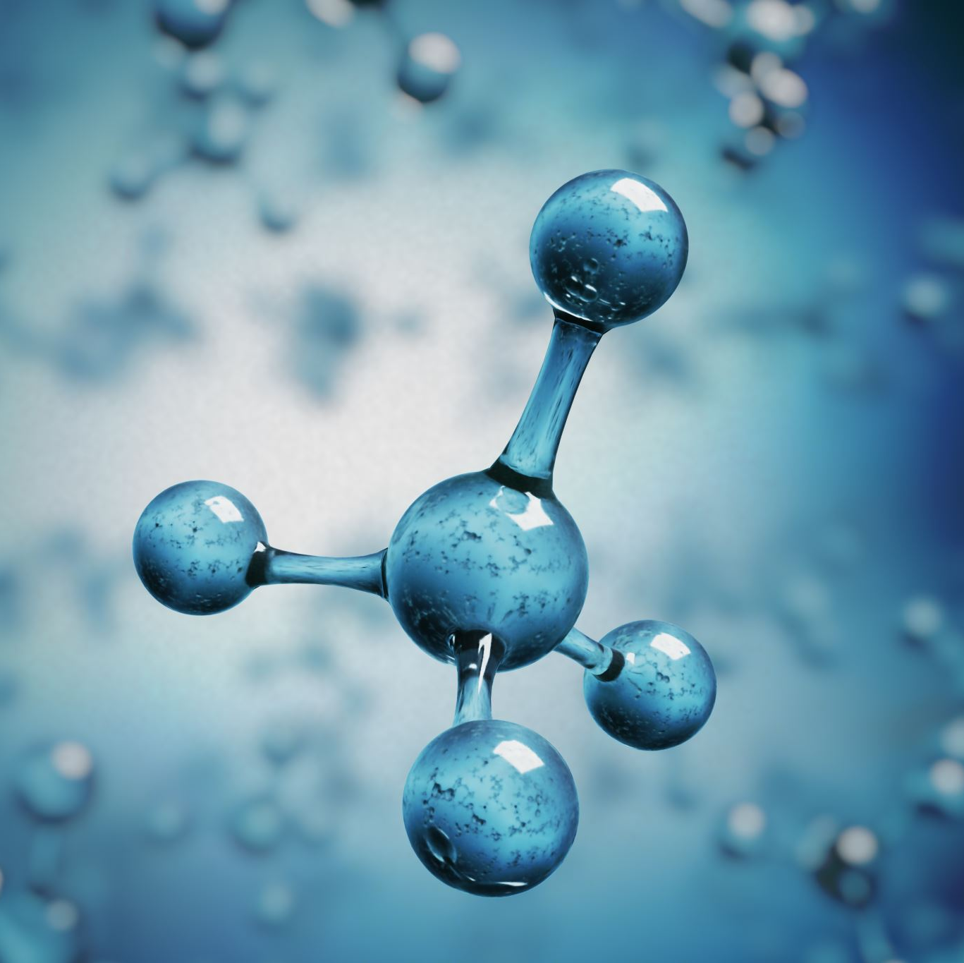
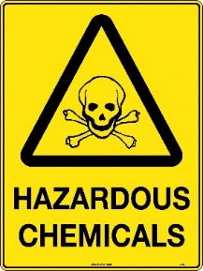
Chemical hazards are mainly two kinds – inorganic such as toxic metals (Lead, Pb; Copper, Cu; Iron, Fe; Mercury, Hg; Aluminum, Al.
Also included in chemical hazards exist as gases such as carbon dioxide, sulfur dioxide, carbon monoxide, fibers such as asbestos, and organic chemicals such as methane (CH₄), methyl mercury (CH₃Hg ).
Radiation emitted by radioactive chemicals such as Cesium, Uranium, Plutonium, etc., will have devastating long term and generational consequences in life forms due to their mutagenic (mutation causing) and carcinogenic (cancer causing) properties.

Slide 4
The Occupational Safety & Health Administration's (OSHA), the U.S. Environmental Protection Agency (EPA) and the National Fire Protection Association (What are the NFPA Color Codes? (safetysign.com) have established a range of color-coded hazards to identify their nature indicated by specific symbols.
Table 6.1: Hazardous Materials
Hazard Class | Color | Symbol
Explosives | Orange | Starburst
Non-flammable Gases | Green | Cylinder
Flammable Gases or Liquids | Red | Flame
Flammable Solids | Red/White Stripes | Flame
Oxidizers | Yellow | Flaming Ball
Poisons | White | Skull & Crossbones
Radioactives | Yellow/White | Propeller
Corrosives | White/Black | Test Tube
Source: The Occupational Safety & Health Administration's (OSHA) Hazard Communication Standard)

Slide 5
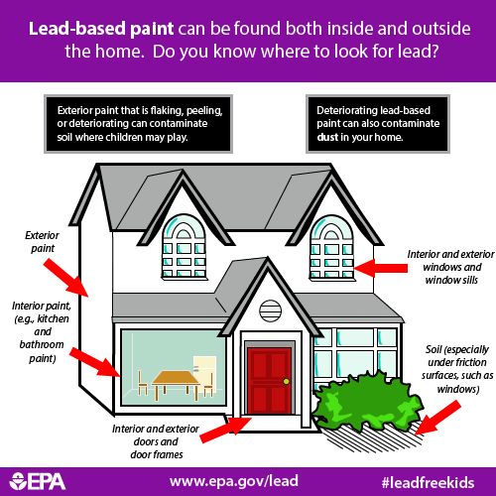
Heavy Metals
Lead (Pb) is a metal that occurs naturally in the rocks and soil of the Earth’s crust. It is also released from mining, manufacturing, and the combustion (burning) of fossil fuels such as coal, oil, gasoline, and natural gas.
More notably, lead is used to produce batteries, pipes, roofing, scientific electronic equipment, military tracking systems, medical devices, and products to shield X-rays and nuclear radiation. It is used in ceramic glazes and crystal glassware.
The U.S. Food and Drug Administration has set a limit on the amount of lead that can be used in ceramics.
(Source: lbp_in_the_home_1.jpg )(500×500) epa.gov)

Slide 6
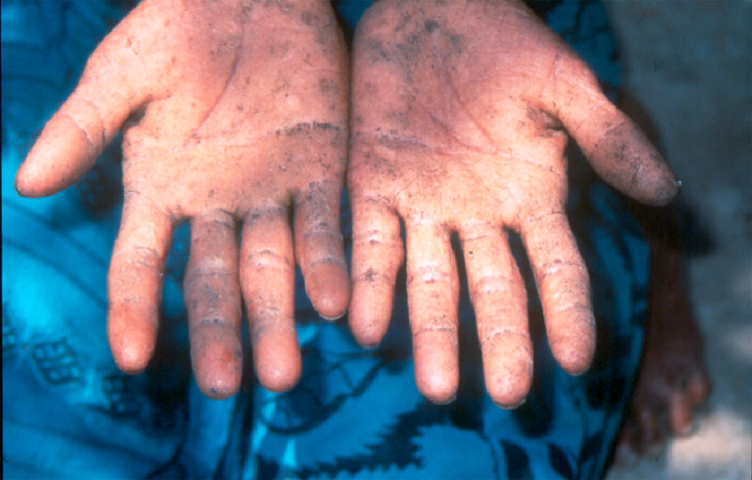
Arsenic (As) is a naturally occurring element that is normally present throughout our environment in water, soil, dust, air, and food.
The arsenic from farming and smelting tends to bind strongly to soil and is expected to remain near the surface of the land for hundreds of years as a long-term source of exposure.
Most arsenic gets into the body through ingestion of food or water. Arsenic in drinking water is a problem in many countries around the world, including Bangladesh, Chile, China, Vietnam, Taiwan, India, and the United States.
At low levels, arsenic can interfere with the body’s endocrine system. Arsenic is also a known human carcinogen associated with skin, lung, bladder, kidney, and liver cancer.
Figure 6.2: This figure shows patchy areas of dark skin pigmentation (arsenical hyperkeratosis) on the palms of the hands, a symptom of arsenic poisoning. Image and caption (modified) from Agency for Toxic Substances and Disease Registry/CDC (public domain).

Slide 7
DDT (dichloro-diphenyl-trichloroethane) a synthetic insecticide was developed and used to combat malaria, typhus, and other insect-borne human diseases.
DDT's quick success as a pesticide and broad use in the United States and other countries led to the development of resistance and bioaccumulation by many insect pest species and higher animals in food chains and food webs. (Source: DDT - A Brief History and Status | US EPA)
Figure 6.5: DDT pesticide residue in fish and other prey poisoned Bald Eagles, causing eggshell thinning that resulted in widespread nesting failures. Image by Ron Holmes/USFWS (public domain).

Slide 8
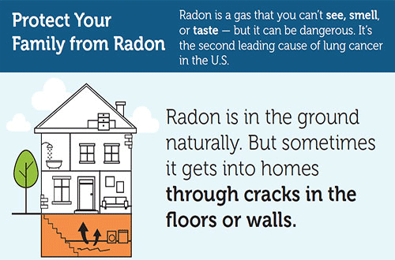
Radon is a natural inert gas that emits radioactive particles from the soil into the atmosphere and causes lung cancer over a period of long exposures (figure 6.6). This is the second leading cause of lung cancer in the United States of America (Radon and Your Health | NCEH | CDC).
Figure 6.6: This information graphic from the Centers for Disease Control explains how people can be exposed to radon from underground and its health risks. It reads "Protect your family from radon.” Image by CDC (public domain). Radon is a gas that you can't see, smell, or taste— but it can be dangerous. It's the second leading cause of lung cancer in the U.S. Radon is in the ground naturally. But sometimes it gets into homes through cracks in the floors or walls."

Slide 9
Physical hazards ranging from a wet floor in buildings, foul odor in the air, depth in water bodies, explosion, or trampling by heavy machinery or hikers, and extreme temperatures cause thermal pollution.
Warzones and ball games in indoor stadia such as Superdome in New Orleans, Louisiana, causes noise pollution. Excessive rainfall and flooding cause loss of property and life especially in low-lying areas and flood-prone zones. Forest fires cause loss of life, biomass of ecosystems, and release of toxic gases, etc.
Thermal hazard: Heat pollution is caused by the release of heat (thermal energy) into the environment, which results in ecological stress.
The tolerance levels for heat are different for different organisms based on their geographic locations such as temperate and tropical environments. It is also associated with discharges of hot water from power plants and industries into surrounding ponds and habitats.

Slide 10
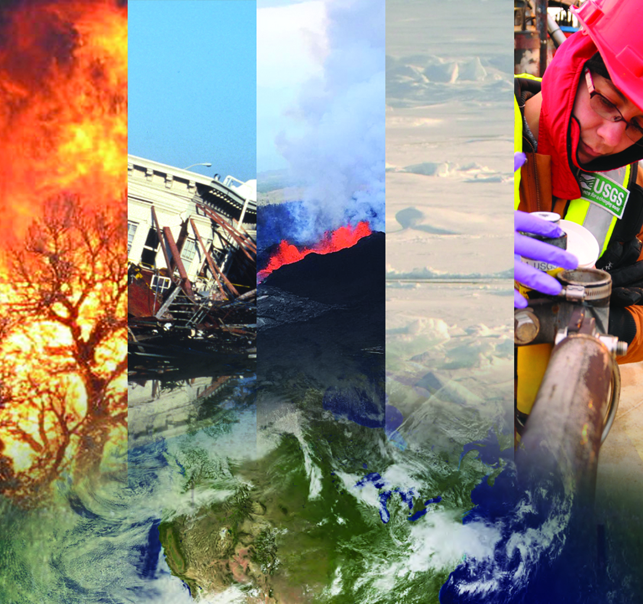
Radiation hazard: Radiation stress is caused by excessive exposure to ionizing energy. The radiation may be emitted by nuclear waste or explosions, or it can be diagnostic X-rays or solar ultraviolet energy.
Natural disasters such as hurricanes, tornadoes, earthquakes, volcano eruptions, etc., individually or collectively, cause hazardous conditions and result in loss of life and biodiversity, disrupt the harmony in ecosystems, reduces the productivity of food chains and food webs, and damages the environmental quality.
Figure 6.8. This figure shows a variety of natural hazards ranging from forest fires to earthquakes. Source: Collage of images showing Natural Hazard activities | U.S. Geological Survey (usgs.gov).

Slide 11
Cyclones: A tropical cyclone is a rotating, organized system of clouds and thunderstorms that originates over tropical or subtropical waters and has a closed low-level circulation. Tropical cyclones rotate counterclockwise in the Northern Hemisphere. The Atlantic hurricane season runs from June 1st to November 30th, however, these storms can develop before or after the season.
Hurricane hazards: Storm surge (increase the mean water level by 15 feet or more), inland flooding, high winds, and tornadoes are the most common hazards caused by hurricanes. These hazards are highly destructive to human and wildlife habitats and life, buildings, businesses, transportation, agriculture, etc.
Wind hazards: High winds are deadly hazards especially when they combine with rain and fire. The Saffir-Simpson Hurricane Wind Scale is a 1 to 5 rating based on a hurricane’s maximum sustained wind speed.

Slide 12
Table 6.3. This table shows the hurricane levels, wind speed, and the damage caused by hurricanes.
Category | Sustained winds (mph) | Types of Damage
1 | 74 - 95 | Very dangerous winds will produce some damage: Well-constructed frame homes could have damage to roof, shingles, vinyl siding and gutters. Large branches of trees will snap and shallowly rooted trees may be toppled. Extensive damage to power lines and poles likely will result in power outages that could last a few to several days.
2 | 96 - 110 | Extremely dangerous winds will cause extensive damage: Well-constructed frame homes could sustain major roof and siding damage. Many shallowly rooted trees will be snapped or uprooted and block numerous roads. Near-total power loss is expected with outages that could last from several days to weeks.
3 | 111 - 129 | Devastating damage will occur: Well-built framed homes may incur major damage or removal of roof decking and gable ends. Many trees will be snapped or uprooted, blocking numerous roads. Electricity and water will be unavailable for several days to weeks after the storm passes.
4 | 130 - 156 | Catastrophic damage will occur: Well-built framed homes can sustain severe damage with loss of most of the roof structure and/or some exterior walls. Most trees will be snapped or uprooted and power poles downed. Fallen trees and power poles will isolate residential areas. Power outages will last weeks to possibly months. Most of the area will be uninhabitable for weeks or months.
5 | 157 - > | Catastrophic damage will occur: A high percentage of framed homes will be destroyed, with total roof failure and wall collapse. Fallen trees and power poles will isolate residential areas. Power outages will last for weeks to possibly months. Most of the area will be uninhabitable for weeks or months.
Table 6.3 summarizes the level of hurricane and wind speed. Hurricane level 3 or above are considered as major hurricanes due to the level of destruction and loss of life that caused by the high-speed winds and rain. (Source: Saffir-Simpson Hurricane Wind Scale (noaa.gov)).

Slide 13
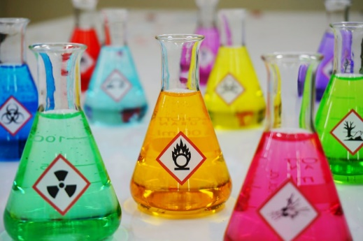
Anthropogenic (man-made) hazards: Intentional and accidental combustion of the biomass of an ecosystem causes forest fires. A wildfire can be ignited by people. A severe fire consumes much of the biomass of an ecosystem, but even a less-severe fire may kill many organisms by scorching and poisoning by toxic gases (source: B. Freedman).
Toxicology is the science of the study of poisons. It examines their chemical nature and effects on the physiology of organisms. If the dose (exposure) is large enough, any chemical, even water, can cause toxicity. In the biological sense, a chemical can poison an organism if it detrimentally affects some aspect of its metabolism. This effect is called toxicity.
Source: What is Toxicology? (hazwoper-osha.com)

Slide 14
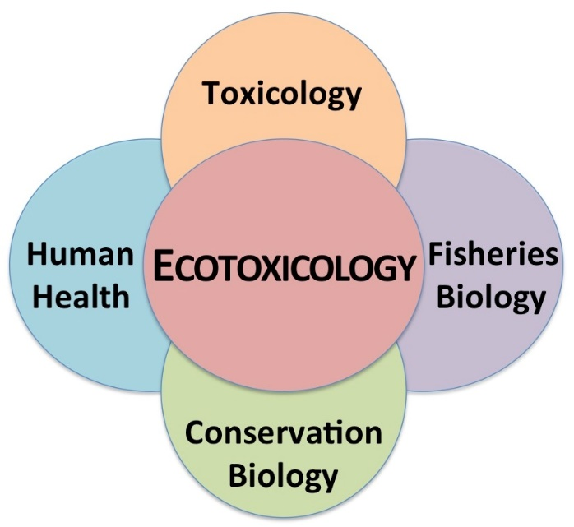
Ecotoxicology has an even broader domain because it studies the direct poisonous influences of chemicals as well as indirect ones. Examples of indirect ecological influences include changes in habitat or in the abundance of food.
The use of a herbicide in forestry or agriculture will affect the biomass and species composition of the vegetation in a treated area. These are important changes in the habitats of animals. Even if the herbicide does not poison animals that are exposed to the spray, they may be affected by changes in their habitat.
Source: ecotoxicology pictures - Google Search

Slide 15
Anthropogenic Toxins and their distribution in the environment and among the biota are due to human activities which eventually damage the natural resources and human health.
Most commonly, anthropogenic (man-made) toxins are associated with:
(a) accidental or deliberate emissions of chemicals into the environment, such as lead, copper, cadmium, zinc, nickel, sulfur dioxide, nitrates, phosphates, pesticides, biological waste, and hydrocarbons;
(b) releases of substances such as chlorofluorocarbons (commonly used in refrigerators, air conditioners, etc.) that react in the environment to synthesize chemicals of greater toxicity;
(c) releases of excessive heat from factories and industrial sites into the nearby water bodies increases the water temperatures; and
(d) discharge of chemicals such as nitrogen, phosphorus, potassium, etc. from fertilizers (source B. Freedman).

