Slide 1
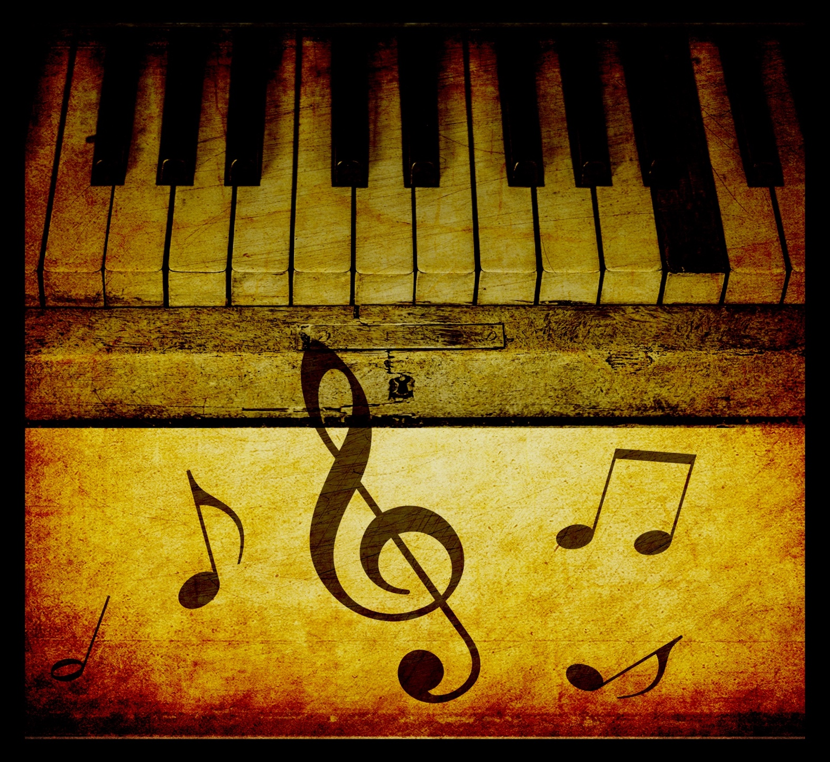
THE BAROQUE PERIOD IN MUSIC
17TH CENTURY
Piano Keys Vintage Background
Author: Karen Arnold
Public Domain Pictures (Images)

Slide 2
OVERVIEW OF THE INVENTIONS IN THE BAROQUE PERIOD
TECHNOLOGY
SCIENCE
MATHEMATICS
INVENTIONS

Slide 3
Renaissance Music
Much music with rhythms indicated by musical notation
Mostly polyphony (much is imitative polyphony)
Growing use of thirds and triads
Music – text relationships increasingly important with word painting
Invention of music publishing
Growing merchant class increasingly acquires musical skills

Slide 4
Baroque Music
Meter more important than before
Use of polyphony continues
Rise of homophony. Rise of instrumental music, including the violin family
New genres such as opera, oratorio, concerto, cantata, and fugue
Emergence of program music
First notation of dynamics and use of terraced dynamics
Continued present of music at church and court
Continued increase of music among merchant classes

Slide 5
OVERVIEW OF THE BAROQUE PERIOD IN MUSIC

Slide 6
Physics & Astronomy
Galileo Galilei (1564-1642)
Italian
Improved the telescope
Discovered (4) of Jupiters’ moons
Studied Neptune and Venus

Slide 7
Physics and Astronomy
Nicolaus Copernicus (1473-1543)
Polish
Mathematician, soldier, govenor, physician.
Provided the heliocentric theory

Slide 8
Physics and Astronomy
Johannes Kepler (1571-1630)
German
Nearly blind
Came up with the laws of planetary motion

Slide 9
Mathematics
Rene Descartes (1596-1650)
French
“Father of Modern Day Mathematics”
Cartesian-coordinate system (x- and y- coordinates)

Slide 10
Science
William Harvey (1578-1657)
English
Medical doctor
Circulation of blood

Slide 11
Religion in the Baroque Era
Intensely devout
Protestants were centered in England, Scandinavia, Holland, and North Germany
Catholics (2 powerful dynasties)
Bourbons
Hapsburgs

Slide 12
The Role of the Artist
Artists could be employed by royalty or city/church administration

Slide 13
Monodic Style
Monody - a solo song with instrumental accompaniment.
Solo line becomes more famous than the contrasting, contrapuntal lines.
The Camerata cultivated this musical style

Slide 14
The Camerati
Aristocrats (humanists, musicians, poets, intellectuals)
Florentine, Italy
They met mainly 1573-1580’s
Under the patronage of Count Giovanni de’Bardi
Aimed to resurrect the musical-dramaticism of Ancient Greek art
Believed that music should heighten the emotional power of the text (stile rappresentativo)

Slide 15
New Harmonic Structures
Middle Ages---neumes / Renaissance---polyphony
Baroque---figured bass
Figured Bass is a type of notation that allows the composer to place a numeral above or below the bass note. The musician is then able to play the chord represented by that number.

Slide 16
New Harmonic Structures
Figured Bass is a musical shorthand
Basso continuo refers to the system represented by this style of writing

Slide 17
Figured Bass

Slide 18
Baroque Musical Style
Vocal music
Wide leaps and jumps as well as chromaticism express the text
Instrumental music - dissonant (clashing) chords were used to provide a sense of color for emotionally heightened areas of the music

Slide 19
Baroque Musical Style
Terraced dynamics were used in the Renaissance period and this carried over to the Baroque period.
However, artists began using the forte-piano method. Dynamics increased (or decreased) based upon the lyrics that were used.

Slide 20
The Rise of the Virtuoso Musician
Castrati were used to cover soprano and contralto roles
Young boys typically sang soprano roles in church
Embellishment was a significant part of Baroque music

Slide 21
Virtuoso Musician
Farinelli (1705-1782)
Real name - Carlo Broschi
One of the most famous Italian soprano castrati of the 18th century

Slide 22
The Doctrine of Affections
Music ought to arouse emotions (i.e. joy, anger, fear, love, etc.)
Building an entire piece on a single affection

Slide 23
Women in Baroque Music
Women played more of a role in the Baroque period than previous periods in Musical history
They were notable singers, harpsichord players, and composers

Slide 24
Francesca Caccini
1587 - c.1640
First woman to write and opera
Daughter of Giulio Caccini (one of the Camerati)
La Liberazione de Ruggiero (1625)

Slide 25
Internationalism
National styles existed but without nationalism
Because of the voyages of the Renaissance period, unknown regions from around the globe became the settings of many early Baroque Operas

Slide 26
BAROQUE OPERA

Slide 27
Components of Opera
Opera-large scale drama that is sung virtually throughout the whole presentation
Uses soloists, ensembles, orchestra, and sometimes ballet
Combines these elements with poetry and drama, acting and pantomime, and scenery and costume

Slide 28
Components of Opera
Recitative - Speech-like melody that sets up the aria
Aria - Italian for song
Orchestras usually perform an overture, which is an introduction to the opera consisting of melodies that are extracted from the opera
Libretto - Book that contains the lyrics of the opera
Sinfonias - Musical interludes provided by the orchestra

Slide 29
Claudio Monteverdi
1567-1643
One of the first great masters of Italian opera
More drama was used than the previous Camerata style

Slide 30
Opera in France
France rejected the Italian opera and French composers set out to make their own style
Tragedie lyrique - The French nationalistic style of the Italian opera

Slide 31
Jean-Baptiste Lully
1632-1687
The most important composer of the tragedie lyrique

Slide 32
Opera in England
The English masque was a type of entertainment that combined vocal and instrumental music
Masques were presented in the private homes of the noble
Between 1649-1660, English Puritans regarded the theater as the “invention of the devil”
Still concerts could be performed

Slide 33
John Blow
1649-1708
Englishman
Composed Venus and Adonis

Slide 34
Henry Purcell
1659 - 1695
The first real English composer of opera
Pupil of Blow
Singer, organist, and composer
Dido and Aeneas

Slide 35
THE CANTATA

Slide 36
The Cantata
The cantata is a work for one or more solo vocalists with instrumental accompaniment based on of three poetic genres
Lyric expresses personal emotion and places the music at the forefront
Dramatic is written for performance in a play
Narrative follows characters throughout a plot (tells a story)

Slide 37
BACH AND THE SACRED CANTATA

Slide 38
His Life
Johann Sebastian Bach
1685-1750
Eisenach, Germany
Orphaned at 10, raised by older brother

Slide 39
His Life
Appointed as court organist and chamber musician to the duke of Weimer at the age of 23
Married twice, 19 children
Appointed as the cantor of St. Thomas’ Church in Leipzig at the age of 38

Slide 40
Leipzig
Supervise the music for the city’s (4) main churches
Select and train choristers
Write music for the church services, weddings, ad funerals

Slide 41
His Music
Bach believed that music must serve “the Glory of God”
He was a devout Lutheran
Known as a virtuoso organist while he was alive
A Mighty Fortress is our God
Raised existing forms in music history rather than attempting to come up with new ones

Slide 42
His Life
Suffered a stroke and had several operations for cataracts
Became blind
Dictated his final work to his nephew
Died in Leipzig at the age of 65
Composed more than 1,000 works

Slide 43
HANDEL AND THE ORATORIO

Slide 44
The Oratorio
A large-scale work for soli, chorus, and orchestra
Based from the Bible and is not staged nor directed (like an opera is)
The role of the chorus (the people) is usually emphasized

Slide 45
Handel
George Frideric Handel
1685-1759
Represents the worldliness of Baroque music (whereas Handel represents the spiritual side)

Slide 46
His Life
Born in Halle, Germany
Attended the University of Halle
Wrote his first opera (Almira) at the age of 23
Was appointed conductor to the Elector of Hanover at the age of 25

Slide 47
His Life
Stayed in England for almost 50 years
Became one of the musical directors of the Royal Academy of Music at the age of 35

Slide 48
His Life
Suffered from cataracts (like Bach) and lost is eyesight
Dictated his last works
Collapsed while conducting The Messiah in 1759 and died some days later

Slide 49
His Music
Powerful rhythmic drive
Operas are centered around heroes and adventures
Arias are quite virtuosic and mainly about love
Oratorios include soaring arias, grandiose fugues (polyphonic, imitative contrapuntal development of a theme), and majestic choruses.

Slide 50
“The Messiah”
Premiered in the city of Dublin in the spring of 1742
Took Handel 24 days to compose
The libretto is a compilation of Biblical verses from the Old and New Testaments set in (3) parts

Slide 51
The Libretto
Part 1 - Christmas section
Relates the prophecy of the coming of Christ and His birth
Part 2 - Easter section
His suffering, death, and spread of His doctrine
Part 3 - Redemption section
Redemption of the world through faith

Slide 52
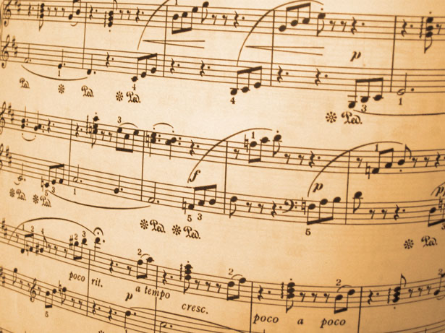
MUSIC OF THE BAROQUE PERIOD – 17th CENTURY FORMS

Slide 53
MUSIC OF THE BAROQUE PERIOD
This brief introduction to the Baroque period is intended to provide a short summary of the music and context in the Baroque Era, which lasted from about 1600-1750. This period includes several composers that we now hear on so-called “classical” music stations. You are probably familiar with such names as Bach, Handel, and Pachelbel, whose Canon is used in many modern weddings. You have almost certainly heard snippets of these composers on TV shows, commercials, or movies. In this section, we will add some context and history to these and many other personalities from the Baroque Era.
The term “Baroque” has an interesting and disputed past. Baroque ultimately is thought to have derived from the Italian word barocco. Philosophers during the Middle Ages used this term to describe an obstacle or veering from schematic logic. Later the term came to denote or bring attention to any contorted idea, obscure thought, or anything different, out of the ordinary, or strange. Another possible origin is from the Portuguese term barrocco, in Spanish barrueco. Jewelers use this term even today to describe irregular or imperfectly shaped pearls: a baroque pearl. The baroque period is a time of extremes resulting from events stemming back to the renaissance. The conflict between the reformation and counter-reformation, and the influence of Greek/Roman culture as opposed to medieval roots are present throughout the Baroque era.

Slide 54
General Trends of Baroque Music
The characteristics highlighted in the chart above give Baroque music its unique sound and appear in the music of Monteverdi, Pachelbel, Bach, and others.
To elaborate:
Definite and regular rhythms in the form of meter and “motor rhythm” (the constant subdivision of the beat) appear in most music. Bar lines become more prominent.
The use of polyphony continues with more elaborate techniques of imitative polyphony used in the music of Handel and Bach.
Homophonic (melody plus accompaniment) textures emerge including the use of basso continuo (a continuous bass line over which chords were built used to accompany a melodic line)
Homophonic textures lead to increased use of major and minor keys and chord progressions (see chapter one)
The accompaniment of melodic lines in homophonic textures are provided by the continuo section: a sort of improvised “rhythm section” that features lutes, viola da gambas, cellos, and harpsichords. Continuo sections provide the basso continuo (continuous bass line) and are used in Baroque opera, concerti, and chamber music
Instrumental music featuring the violin family—such as suites, sonatas, and concertos emerge and grow prominent.
These compositions are longer, often with multiple movements that use defined forms having multiple sections, such as ritornello form and binary form.
Composers start to notate dynamics and often write abrupt changes between loud and softs, what are called terraced dynamics.

Slide 55
Baroque Formats in Music
17th Century

Slide 56
Opera
An Opera is a dramatic musical work in which the characters sing rather than speak to an orchestral accompaniment. An opera involves costume, scenery, music, tells a story and involve singing of arias (solos), ensembles, and choruses.

Slide 57
BIRTH OF OPERA IN THE BAROQUE PERIOD IN MUSIC
The beginning of the Baroque Period is in many ways synonymous with the birth of opera. Music drama had existed since the Middle Ages (and perhaps even earlier), but around 1600, noblemen increasingly sponsored experiments that combined singing, instrumental music, and drama in new ways.
Renaissance Humanism led to new interest in ancient Greece and Rome. Scholars as well as educated noblemen read descriptions of the emotional power of ancient dramas, such as those by Sophocles, which began and ended with choruses. One particularly active group of scholars and aristocrats interested in the ancient world was the Florentine Camerata, so called because they met in the rooms (or camerata) of a nobleman in Florence, Italy. This group, which included Vicenzo Galilei, father of Galileo Galilei, speculated that the reason for ancient drama’s being so moving was its having been entirely sung to a sort of declamatory style that was midway between speech and song. Although today we believe that only the choruses of ancient drama were sung, these circa 1600 beliefs led to collaborations with musicians and the development of opera. Less than impressed by the emotional impact of the rule-driven polyphonic church music of the Renaissance, members of the Florentine Camerata argued that a simple melody supported by sparse accompaniment would be more moving.
They identified a style that they called recitative, in which a single individual would sing a melody line that follows the inflections and rhythms of speech (see figure one with an excerpt of basso continuo). This individual would be accompanied by just one or two instruments: a keyboard instrument, such as a harpsichord or small organ, or a plucked string instrument, such as the lute.

Slide 58
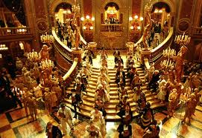

Slide 59
Sonata
A Sonata is a piece of music, often in three sections (exposition, development, and recapitulation). Usually written for a single player or small ensemble, it is a kind of essay in composition. As such, a sonata is a self-contained work, not based on existing dance forms, texts or stories.

Slide 60
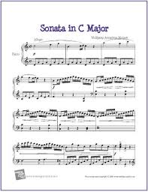

Slide 61
Oratorio
A work for orchestra, chorus, and soloists with a religious theme. Intended for performance in a concert hall or church. Oratorios are religious compositions.

Slide 63
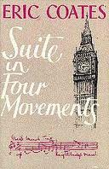
Suite
A Suite is a set of pieces, originally based on dance forms, grouped together in one work.

Slide 64
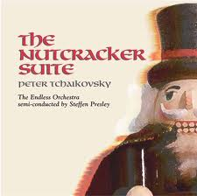

Slide 65
Fugue
A Fugue is a composition in which a theme develops by counterpoint. That is, when one voice or part ends, the next voice picks up the theme, imitating and developing it, and so on. Johann S. Bach is considered the master of this form of music.

Slide 66
Concerto
A Concerto is a three division musical composition based on a fast, slow, fast movements with a showpiece cadenza. It is accompanied by Orchestra. The word Concerto is Italian. It consist of three movements only.

Slide 67
The String section was the dominant section in the orchestra
We have reviewed the basic forms in the Baroque Period 17th Century. At this time the Orchestra started to take shape with a small group of musicians, and instruments were not developed as they are today. Vocal music and instrumental music both became equal in this period of music.

Slide 68
DR. DORIS SPOONER HALL EXPLORING THE ARTS
THE END

