Slide 1
Music In A New Millennium
Music For Television,
Film, Stage, Mix-Tapes, Videos, Media, I-pods, to Technology
and
American Idol

Slide 2
John Williams Composer Extraordinaire For Scoring Music for Film

Slide 3
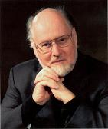
John Williams
John Williams should need little introduction since he is almost certainly the most well-known film composer, and possibly to many people the best-known composer, period. He was born in New York where his father Johnny Williams was a percussist and the young John started piano lessons from age 7. When the family moved to the West coast, his father found session work playing on film soundtracks so it was quite a natural thing for John to start out with similar work as a freelance pianist. During the Golden Age of Hollywood Cinema, he worked as a pianist and arranger with film music luminaries such as Alfred Newman, Franz Waxman, Bernard Herrmann, and later Henry Mancini.

Slide 4
John Williams
With such exposure to the industry, and the encouragement of Newman in particular, Williams made the transition into composition. Among his early work as a composer were the television shows of Irwin Allen such as "Lost in Space", "Time Tunnel" and "Land of the Giants".
He then composed for a variety of films including "The Reivers", "The Cowboys" and some popular disaster movies including "The Poseidon Adventure" and "The Towering Inferno". One particular early success was his first Oscar (of five currently) for his adaptation of Jerry Bock's music for the stage musical "Fiddler on the Roof".
Williams also conducted and provided the incidental music for the film, and the part of the fiddler himself was played by violinist Isaac Stern.

Slide 5
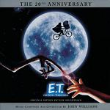
John Williams and The “Movie E.T.”
Williams was already establishing a respected position for himself in Hollywood, when his career was to reach an important turning point. Stephen Spielberg was starting out in the movie business and approached Williams to score his early movies. In quick succession this led to Williams' second Oscar for Jaws and his introduction to George Lucas who then hired him for his Star Wars saga leading to his third Oscar. This succession of events rapidly established John Williams as one of the foremost film composers of the day. The close relationship with Steven Spielberg and the director's own meteoric career meant that he was the composer for many major films of the period, including "Close Encounters of the Third Kind", "Superman", "E.T." (winning Oscar number four) and the Indiana Jones movies.

Slide 6
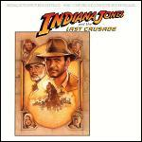
John Williams and “Indiana Jones”

Slide 7
John Williams and “Indiana Jones”
Williams' music is firmly from the classical tradition, based heavily on the style of the late-romantics such as Gustav Mahler and Richard Strauss. It has at times some modernistic overtones (such as with Close Encounters of the third kind), yet primarily it is just wholesome music full of good memorable tunes with fanfares and fun marches particularly prominent. Williams is rightly well-regarded for his ability to construct a tune and sound which perfectly complements the mood of a film.
An interesting documentary about John Williams' film music has appeared on youtube, made during the making of "The Empire Strikes Back" but including many clips from his films and comments from Lucas and Spielberg. The documentary is in 6 parts - start here with part 1 of Star Wars Music by John Williams and follow the links to related videos to see the other parts. Here is the 1st part of a late documentary where the composer talks about the scoring for "The Phantom Menace.”

Slide 8
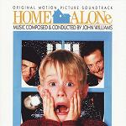
John Williams and “Home Alone”
Although the relationship with Spielberg was obviously central to his career in Hollywood, it can also be seen as perhaps limiting musically, since most of his movies belonged to a narrow range of family fantasy and adventure stories. However that limitation was not significant in the longer term. Firstly, both director and composer have not always shared an exclusive relationship. Spielberg chose Quincy Jones to score his "The Colour Purple" for example, and John Williams for his part has worked with a number of different directors. Irwin Allen and George Lucas have been mentioned already and, outside this circle, Williams also scored "The Witches of Eastwick" (for George Miller), "J.F.K." (Oliver Stone), "Home Alone" (Chris Columbus), and many others. The other factor that impacted the type of movie he worked on, was that Spielberg himself sought to broaden his range of movie genres with films such as "Empire of the Sun", "Schindler's List" (Williams winning his fifth oscar), "Saving Private Ryan", "Amistad" and most recently "Minority Report".

Slide 9
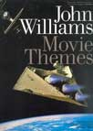
John Williams Movie Themes

Slide 10
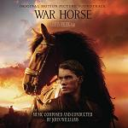
John Williams and “War Horse”
John Williams has recently re-crafted his Star Wars music from all six films to fit a show called "STAR WARS: A Musical Journey". This is a live two-hour musical event with the Royal Philharmonic Orchestra and chorus, with scenes from the movies and live narration. The show started in London's "O2 arena" (previously called the Millennium Dome) in April 2009 before going on tour across Europe. The venues will also host an exhibition of models, props, costumes and artwork from the Lucas film Archives. For tickets and further information see The O2 site or your local press for further information. Here is the Maestro conducting the world premiere of his piece called Soundings commissioned for the opening of the new Walt Disney Concert Hall in Los Angeles in 2003. The composer's goal was to make the hall sing, and he certainly does that! See also our review of the new box set Indiana Jones: The Soundtracks Collection which explores the most complete versions of these film scores so far released, and the show Star Wars in Concert.

Slide 11
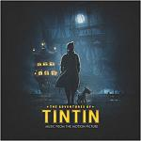
John Williams and “Tintin”

Slide 12
“Tintin” by John Williams
It's a long time since we heard a completely new film score by John Williams, but The Adventures of Tintin:
The Secret of the Unicorn is now on general release in various parts of the world. Steven Spielberg worked with Peter Jackson on the movie, and yet again Andy Serkis gets involved in motion capture to create the character of Captain Haddock. The story involves Tintin and his friends finding directions to a sunken ship which was commanded by one of Haddock's ancestors, so they go off on a treasure hunt.

Slide 13
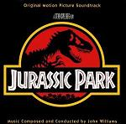
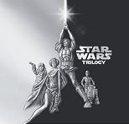
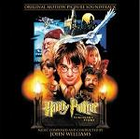
Films by John Williams

Slide 14
Films by John Williams
Valley of the Dolls
Goodbye, Mr. Chips
The Reivers
The Missouri Breaks - an example of Williams' earlier experiments using a Jazz influenced style
Images
Tom Sawyer
The Rare Breed
Cinderella Liberty

Slide 15
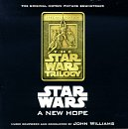
John Williams and “Star Wars”

Slide 16
John Williams and His Additional Films
The Cowboys - an early taste of the Williams style
Dracula - just like the Hammer Horror sound
Fiddler on the Roof - though Jerry Bock did the songs
The Poseidon Adventure
The Long Goodbye
Earthquake - the main disaster effects are played without music, but the titles and rescue scenes show interesting examples of John Williams' early style for the cinema
Seven Years in Tibet
Jane Eyre - made for TV in 1971
The Fury - some very effective string writing for this Brian DePalma horror movie
Sugarland Express - his first film collaboration with Steven Spielberg, who had previously worked with the composer Billy Goldenberg on several TV series and the film "Duel"
Black Sunday - an action suspense movie with a suggestion of ethnic musical influences in the earlier scenes
The Towering Inferno

Slide 17
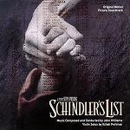
John Williams and Movies

Slide 18
Films of John Williams
The Man Who Loved Cat Dancing - replacing Michel Legrand at short notice, Williams used some Cowboys western style, but mostly a harmonica led jazz theme with some dreamy sequences and short cues for timpani and snare drum
The Eiger Sanction - suitably European sounding
Jaws 1, 2, 3D, 4
Family Plot - Williams worked with Alfred Hitchcock on this his last movie - the composer used ethereal music for the seance scenes, though the film is a thriller there is a slight comedic touch often indicated by a harpsichord - here is a you tube documentary (from the Family Plot DVD) where the composer discusses Hitchcock's approach to film music with references to Bernard Herrmann
Battle of Midway - a long film with a single stirring march
Close Encounters of the third Kind - with its integral 5-note theme
Superman 1, 2, 3, 4 - absolutely perfect for the comic book hero
1941 - includes another march and also borrows the Jaws theme for a rising submarine!
Raiders of the Lost Ark, no.2 Indiana Jones and the Temple of Doom, no.3 (Indiana Jones and the Last Crusade) and no.4 (Indiana Jones and the Kingdom of the Crystal Skull) - another rousing march, adventure, excitement and some nods to ethnic styles
Star Wars 4 (A New Hope), 5 (The Empire Strikes Back), 6 (Return of the Jedi) [the Original Trilogy], and 1 (The Phantom Menace), 2 (Attack of the Clones) and 3 (Revenge of the Sith) [the later prequels] - fanfares and themes to denote characters now familiar the world over

Slide 19
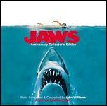
John Williams and “Jaws”

Slide 20
John Williams and Film
Presumed Innocent
J.F.K.
Nixon
Hook
Schindler's List - haunting Jewish melodies
Jurassic Park and Jurassic Park 2 - majestic
Far and Away - almost celtic and with a contribution from Enya
Sleepers - with Brad Pitt and Robert de Nero
Amistad - includes African influences
Rosewood
Saving Private Ryan - low-key except for the end title "Hymn to the Fallen" which emotes reverence, sorrow and pride
Sabrina
Stepmom - a homely theme and generally playing a supportive role to the story and characters
Seven Years in Tibet - the music is a touch enigmatic for this soul-less film

Slide 21
John Williams TV Music and Themes
Checkmate - an effective theme and incidental music for one of his first TV Series when Williams was still known as "Johnny"
Lost in Space (seasons 1, 2, 3)
Heidi - TV movie
Time Tunnel
Gilligan's Island
Land of the Giants
NBC News "Mission Theme"

Slide 22
Hip-Hop From the Top

Slide 23
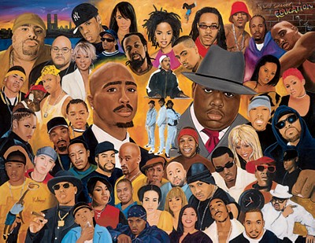
Tupac and Biggie
East Coast–West Coast hip hop rivalry
The East Coast–West Coast hip hop rivalry was a feud in the 1990s between artists and fans of the East Coast hip hop and West Coast hip hop scenes in the United States. Focal points of the feud were East Coast-based rapper The Notorious B.I.G. (and his label, Bad Boy Records) and West Coast-based rapper Tupac Shakur (and his label, Death Row Records), both of whom were murdered by unknown assailants.

Slide 24
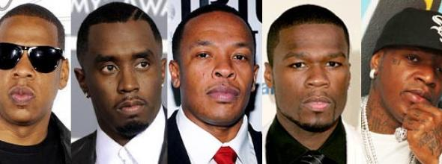
Jay-Z/ Kanya West -Diddy/ Dr. Dre/50 Cents/ Birdman

Slide 25
What is Hip-Hop Music/Rap Music
Hip hop music, also called hip-hop, rap music, or hip-hop music, is a music genre consisting of a stylized rhythmic music that commonly accompanies rapping, a rhythmic and rhyming speech that is chanted.^{[2]} It developed as part of hip hop culture, a subculture defined by four key stylistic elements: M-Cing/rapping, D-Jing/scratching, break dancing, and graffiti writing.
Other elements include sampling (or synthesis), and beat-boxing.
While often used to refer to rapping, "hip hop" more properly denotes the practice of the entire subculture.
The term hip hop music is sometimes used synonymously with the term rap music, though rapping is not a required component of hip hop music; the genre may also incorporate other elements of hip hop culture, including D-Jing and scratching, beat-boxing, and instrumental tracks.

Slide 26
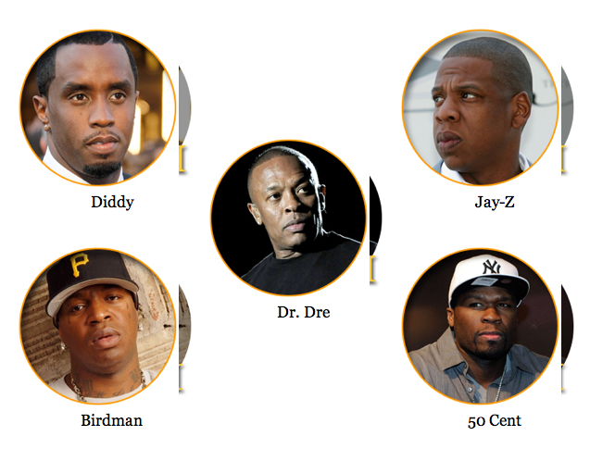
Hip-Hop and Rappers That Hit the Chart Real High

Slide 27
What is the Difference of Hip-Hop Compared to Rap Music?

Slide 28
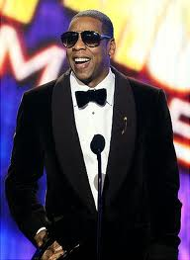
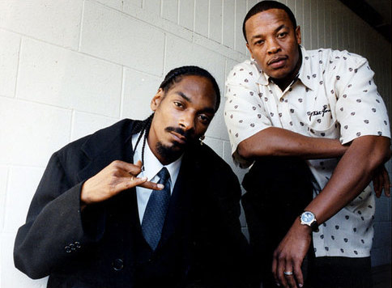
Jay-Z/Snoop Dog/Dr. Dre
Calvin Cordozar Broadus, Jr., known by his stage names Snoop Doggy Dogg, Snoop Dogg, and more recently Snoop Lion, is an American rapper, singer-songwriter, and actor. Snoop has sold over 30 million albums worldwide.
Shawn Corey Carter, known by his stage name Jay-Z, is an American rapper, record producer, and entrepreneur. He is one of the most financially successful hip-hop artists and entrepreneurs in America. Born: December 4, 1969 (age 43), Shawn Corey Carter.

Slide 29
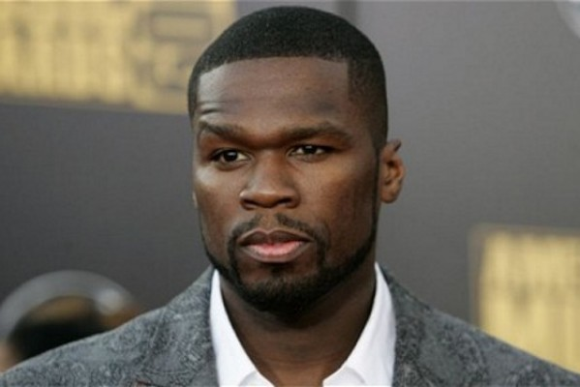
Rapper 50 Cent and Mix-tapes
In 2002, rapper 50 cents changed the way mix-tapes were made. He lost his contract with Columbia Records when he was shot and almost killed in 2000. In attempting a comeback, he made his own cover versions of popular songs and released them in mix-tapes to the underground scene in New York. In 2002, 50 cents signed both with Dr. Dre’s Aftermath Entertainment and Eminem’s Shady Records. Thanks to the work of 50 cents and the explosion of the DJ culture in general, hip hop artists began pursuing the DJs instead of the record labels

Slide 30
Nicki Minaj
Onika Tanya Maraj, known by her stage name Nicki Minaj, is a Trinidadian-born American rapper, singer, songwriter, actress, and television personality. December 8, 1982 (age 30),

Slide 31
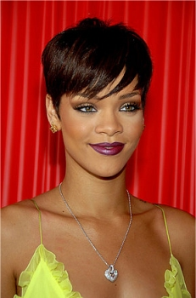
Rihanna & Masterfile Women Rappers

Slide 32
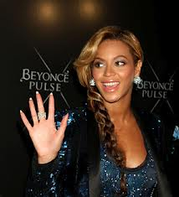
Beyonce Giselle Knowles Carter
Beyoncé Giselle Knowles-Carter, simply known as Beyoncé born September 4, 1981, is an American singer, songwriter and actress. Born and raised in Houston, Texas, she performed in various singing and dancing competitions as a child, and rose to fame in the late 1990s as lead singer of R&B girl-group Destiny's Child. Managed by her father Matthew Knowles, the group became one of the world's best-selling girl groups of all time. Their hiatus saw the release of Knowles' debut album Dangerously in Love (2003), which established the singer as a viable solo artist worldwide; it sold 11 million copies, earned five Grammy Awards and featured the Billboard number one singles "Crazy in Love" and "Baby Boy".

Slide 33
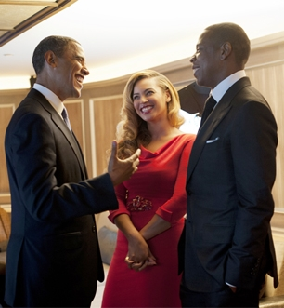
Mr. & Mrs. Carter with President Barack Obama

Slide 34
BEYONCE AND THE WORLD TOUR 2013-2014

Slide 35
World Tour Choreographers 2013-2014
Tria, Durrell Moultrie, Beyonce Knowles Carter, Amy Hall Garner

Slide 36
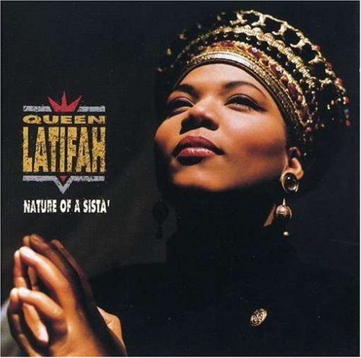
Queen Latifah
Dana Elaine Owens (born March 18, 1970),better known by her stage name Queen Latifah, is an American singer-songwriter, rapper, actress, model, television producer, record producer and talk show hostess. She has long been considered one of hip-hop's pioneer feminists. Her work in music, film, and television has earned her a Golden Globe award, two Screen Actors Guild Awards, two Image Awards, a Grammy Award, six additional Grammy nominations, an Emmy Award nomination and an Academy Award nomination.

Slide 37
Music Technology

Slide 38
Music Technology Age
At the beginning of the New Millennium, MP3 players existed.
Steve Jobs is the founder and CEO of Apple Computers. He associated heavily with Microsoft’s Bill Gates.
Technology Association of these Two Men: (Jobs & Gates)
iPod
iTunes
Macintosh Computers
CDs
Garage Band
Computers with Piano

Slide 39
Music Technology and the Media

Slide 40
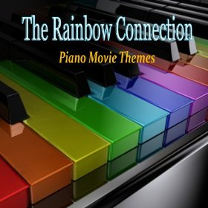
Music Technology

Slide 41
The End
Dr. Doris Spooner Hall, Ed.D,DMA

