Slide 1
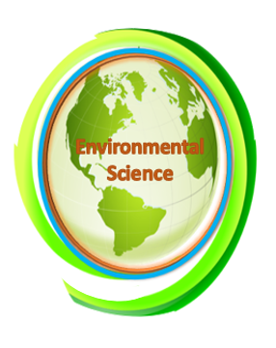
Biodegradable and Non-Biodegradable Waste
Chapter 5 Learning Objectives
After completing this chapter, you will be able to:
Critique biodegradable and non-biodegradable substances that are constantly being added to the environment.
Explain the amount of biodegradable waste produced by humans from agriculture and non-agricultural sources.
Describe different kinds of non-biodegradable substances that are increasing in our environment.
Explain the importance of plastic pollution as nanoplastics are creating different levels of pollutants in our environment.
Explain environmental pollutants in terms of organic and inorganic substances and cumbersome metal generation.
Describe how municipality waste is becoming an environmental hazard.
Examine overall waste management strategies taken by the government and non-profit organizations.

Slide 2
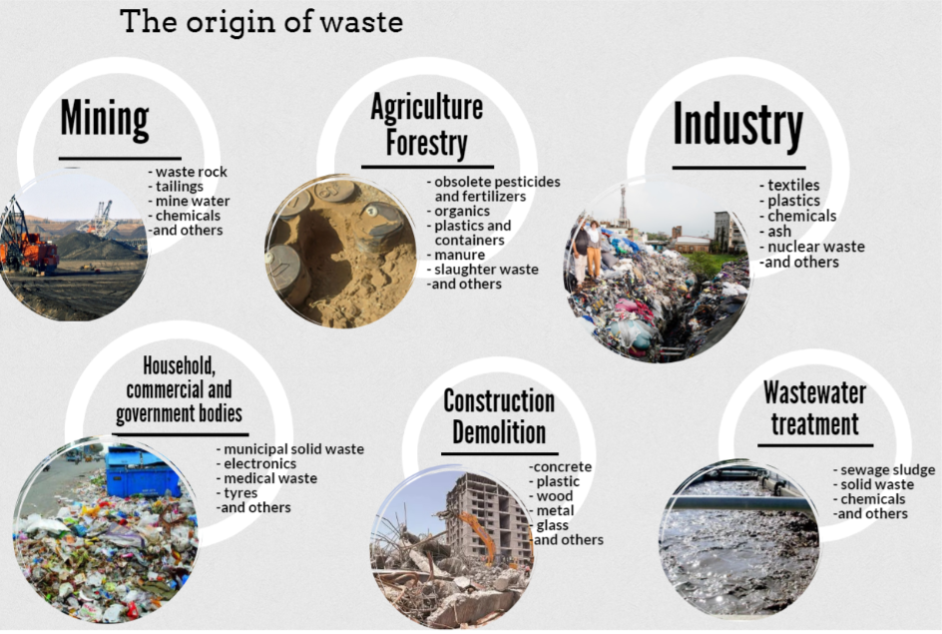
Classification of Waste
Waste is a product or substance that is no longer suited for its intended use. Biodegradable and non-biodegradable waste are the two broad categories of waste.
In a natural ecosystem, the decomposable substances and the gaseous substances generated from animal and plant sources (dead organic matter) are utilized as food or reactants.
But very often some of the substances resulting from human often takes a long time to degrade. Therefore, the definition of waste is based on the concept of waste removal or disposal.
Figure5.1: Waste classification based on origin (National Audit Office of Estonia). Source Link: 1.1. Definition and classification of waste | MOOC: Auditing waste management (ut.ee)

Slide 3
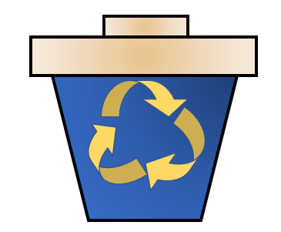
OECD defined as based on the fact that "Wastes are substances or objects, other than radioactive materials covered by other international agreements, which: i) are disposed of or are being recovered, or ii) are intended to be disposed of or recovered; or iii) are required, by the provisions of national law, to be disposed of or recovered " (OECD Report, 2023).
The main categories identified by legislation and policymakers are non-hazardous or solid and hazardous waste. Hazardous waste is controlled and regulated at the National level of importance whereas non-hazardous waste is managed by municipality corporation and city.
Non-hazardous/solid waste: All waste materials that are not severely harmful to human, and animal health such as plastics, beverage cans, bottles, organic waste, etc. This non-hazardous waste can have a serious impact on health and the environment if it is not properly managed (collected and recycled). A large proportion of solid waste can be recycled and reused if the waste can be collected selectively.

Slide 4
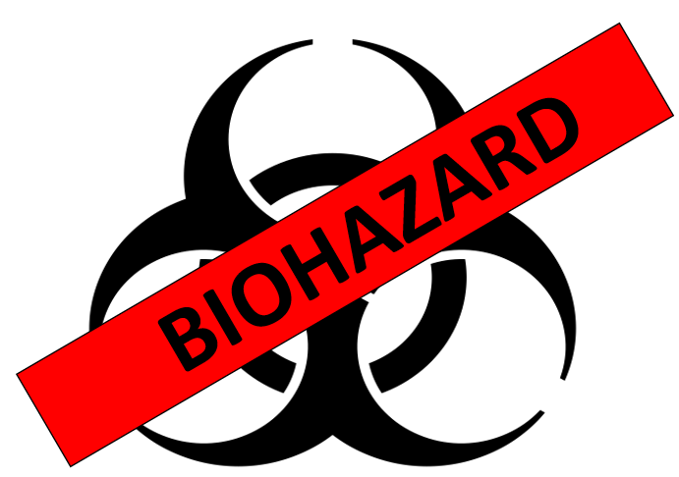
Hazardous Waste
E-waste: E-waste is non-functioning electronic devices such as unusable computers, cell phones, CDs, and household appliances. These wastes are categorized as hazardous waste as they contain printed circuit boards (PCBs) and various reactive metals.
Medical waste: Human and animal health care system in every country produces a huge number of expired medicines, chemicals, pharmaceuticals, used medical devices/equipment, bandages, body fluids, and body parts. This type of waste can generate transmission of harmful microorganisms, can cause toxicity, and in some cases contain radioactive elements used in diagnostic equipment.
Radioactive waste: The most powerful and harmful for the environment is improper disposal of radioactive materials used in various equipment. The radioactive waste management system is controlled by a separate powerful agency under the Environmental Protection Agency (EPA) in the United States.

Slide 5
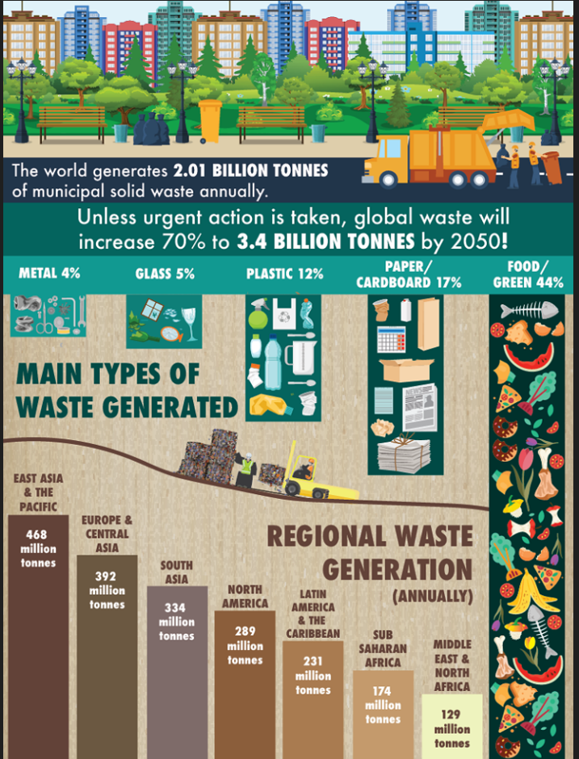
Global Waste Generation
Global waste generation data is not accurate due to waste classification varies from country to country. Only accurate data is available on municipal solid waste as these data are maintained by the municipalities, though this amount is only a portion of the waste generated.
The accumulation of waste material in the industrial sector is 18 times more than the waste generated by municipalities. Other sectors such as agriculture, and demolition of construction create a huge amount of solid waste.
According to World Bank data, municipal waste generation is rising and will keep on rising if proper management strategies are not undertaken. In low-income countries, waste management is very poorly developed, and this is the reason 90% of the waste is mismanaged.
Figure 5.2: Global waste management (World Bank 2018).

Slide 6
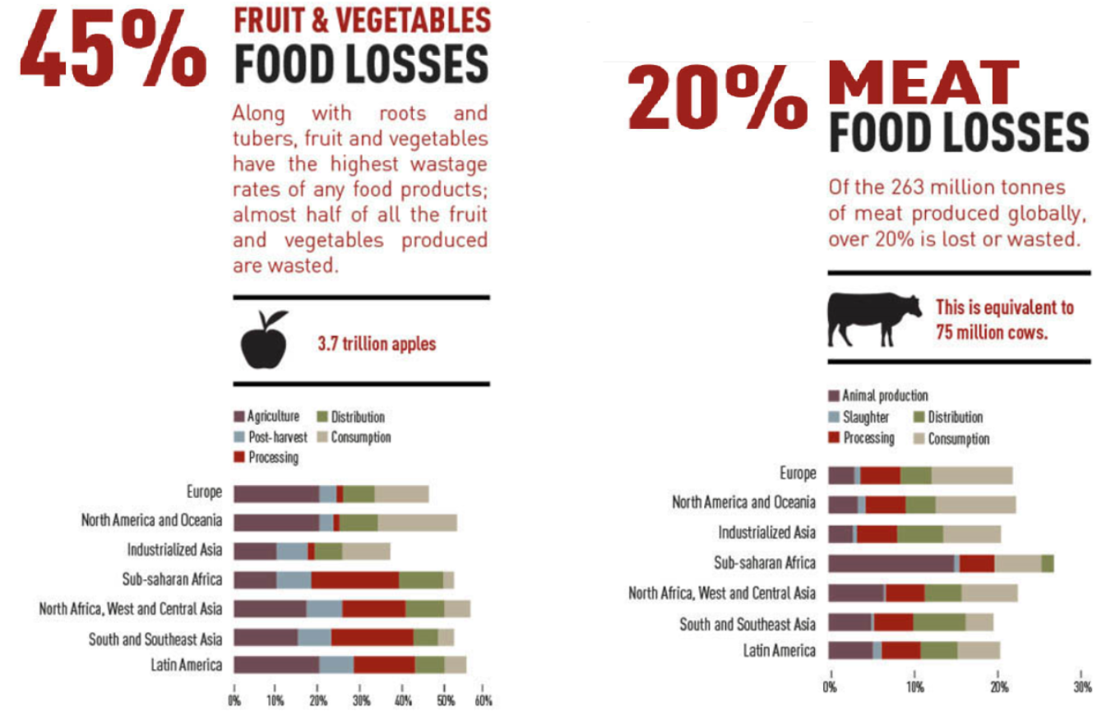
Food waste is a major sector of biodegradable waste and the annual generation of food waste is approximately 1.3 million which is one-third of the total produce for human consumption.
Food loss and food waste are differentiated following two levels – food loss is designated by the degeneration of food while transporting to farm to the processing unit and food waste is the waste of prepared food before human consumption due to expiry date and other possible causes.
Industrialized and developed countries also produce equal amounts of organic food waste: 670 and 630 million tons respectively. In developed countries, 40% of food loss occurs during the post-harvesting period and processing. At the consumer and retailer level, the amount of food loss is more than 40% of the total food production. Perishable foods are fruits, vegetables, and meat.
Figure 5.3 Food waste – fruits/vegetables and meat products. Source: FAO 2019. Available at: http://www.fao.org/save-food/resources/keyfindings/en/ (accessed in 2019, now archived)

Slide 7
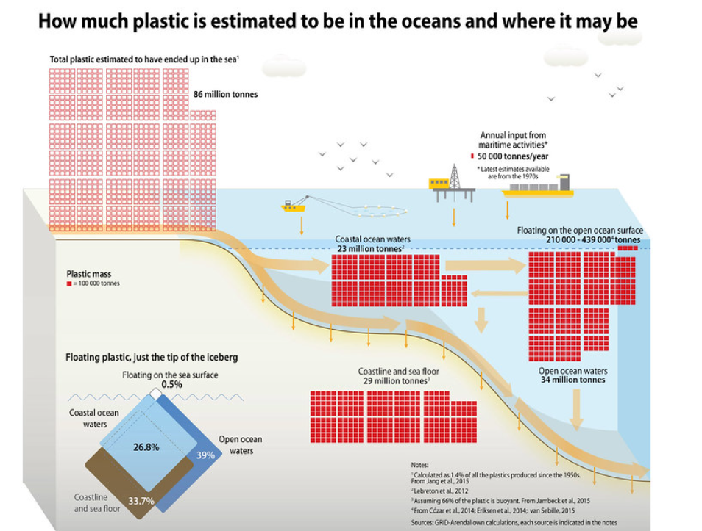
Plastic Waste
Plastic waste is the most important sector of waste management. The use of plastic and the production of plastic materials has created a critical concern for environmental pollution, especially in the oceans. Plastics are made of stable chemicals, and due to this stability and persistence of the chemicals. Bioaccumulation of plastic chemicals causes a concerning and prominent situation for the environment.
The abundant use of plastics has covered the Earth's surfaces and plastic is detected in every place such as in soils, lakes, oceans, and most interestingly in the places where human activity is mere, such as Antarctica and the Arctic region.
Due to their smaller size and low density, microplastics can leach the traditional wastewater treatment and flow into the sea. These microplastics further degraded to nano-sized plastics (1nm-100nm). The product formulated with nano-sized plastics is also an important source of nano-sized plastics in the environment.
Figure 4.5 The accumulation of plastics on the ocean floor. Source: Created by Maphoto/Riccardo Pravettoni. Link: How much plastic is estimated to be in the oceans and where it may be | GRID-Arendal (grida.no)

Slide 8
Effect of Nanoplastics on the Ecosystem
The degradation process of microplastics to nanoplastics is not very well understood, but the degradation process is undoubtedly a continuing process, and the decomposition of microplastics accumulates an enormous number of nanoplastic particles in the respective places where large amounts of microplastics form gyre.
Types of microplastics found in bottled water are Polypropylene, nylon, polystyrene, polyethylene, polyester, polyethylene terephthalate, azlon, and polyacrylates.
Nanoplastics in the aquatic environment are easily ingested by aquatic organisms because of the particle size and the widely distributed nature.
The presence of nanoplastics in the blood, liver, and other organs indicates that polystyrene nanoparticles can pass through the blood-brain barrier. The blood-brain barrier in the animal system protects the entry of neurotoxins and prevents them from entering an active transport system controlled by p-glycoprotein.

Slide 9
Heavy metals are added to the environment due to the management of waste where municipality waste is not adequately separated and managed. So directly, it is deposited or disposed of as solid and non-biodegradable waste.
Heavy metals in compost products from municipal waste are the crude source (Kupper et al., 2014). The amount of heavy metal in compost is determined by the collection method of the solid waste and the separation of the mix from other metals.
Table 1: Maximum acceptable concentration of metal in different countries (mg/kg dry matter).
Country | Cadmium | Copper | Chromium | Mercury | Nickel | Lead | Zinc | Reference
UK | 1.5 | 200 | 100 | 1 | 50 | 200 | 400 | BSI-PAS100:2011
Italy | 1.5 | 150 |  | 1.5 | 50 | 140 | 500 | Wei et al. 2009
Spain | 0.7 | 70 | 70 | 0.4 | 25 | 45 | 200 | Spain RD/506 2003
Germany | 0.7 | 70 | 70 | 0.5 | 35 | 100 | 300 | Biowaste Ordinance
Netherland | 0.7 | 25 | 50 | 0.2 | 10 | 65 | 5 | SDU 1991
Switzerland | 1 | 100 | 100 |  | 30 | 120 | 400 | Swiss Federal Council
California, USA | 39 | 1500 | 1200 | 17 | 420 | 300 | 2800 | CalRecycle
USA | 39 | 1500 | 1200 | 17 | 420 | 300 | 2800 | EPA
Canada | 3 | 400 | 210 | 0.8 | 62 | 150 | 700 | CCME

Slide 10
Heavy Metal Control Strategies
Heavy metal can cause potential risks to human and environmental health. Process control is the primary step to mitigate the disposal of these metals. A downstream control of mitigating steps can reduce the amount of heavy metal in municipal solid waste compost, including separation, advanced mechanical separation, and final product screening to remove heavy metal particles.
Source Separation Strategies: Separation is considered one of the most efficient methods of improving the disposed compost in municipal solid waste management. Metals such as lead, Zinc, Copper, and Cadmium. Chromium and Nickel can be easily separated by source separating process and are indicative of clean recycling of solid waste.
However, it is difficult to conclude based on studies as these solids contained a heterogeneous mixture of metals and non-metal solid waste. Source-separated waste contains fewer heavy metals than mechanically separated waste.

Slide 11
End-of-the-product separation strategies: To reduce the harmful consequences of heavy metals in soil, countries follow their governmental legal guideline over solid waste management regulations. Table 1 lists the optimum maximum acceptable concentrations of heavy metals in selected countries.
Biodegradable and non-biodegradable materials can cause different negative impacts on human health and the environment. Biodegradable waste can cause environmental pollution if the management is not followed, whereas non-biodegradable waste leaves long-term effects on the environment and ecosystem.
Air emissions are generated by the waste management system's incineration plant and air from the waste landfill gases. The fumes generated from open waste burning add hazardous compounds into the air. Waste incineration or control burning practices using advanced and modern incinerators reduce the production of less or no toxic components into the air. But the old inclinators still produce many hazardous emissions like heavy metals and dioxins.

Slide 12
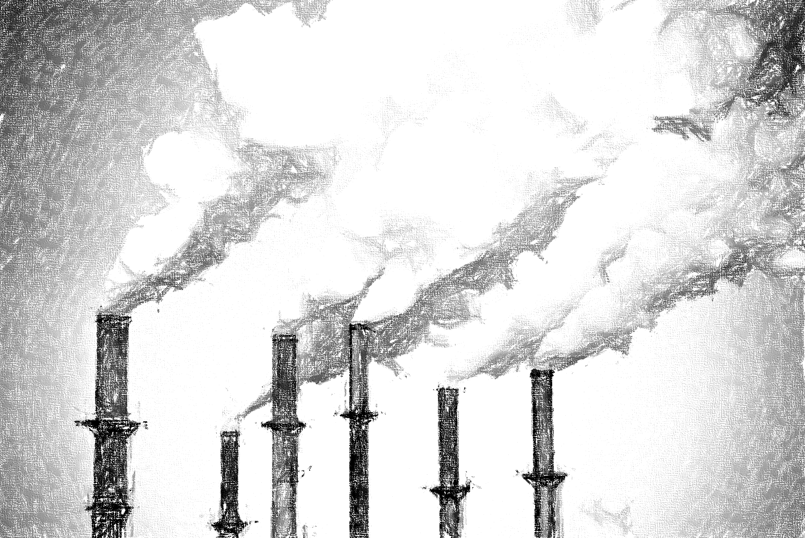
Air emissions are generated by the waste management system's incineration plant and air from the waste landfill gases. The fumes generated from open waste burning add hazardous compounds into the air.
Waste incineration or control burning practices using advanced and modern incinerators reduce the production of less or no toxic components into the air. However, the old inclinators still produce many hazardous emissions like heavy metals and dioxins.
An enormous amount of odor-causing gas is emitted from the landfill area of the waste management system that is poorly managed during the degeneration of organic matter in landfills. The primary gas produced by landfill compost from the degeneration of organic matter is methane (55%), and the carbon dioxide emission amount is 35%.

Slide 13
Soil and groundwater
Hazardous substances from biodegradable and non-biodegradable waste may enter the soil. Water passes from contaminated sites, leaching hazardous compounds, fertilizers in agricultural fields, and pesticides. These contaminants also seep and carry them into the surface and groundwater. Both soil and groundwater are seriously being polluted due to mismanaged solid biowaste generated by human activities.
Marine waste
Marine pollution due to plastic waste constitutes a significant danger to marine ecosystems such as fisheries, mangroves, coral reefs, and coastal zones. A major waste in the marine ecosystem is deposited from land-based sources such as persistent organic pollutants, heavy metals from mining, radioactive elements in e-waste, and industrial discharge.
Plastic waste is a growing concerning material as it can flow across the world's oceans. The slow degradation of plastic waste has been drifting on the ocean floor for years. Also, slow degeneration produces nanoplastic formation, as discussed in the nanoplastic section.

Slide 14
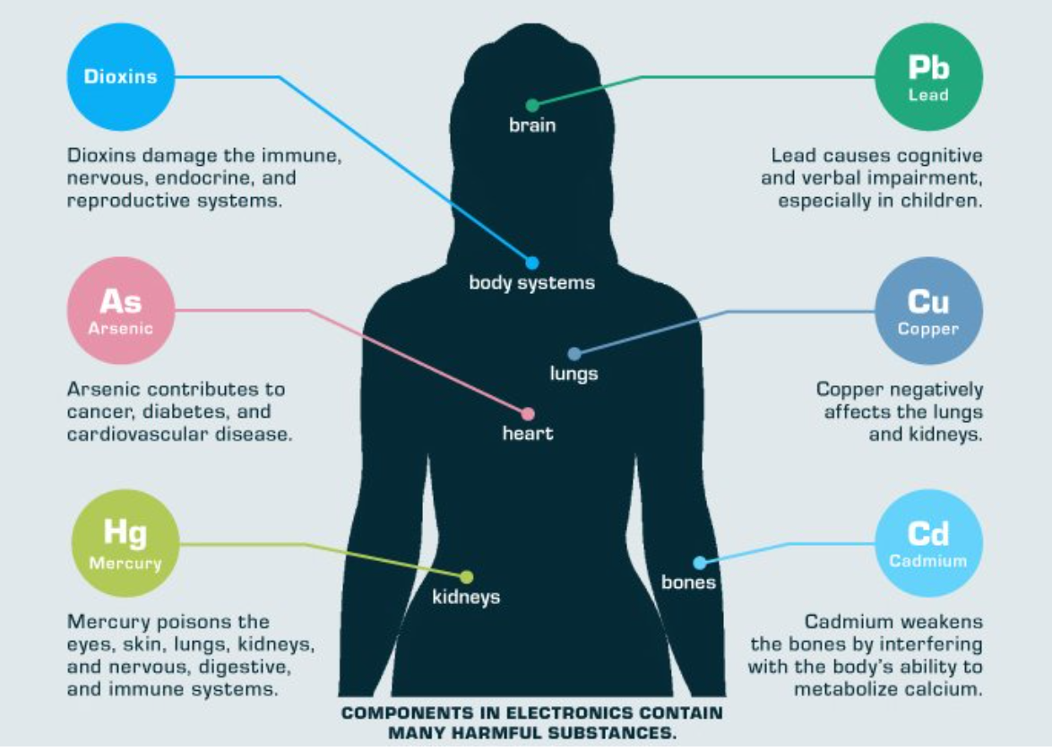
Persistent Organic Pollutants from biodegradable waste pose a high risk to human health and the contaminating environment as these pollutants accumulate through our food web chain. The small animals eating contaminated/bioaccumulated toxins have higher doses of hazardous components than direct contact.
For humans, the pollutants they come in contact with either through exposure or food chain or air-born aerosols may have effects on their nervous system, deteriorate healthy kidneys, and cause cancers.
Figure 5.7 illustrates the health impact due to mismanaged e-waste that is constantly generated by human use. Mismanaged biowaste collected from households and community - especially excreta and other body liquids- is a severe biohazard and cause the spread of infectious pathogens.
For example, acute dermatitis and blood infection can result from direct contact, eye, and respiratory infection might be caused by infected dust particles. Many diseases result from bites of animals eating waste.
Figure 5.7: Effect of e-waste on human health. Source: Source: https://www.greenit. co.in/impacts-of-e-waste-on-health.html

