Slide 1
Biochemical Cycles
Chapter 7 Learning Objectives
After completing this chapter, you will be able to:
Explain what nutrients are and give examples.
Discuss the concept of nutrient cycling and describe important
compartments and fluxes.
Describe factors that affect the development of major soil types.
Describe the cycles of carbon, nitrogen, phosphorus, and sulfur.

Slide 2
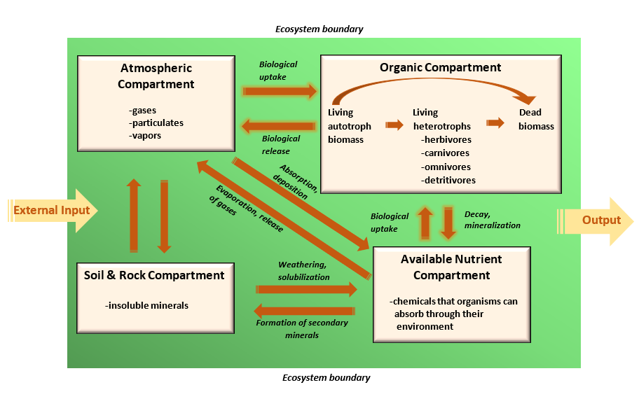
Four Major Ecosystem Compartments
The atmosphere consists of gases and small concentrations of suspended particulates and water vapor.
Rocks and soil consist of insoluble minerals that are not directly available for uptake by organisms.
Available nutrients are present in chemical forms that are water soluble to some degree, so they can be absorbed by organisms from their environment and contribute to their mineral nutrition.
(Source: Waneene C. Dorsey, Grambling State University. Adapted from Likens et al., 1977).

Slide 3
The organic compartment consists of nutrients present within living and dead organic matter. This compartment can be divided into three functional groups:
a) living biomass of autotrophs such as plants, algae, and autotrophic
bacteria,
(b) living heterotrophs including herbivores, carnivores, omnivores, and detritivores, and
(c) all forms of dead organic matter.
Insoluble forms of nutrients in rocks and soil become available for uptake by organisms through various chemical transformations, such as weathering, that render the nutrients soluble in water. This is reversed by reactions that produce insoluble compounds from soluble ones.

Slide 4
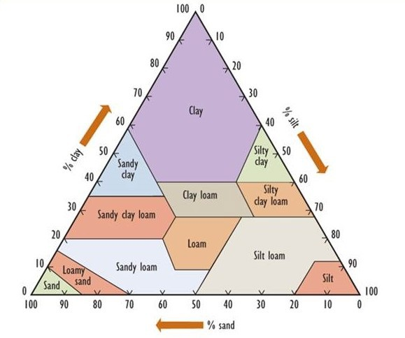
The Soil Ecosystem
Soil is a dynamic ecosystem that consists of a complex and variable mixture of fragmented rock, organic matter, moisture, gases, and living organisms that covers almost all terrestrial landscapes.
Clay particles have a diameter less than 0.002 mm, while silt ranges from 0.002 to 0.05 mm, sand from 0.05 to 2 mm, gravel from 2 to 20 mm, and coarse gravel and rubble are larger than 20 mm.
Figure 7.3 presents a textural classification of soil based on the percentage of clay-, silt-, and sand-sized particles.

Slide 5
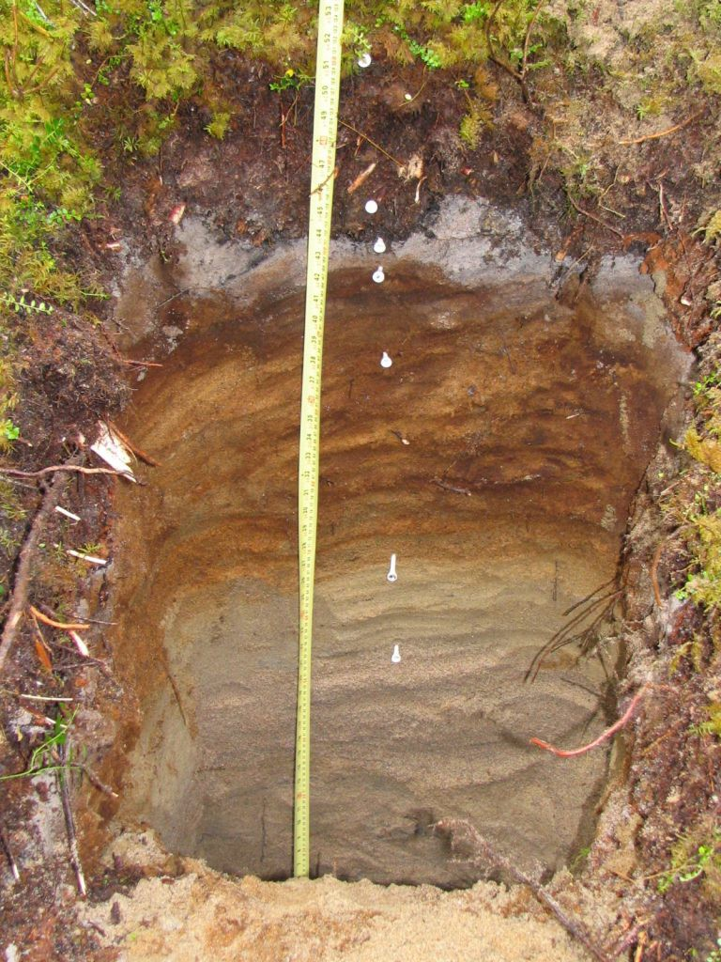
Table 7.2 USDA Soil Taxonomy: Soil Orders and Their Characteristics
Soil Type Description
Alfisol | Soils with aluminum and iron composites constitute 10% of worldwide soils. Horizon layers are the accumulation of clay.
Andisol | Young soils are made of volcanic ash and cover 1% of ice-free surfaces around the world.
Aridisol | Soils with salt, gypsum, and carbonate composites are formed under desert or dry conditions. They constitute 12% of soils worldwide.
Entisol | Soils are composed of non-layered river and beach sediments with sand and clay composites. They constitute 18% of worldwide soils.
Gelisol | Frozen soils are found near the Artic and Antarctic regions. Permafrost soil inhibits the growth of most plants. They cover 9% of the Earth.
Histosol | Referred as bog soils, peat land, and fens that cover 1% of the world.
Inceptisol | Young soils that show eroded layers with little eluviation and illuviation. Inceptisols constitute approximately 15% of the Earth.
Mollisol | Dark colored soils composed of calcium and magnesium minerals. Soils are found in grasslands and hardwood forests. Found in 7% of global soils.
Oxisol | Heavily eroded soils because of tropical heavily. Soils are composed kaolin or aluminum oxides, and iron and constitute 8% of worldwide soils.
Spodosol | Soils are found in coniferous and deciduous forests. They are acidic soils integrated with iron and aluminum minerals that constitute 4% of worldwide soils.
Ultisol | Acidic soils with low mineral depletion in calcium, potassium, and potassium. Found in 8% worldwide soils.
Vertisol | Clay-rich soils that swell when wet and shrink when dry. Occupy 2% of global soils.
Figure 7.4. Soil in natural ecosystems often develops a vertical stratification.

Slide 6
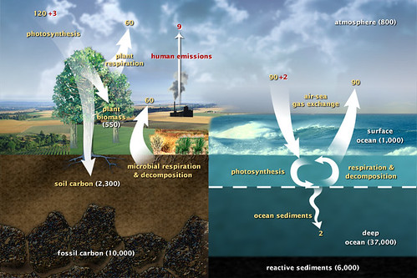
The Carbon Cycle
Carbon is one of the basic building blocks of life and the most abundant element in organisms about half of typical dry biomass.
Overall, carbon is continuously recycled in the energetic processes occurring in the earth's atmosphere, organic materials on the surface, crust, oceans, soil substratum, and rock.
Atmospheric CO₂ also dissolves into oceanic water, forming the bicarbonate ion (HCO₃–), which can be taken up and fixed by photosynthetic algae and bacteria, which are the base of the marine food web.
(Source: “Fast Carbon Cycle” by Atmospheric Infrared Sounder, CC-BY-2.0.)

Slide 7
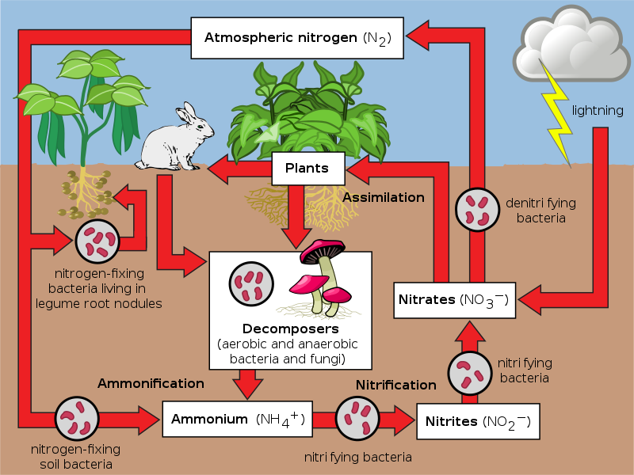
The Nitrogen Cycle
Nitrogen occurs in three main compartments: the atmosphere, terrestrial organic material, and oceanic organic material. Atmospheric nitrogen must transform into various forms of nitrogen compounds so that it can be used by soil microorganisms.
Nitrogen occurs in many additional forms in terrestrial and aquatic environments. “Organic nitrogen” refers to the great variety of nitrogen-containing molecules in living and dead biomass.
Figure 7.5. Global Nitrogen Cycle. (Source: Nitrogen Cycle, Wikipedia, CC BY-SA 3.0)

Slide 8
The Nitrogen Cycle Processes
Biological nitrogen fixation is a critical process – most ecosystems depend on it to provide the nitrogen that sustains their primary productivity.
The best known of the N₂-fixing microorganisms are bacteria called Rhizobium, which live in specialized nodules on the roots of leguminous plants, such as peas and beans.
Nitrification is the process by which nitrate is synthesized from ammonium. The initial step is the conversion of NH₄ ⁺ to nitrite (NO₂⁻), a function carried out by bacteria known as Nitrosomonas.
Denitrification occurs under anaerobic conditions, and its rate is greatest when there is a large concentration of nitrate, for example in fertilized agricultural land that is temporarily flooded.

Slide 9
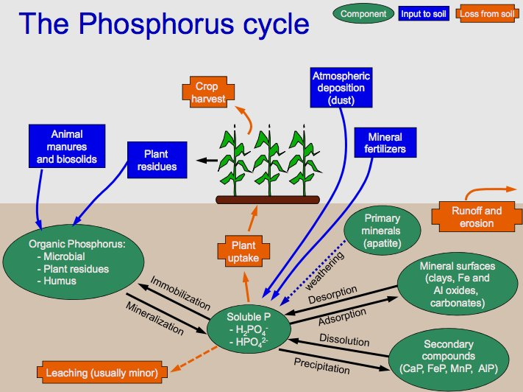
The Phosphorus Cycle
Phosphorus is a key constituent of many biochemicals, including fats and lipids, nucleic acids such as the genetic materials DNA and RNA, and energy-carrying molecules such as ATP.
Soil is the principal source of phosphorus uptake for terrestrial vegetation. The phosphate ion (PO₄³ ⁻) is the most important form of plant-available phosphorus.
Eutrophication, or an excessive productivity of waterbodies, is another environmental problem related to an excessive supply of nutrients. It is most often caused by an excess of PO₄^{3–}, usually because of sewage dumping or runoff from fertilized agricultural land.
Figure 7.8. The Phosphorus Cycle. Source: Wikipedia.

Slide 10
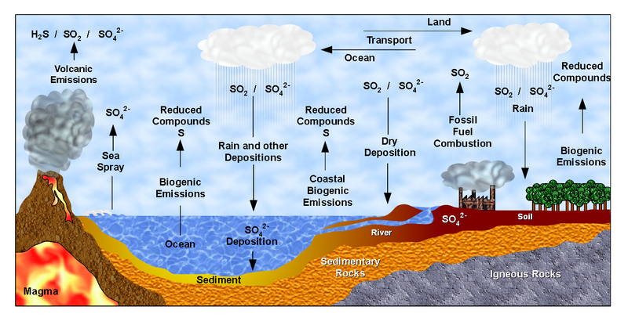
The Sulfur Cycle
Sulfur flows between the ocean, soil, rocks, atmosphere, and living organisms. Sulfur compounds enters the atmosphere from the activity of volcanic eruptions, fossil fuel emissions, and decomposition of organic materials in wetlands.
Soil microorganisms oxidize organic sulfur to sulphate, an ion that plants can use in their nutrition. Most emissions of SO₂ to the atmosphere are associated with human activities, but almost all H₂S emissions are natural.
The The
Figure 7.10. The Sulfur Cycle. (Source: Wikipedia Commons)

Slide 11
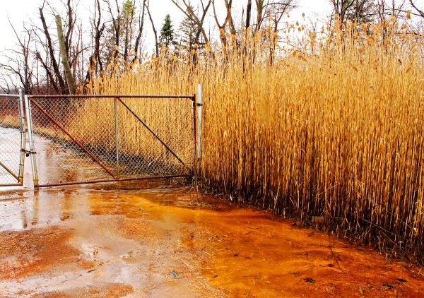
Soil microorganisms oxidize organic sulfur to sulphate, an ion that plants can use in their nutrition. Most emissions of SO₂ to the atmosphere are associated with human activities, but almost all H₂S emissions are natural.
This kind of primary productivity is called chemosynthesis (in parallel with the photosynthesis of plants). In places where large amounts of sulfide are oxidized, high levels of acidity are associated with the sulphate product, a phenomenon referred to as acid-mine drainage.
Sulfur is also an important mineral commodity, with many industrial uses in manufacturing and as an agricultural fertilizer. Most commercial sulphur is obtained by cleaning “sour” natural gas (methane, CH₄) of its H₂S content and by removing SO₂ from waste gases at metal smelters.
Acid –Mine Drainage. (Source: Jack W. Pearce, CC BY-SA 2.0

