Slide 1
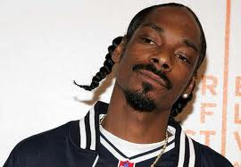
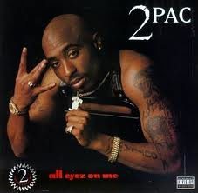
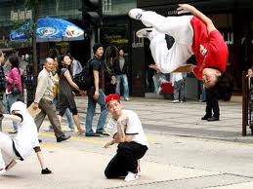
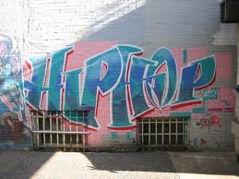
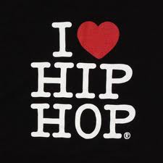
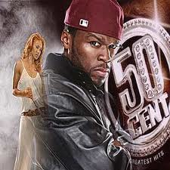
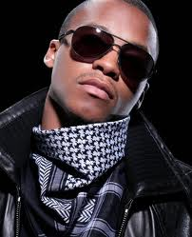
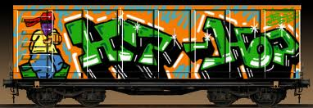
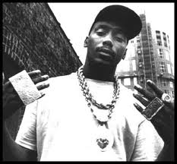
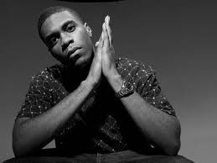
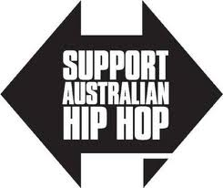
Week 10 MSIT HIP HOP MUSIC GENRES BLAIR HUGHES

Slide 2
What is hip hop?
Hip-hop is a formpopular music that's comprised mainly of emceeing and deejaying.
of
The other two components that complete the four elements of hip-hop are graffiti and breakdancing.
As hip-hop evolves into big business, the four elements (emceeing, deejaying, graffiti, and breakdancing) are constantly being merged with others like clothing trends, slang, and general mindset.

Slide 3
Origins of the word: Hip Hop
Hip hop is the combination of two separate slang terms—"hip", used in African American Vernacular English as early as 1898, meaning current or in the now, and "hop", for the hopping movement.
Keith "Cowboy" Wiggins, a member of Grandmaster Flash and the Furious Five, has been credited with coining the term hip hop in 1978 while teasing a friend who had just joined the US Army, by scat singing the words "hip/hop/hip/hop" in a way that mimicked the rhythmic cadence of marching soldiers.
Jamaican born DJ Clive "Kool Herc" Campbell is credited as being highly influential in the pioneering stage of hip hop music in the Bronx.
Herc created the blueprint for hip hop music and culture by building upon the Jamaican tradition of toasting—impromptu, boastful poetry and speech over music—which he witnessed as a youth in Jamaica.

Slide 4
HIP HOP ORIGINS
Since its emergence in the South Bronx, hip hop culture has spread to both urban and suburban communities throughout the world.
Hip hop music first emerged with disc jockeys creating rhythmic beats by looping breaks (small portions of songs emphasizing a percussive pattern) on two turntables, more commonly referred to as sampling.
This was later accompanied by "rap", a rhythmic style of chanting or poetry presented in 16 bar measures or time frames, and beatboxing, a vocal technique mainly used to imitate percussive elements of the music and various technical effects of hip hop DJ's.
Hip Hop has given a voice to the voiceless & showcased their artistic ingenuity and talent on a global scale; at it's worst Hip Hop has mirrored the worst aspects of the mainstream culture that it once challenged: materialism, sexism, homophobia, an internalized racism and an apathy towards intellectualism

Slide 5
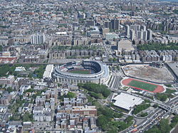
Da BRONX, NYC

Slide 6
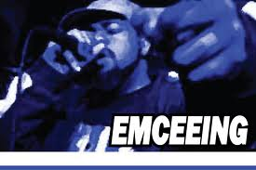
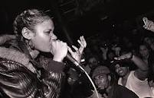
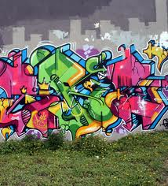
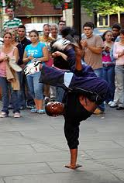
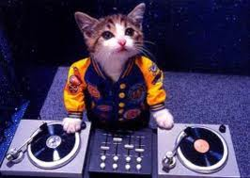
Five PILLARS OF HIP HOP culture
MCing
D-Jing
B-boying
Beat Boxing
Graffiti writing

Slide 7
EMCEEING
Emceeing is the rhythmic spoken delivery of rhymes and wordplay, delivered over a beat or without accompaniment.
Rapping is derived from the folk poets of West Africa, and Jamaican-style toasting.
Rap developed both inside and outside of hip hop culture, and began with the street parties thrown in the Bronx neighborhood of New York in the 1970s by Kool Herc and others.
Rapping (also known as emceeing, MCing, spitting (bars), or just rhyming refers to "spoken or chanted rhyming lyrics with a strong rhythmic accompaniment”.
It can be broken down into different components, such as “content”, “flow” (rhythm and rhyme), and “delivery”.

Slide 8
DJING
Turntablism refers to the extended boundaries and techniques of normal DJing innovated by hip hop.
Traditionally, a DJ will use two turntables simultaneously.
These are connected to a DJ mixer, an amplifier, speakers, and various other pieces of electronic music equipment.
The DJ will then perform various tricks between the two albums currently in rotation using the above listed methods.
The result is a unique sound created by the seemingly combined sound of two separate songs into one song.

Slide 9
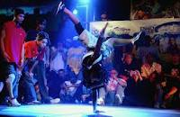
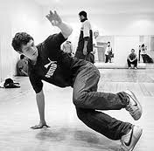
BREAKING
Breaking, also called B-boying or breakdancing, is a dynamic style of dance which developed as part of the hip hop culture.
Like many aspects of hip hop culture, breakdance borrows heavily from many cultures, including 1930s-era street dancing.

Slide 10
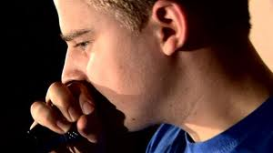
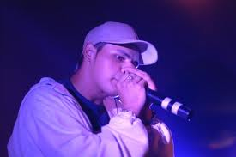
BEATBOXING
Beatbox, popularized by Doug E. Fresh is the vocal percussion of hip hop culture.
It is primarily concerned with the art of creating beats, rhythms, and melodies using the human mouth.
The term beatboxing is derived from the mimicry of the first generation of drum machines, then known as beatboxes.

Slide 11
Graffiti
In America around the late 1960s, graffiti was used as a form of expression by political activists, and also by gangs such as the Savage Skulls, La Familiar, and Savage Nomads to mark territory.
The relationship between graffiti and hip hop culture arises both from early graffiti artists practicing other aspects of hip hop, and its being practiced in areas where other elements of hip hop were evolving as art forms.
Graffiti is recognized as a visual expression of rap music, just as breaking is viewed as a physical expression.

Slide 12
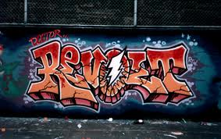
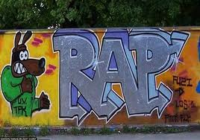
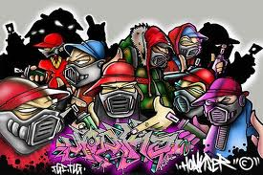
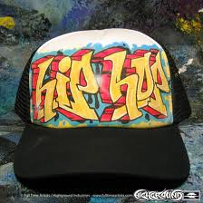
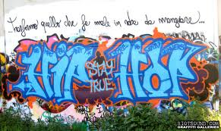
Graffiti

Slide 13
PRODUCT PLACEMENT
Critics such as Businessweek's David Kiley argue that the discussion of many products within hip hop music and culture may actually be the result of undisclosed product placement deals.
Such critics allege that shilling or product placement takes place in commercial rap music, and that lyrical references to products are actually paid endorsements.
In 2005, a proposed plan by McDonalds, which would have paid rappers to advertise McDonalds food in their music, was leaked to the press.
After Russell Simmons made a deal with Courvoisier to promote the brand among hip hop fans, Busta Rhymes recorded the song "Pass the Courvoisier”.
The symbiotic relationship has also stretched to include car manufacturers, clothing designers and sneaker companies, and many other companies have used the hip hop community to make their name or to give them credibility

Slide 14
CENSORSHIP
Hip hop has been met with significant problems in regards to censorship due to the explicit nature of certain genres.
The use of profanity as well as graphic depictions of violence and sex creates challenges in the broadcast of such material both on television stations such as MTV, in music video form, and on radio.
As a result, many hip hop recordings are broadcast in censored form, with offending language "bleeped" or blanked out of the soundtrack, or replaced with "clean" lyrics. The result – which sometimes renders the remaining lyrics unintelligible or contradictory to the original recording

Slide 15
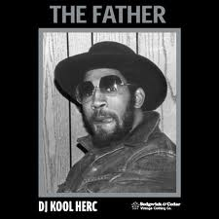
ARTIST SPOTLIGHT: KOOL HERC
Clive Campbell (born April 16, 1955), also known as Kool Herc, DJ Kool Herc and Kool DJ Herc, is a Jamaican-born DJ who is credited with originating hip hop music, in The Bronx, New York City.
His playing of hard funk records of the sort typified by James Brown was an alternative both to the violent gang culture of the Bronx and to the nascent popularity of disco in the 1970s.
“Kool Herc”: http://www.youtube.com/watch?v=Qjnc-X-Vfyg

Slide 16
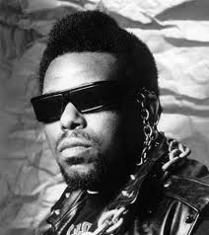
Artist Spotlight: afrika bambaataa
Afrika Bambaataa (born April 19, 1957) is an American DJ from the South Bronx, New York who was instrumental in the early development of hip hop throughout the 1980s.
Afrika Bambaataa is one of the three originators of break-beat deejaying, and is respectfully known as the "Grandfather" and the Amen Ra of Universal Hip Hop Culture as well as the Father of The Electro Funk Sound.
“Renegades of Funk”: http://www.youtube.com/watch?v=yYzakWz3JxU

Slide 17
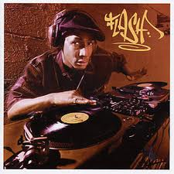
ARTIST SPOTLIGHT: GRANDMASTER FLASH
Joseph Saddler (born January 1, 1958 in Bridgetown, Barbados), better known as King Grandmaster Flash, is an American hip hop musician and DJ—one of the pioneers of hip-hop DJing, cutting, and mixing.
“The Message”: http://www.youtube.com/watch?v=O4o8TeqKhgY

Slide 18
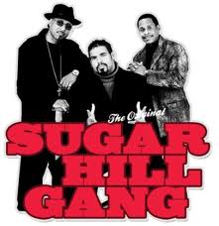
Artist spotlight: THE SUGARHILL GANG
The Sugarhill Gang is an American hip hop group, known mostly for its 1979 hit "Rapper's Delight," the first hip hop single to become a Top 40 hit.
The song "Rapper's Delight" by The Sugarhill Gang, released in 1979, begins with the scat phrase, "I said a hip, hop the hippie the hippie to the hip hip hop, a you don't stop."
“Rappers Delight”: http://www.youtube.com/watch?v=4-MEL84yXh0&feature=fvst

Slide 19
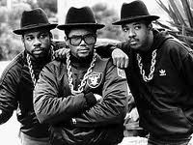
ARTIST SPOTLIGHT: RUN DMC
Run–D.M.C. was an American hip hop group from
Hollis, Queens, New York.
The group is widely acknowledged as one of the most influential acts in the history of hip hop culture.
Run–D.M.C. were one of the most well-known hip hop acts in the 1980s, who along with LL Cool J, signified the advent of the new school of hip hop music.
“It’s Tricky”: http://www.youtube.com/watch?v=l-O5IHVhWj0

Slide 20
HIP HOP AND GANG CULTURE
In the early 1970s, DJ Kool Herc began organizing dance parties in his home in the Bronx.
The parties became so popular they were moved to outdoor venues to accommodate more people.
City teenagers, after years of gang violence, were looking for new ways to express themselves.
These outdoor parties, hosted in parks, became a means of expression and an outlet for teenagers, where "instead of getting into trouble on the streets, teens now had a place to expend their pent-up energy

Slide 21
Gangsta rap
With the commercial success of gangsta rap in the early 1990s, however, emphasis shifted from social issues to drugs, violence, and misogyny.
Early proponents of gangsta rap included groups and artists such as Ice-T, who recorded what some consider to be the first gangster rap record, 6 in the Mornin’ and N.W.A whose second album Efil4zaggin became the first gangsta rap album to enter the charts at number one.
Gangsta rap also played an important part in hip hop becoming a mainstream commodity.
Gangsta rap is a subgenre of hip hop that reflects the violent lifestyles of inner-city American black youths

Slide 22
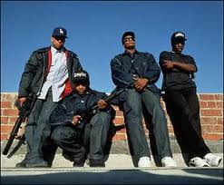
Artist Spotlight: N.W.A
N.W.A (Niggaz Wit Attitudes) was an American hip hop group from California, widely considered one of the seminal acts of the gangsta rap sub genre, at times even credited as the most important group in the history of hip hop.
Active from 1986 to 1991, the rap group endured controversy due to the explicit nature of their lyrics, and was subsequently banned from many mainstream U.S. radio stations. In spite of this, the group has sold over 10 million CD units in the U.S. alone.
“Straight Outta Compton”: http://www.youtube.com/watch?v=TMZi25Pq3T8

Slide 23
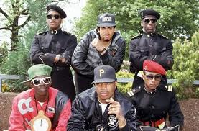
ARTIST SPOTLIGHT: PUBLIC ENEMY
Public Enemy is an American hip hop group consisting of Chuck D, Flavor Flav, Professor Griff and his S1W group, DJ Lord (DJ who replaced Terminator X in 1999), and Music Director Khari Wynn.
Formed in Long Island, New York in 1982, Public Enemy is known for their politically charged lyrics and criticism of the American media, with an active interest in the frustrations and concerns of the African American community.
“Fight the Power”: http://www.youtube.com/watch?v=8PaoLy7PHwk

Slide 24
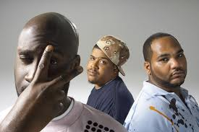
ARTIST SPOTLIGHT: DE LA SOUL
De La Soul is an American hip hop trio formed in 1987 on Long Island, New York.
The band is best known for their eclectic sampling, quirky lyrics, and their contributions to the evolution of the jazz rap and alternative hip hop subgenres
“Saturdays”: http://www.youtube.com/watch?v=ig5Xi-S0Fjo

Slide 25
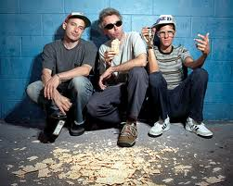
ARTIST SPOTLIGHT: BEASTIE BOYS
The Beastie Boys are an American hip hop group
from Manhattan/Brooklyn, New York City.
The group consists of Mike D (Michael Diamond) (vocals, drums), MCA (Adam Yauch) (vocals, bass), and Ad-Rock (Adam Horovitz) (vocals, guitar) and Mix Master Mike (Michael Schwartz) (turntablist).
“Intergalatic”: http://www.youtube.com/watch?v=qORYO0atB6g

Slide 26
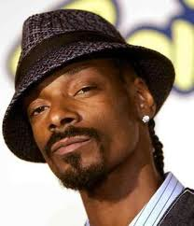
ARTIST SPOTLIGHT: SNOOP DOGG
Calvin Cordozar Broadus, Jr. (born October 20,
1971), better known by his stage name Snoop Dogg (formerly known as Snoop Doggy Dogg), is an American rapper, singer, record producer, and actor.
Snoop is best known as a rapper in the West Coast hip hop scene, and for being one of Dr. Dre's most notable protégés. Snoop Dogg was a Crip gang member while in high school.
“Still feat Dre”: http://www.youtube.com/watch?v=_CL6n0FJZpk

Slide 27
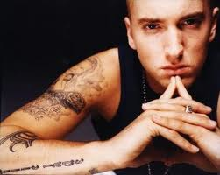
Artist Spotlight: Eminem
Marshall Bruce Mathers III (born October 17, 1972), better known by his stage name Eminem (often stylized as EMINƎM) and by his alter ego Slim Shady, is an American rapper, record producer, songwriter and actor. Eminem's popularity brought his group, D12, to mainstream recognition.
“The Real Slim Shady”: http://www.youtube.com/watch?v=eJO5HU_7_1w

Slide 28
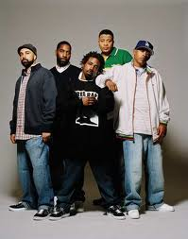
ARTIST SPOTLIGHT: JURASSIC 5
Jurassic 5 was an American alternative
hip hop group formed in 1993 from members of
two previous groups.
The six piece crew that was formed, came out of Los Angeles, California
“The Influence”: http://www.youtube.com/watch?v=E9FbRN-w4Wk

Slide 29
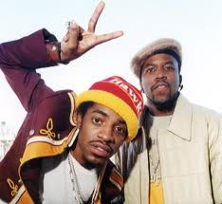
ARTIST SPOTLIGHT: OUTKAST
Outkast (stylized as OutKast) is an American hip hop duo based in East Point, Georgia, consisting of Atlanta native André "André 3000" Benjamin (formerly known as Dré) and Savannah, Georgia-born Antwan "Big Boi" Patton.
The group's original musical style was a mixture of Dirty South and G-funk. Since then, however, funk, soul, rock, electronic music, spoken word poetry, jazz and blues elements have been added to the group's musical palette
“Roses”: http://www.youtube.com/watch?v=f9lkxq7tGuY

Slide 30
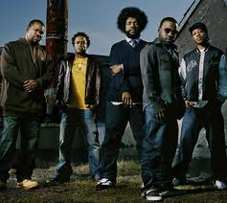
ARTIST SPOTLIGHT: THE ROOTS
The Roots is an American hip hop/neo soul band formed in 1987 by Tariq "Black Thought" Trotter and Ahmir "Questlove" Thompson in Philadelphia, Pennsylvania. They are known for a jazzy, eclectic approach to hip hop which includes live instrumentals.
“The Seed”: http://www.youtube.com/watch?v=ojC0mg2hJCc

Slide 31
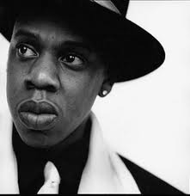
ARTIST SPOTLIGHT: JAY Z
Shawn Corey Carter (born December 4, 1969),
better known by his stage name Jay-Z, is an American rapper, songwriter, record producer, entrepreneur, and occasional actor.
He is one of the most financially successful hip hop artists and entrepreneurs in America, having a net worth of over $450 million as of 2010.
“99 Problems”: http://www.youtube.com/watch?v=etl9kkIGaHo

Slide 32
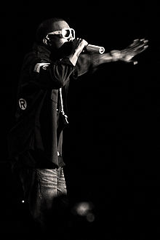
ARTIST SPOTLIGHT: KANYE WEST
Kanye Omari West is an American rapper,
singer, songwriter and record producer.
West first rose to fame as a producer for Roc-A-Fella Records, where he eventually achieved recognition for his work on Jay-Z's album The Blueprint, as well as hit singles for musical artists including Alicia Keys, Ludacris, and Janet Jackson.
His style of production originally used pitched-up vocal samples from soul songs incorporated with his own drums and instruments.
“Touch The Sky”: http://www.youtube.com/watch?v=LFCWHshsw_M

Slide 33
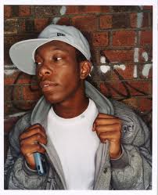
ARTIST SPOTLIGHT: DIZZIE RASCAL
Dylan Kwabena Mills (born 18 September
1984), better known by his stage name Dizzee Rascal, is an English rapper, songwriter and record producer of Ghanaian and Nigerian immigrant status.
His music is a blend of garage, hip hop, grime, ragga, pop and electronic music, with eclectic samples and more exotic styles.
“Dance Wit Me”: http://www.youtube.com/watch?v=GibLntdLiJA

Slide 34
Australian hip hop
Australian hip hop music began in the early 1980s.
Primarily influenced by hip hop music and culture imported via radio and television from the United States of America.
Since the 1990s, a distinctive local style has developed.
Some say that Australian hip hop is an example of how the country has been Americanized. However others argue that Australian hip hop has been localised with the use of the Australian accent, Australian slang, political views, references to localities, dealings with the Australian cultural identity.
In the industry this debate is a sore point with many Australian hip hop artists denying any association with American hip hop.
One way of asserting their authenticity is by making clear that, for them, hip hop is not about race.

Slide 35
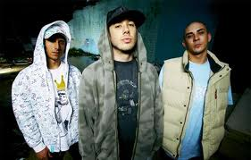
ARTIST SPOTLIGHT: BLISS N ESO
Bliss n Eso are an ARIA Award-winning
Australian hip hop band based in Sydney, and were originally known as Bliss N' Esoterikizm for their debut EP The Arrival.
“Down By The River”
http://www.youtube.com/watch?v=A2YDdGXvfPM

Slide 36
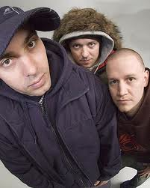
ARTIST SPOTLIGHT: HILLTOP HOODS
The Hilltop Hoods are an ARIA Award winning
Australian hip hop group from Adelaide.
They have been at the centre of the Australian hip hop scene for the better part of two decades, originally forming back in 1991 and releasing their first EP in 1997.
“The Hard Road”: http://www.youtube.com/watch?v=LFCWHshsw_M

