Slide 1
Biodiversity
Chapter 3 Learning Objectives
After completing this chapter, you will be able to:
Define biodiversity and explain its components, including genetic, species, and ecosystem diversity.
Explain biodiversity's ecological, economic, cultural, and ethical importance.
Describe methods and techniques for measuring and assessing biodiversity, including species richness, abundance, and diversity indices.
Identify and analyze various threats to biodiversity, such as habitat loss, pollution, climate change, invasive species, and overexploitation.
Discuss and evaluate conservation strategies and management practices aimed at preserving biodiversity.
Analyze complex biodiversity-related issues and propose innovative solutions for biodiversity conservation.

Slide 2
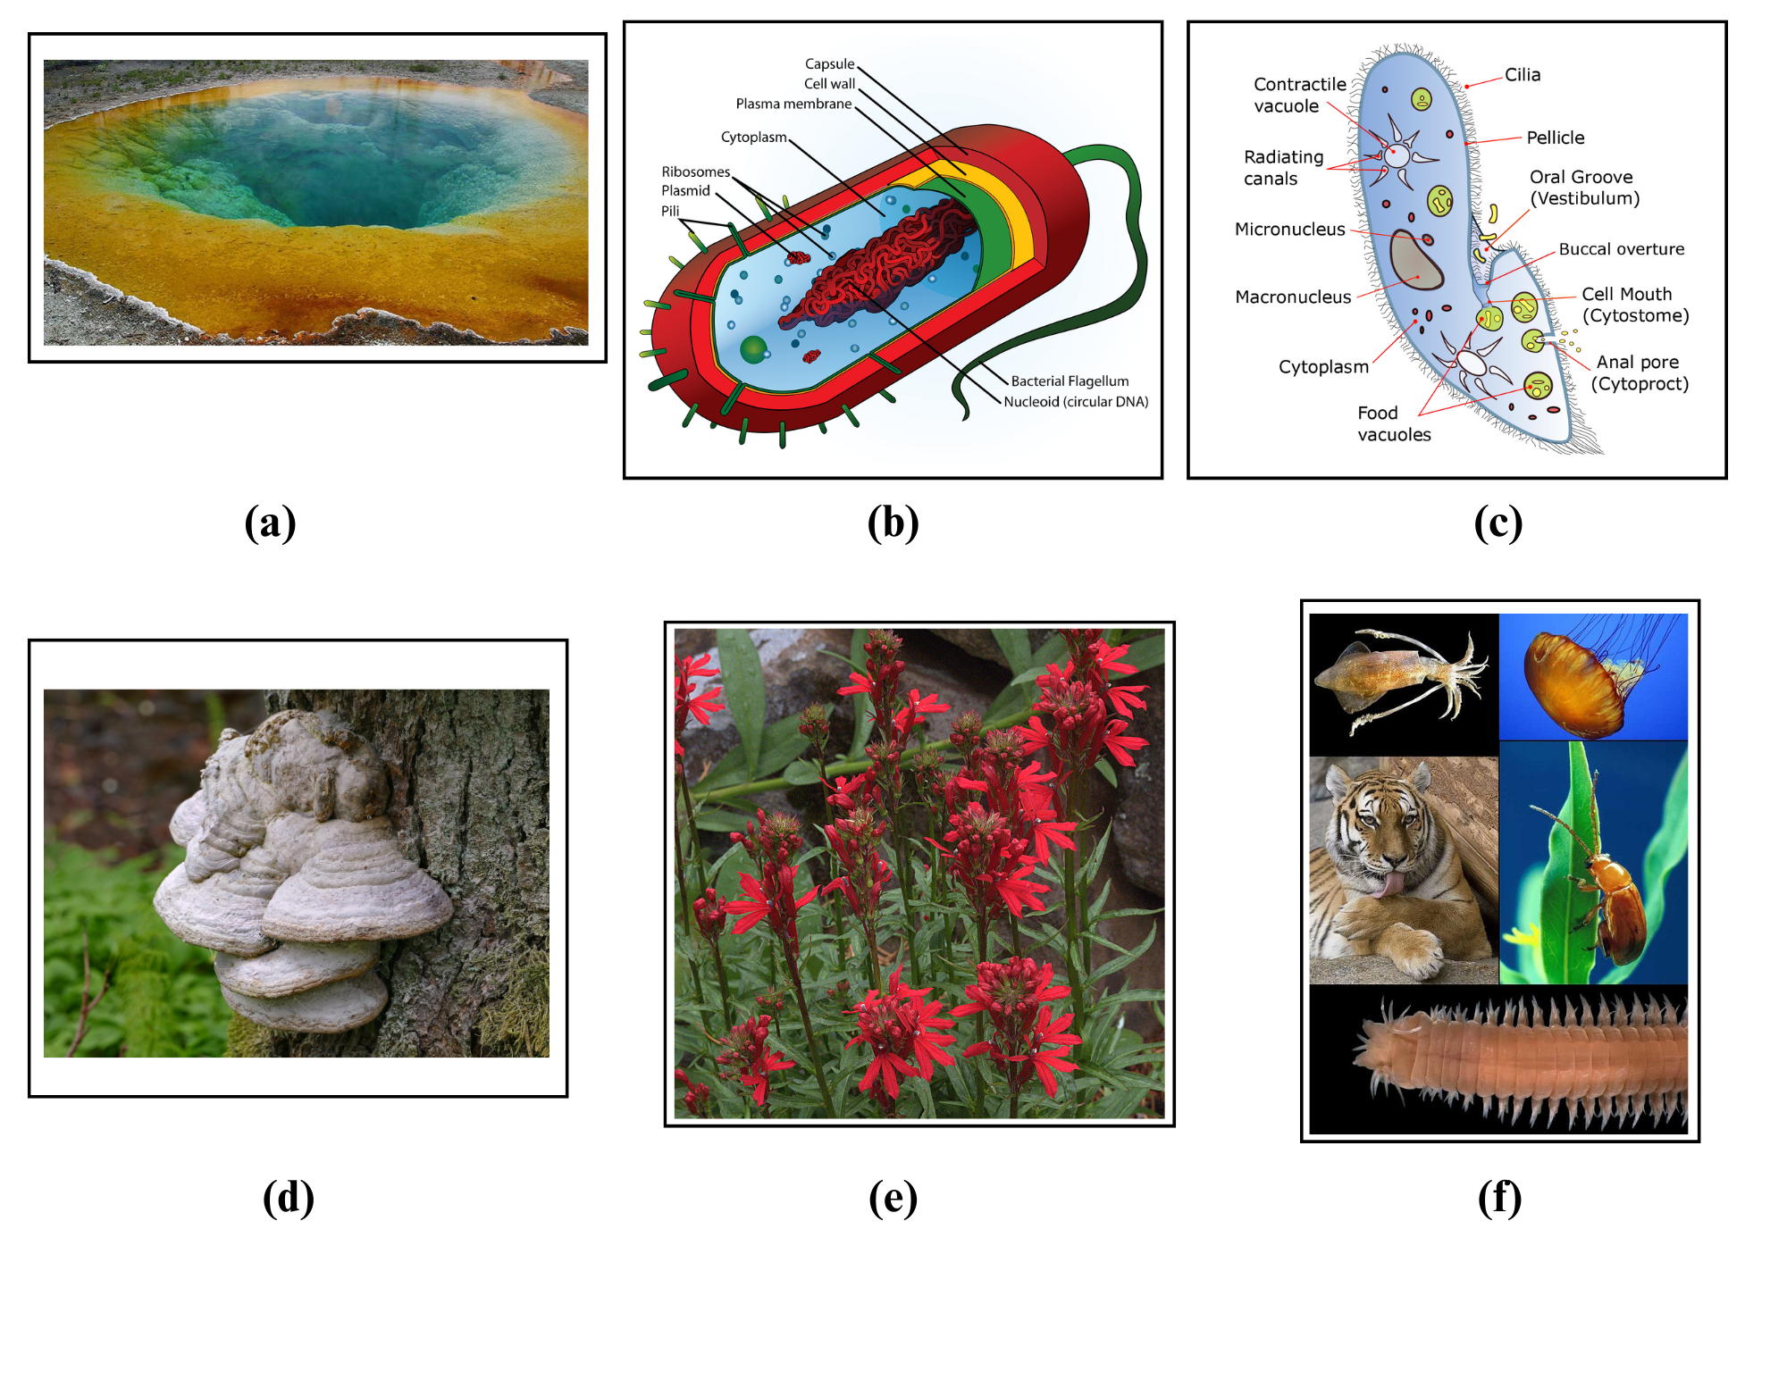
Preserving Biodiversity and the Six Kingdoms of Life
Figure 1.7 shows examples of organisms in the six kingdoms of life. (a) This image shows a hot spring at Yellowstone National Park. Hot springs are extreme environments where some archaea can thrive due to the high aquatic temperatures. (CC BY OpenStax Microbiology). (b) This diagram depicts the structure of an average prokaryotic cell. (c) Paramecia are common examples of protists. (CC BY-SA) (d) A tinder fungus is pictured on a dead pine tree in Lysekil Municipality, Sweden. (e) Plants exist in many forms. This cardinal flower was photographed at the Regional Parks Botanic Garden near Berkeley, California. (CC BY John Rusk) (f) Kingdom Animalia includes approximately 36 phyla with wide-ranging characteristics. This image shows examples within this grouping (from left to right, top to bottom): European squid, Atlantic Sea nettle, tiger, flea beetle, and bristle worm. (CC BY-SA)

Slide 3
Archaea, sometimes called "archaebacteria," are a group of single-celled microorganisms distinct from bacteria and eukaryotes. They are prokaryotic organisms, meaning that they lack a true nucleus and other membrane-bound organelles.
Eubacteria, also known as "true bacteria," are a diverse group of prokaryotic organisms that are found in virtually every habitat on Earth. They are characterized by their lack of a true nucleus or other membrane-bound organelles and their generally small size (usually ranging from 0.2 to 5 micrometers).
Monera is another outdated biological kingdom that was once used to classify prokaryotic organisms, which include bacteria and archaea. These bacteria are vital to many ecological processes, including nutrient cycling and decomposition.

Slide 4
Protista is a biological kingdom that includes a diverse group of eukaryotic microorganisms. The classification of Protista is somewhat outdated and is no longer recognized as a formal taxonomic group in many modern classifications. Protista are typically unicellular or simple multicellular organisms, and they exhibit a wide range of characteristics and lifestyles.
Fungi are a diverse group of organisms that include yeasts, molds, and mushrooms. They are eukaryotic organisms, meaning that they have a true nucleus and other membrane-bound organelles. Fungi play important roles in nutrient cycling and the decomposition of organic matter.
Plants are critical to the survival of many animal species and play a key role in maintaining the health of ecosystems. Animals play vital roles in maintaining ecological balance and are also important sources of food and medicine for humans. To preserve biodiversity in this kingdom, we can work to protect and restore natural habitats, reduce over-fishing and hunting, and promote sustainable tourism practices that do not harm wildlife.

Slide 5
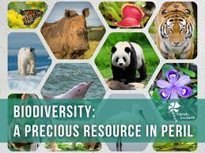
Biodiversity in the United States
The United States of America is a vast and diverse country with a wide range of ecosystems, climate zones, and geological formations. There are several areas of environmental diversity found in the U.S.
Mountains: The U.S. is home to several mountain ranges, including the Rockies, the Sierra Nevada, the Appalachian Mountains, and the Cascade Range. These mountains offer diverse landscapes, from snow-capped peaks to lush forests and valleys.
Deserts: The U.S. has several deserts, including the Mojave, Sonoran, and Chihuahuan deserts. These areas are characterized by hot and dry climates, unique plant and animal species, and stunning rock formations.
Coastal regions: The U.S. has more than 12,000 miles of coastline, ranging from the rocky shores of Maine to the sandy beaches of California and Florida. These regions are home to a variety of marine life, from whales and dolphins to sea turtles and seagulls.

Slide 6
Wetlands: The U.S. has over 110 million acres of wetlands, including marshes, swamps, and bogs. These areas provide important habitats for migratory birds and other wildlife, as well as important ecosystem services like water filtration and flood control.
Grasslands: The U.S. has vast grasslands, including the Great Plains and the prairies of the Midwest. These regions are characterized by rolling hills, grasses, and wildflowers, and support a wide variety of grazing animals like bison and pronghorn antelope.
Forests: The U.S. has a variety of forest ecosystems, including the temperate rainforests of the Pacific Northwest, the hardwood forests of the Northeast, and the pine forests of the Southeast. These forests are important habitats for wildlife, provide important ecosystem services like carbon sequestration and water filtration, and are also used for recreation and timber harvesting.

Slide 7
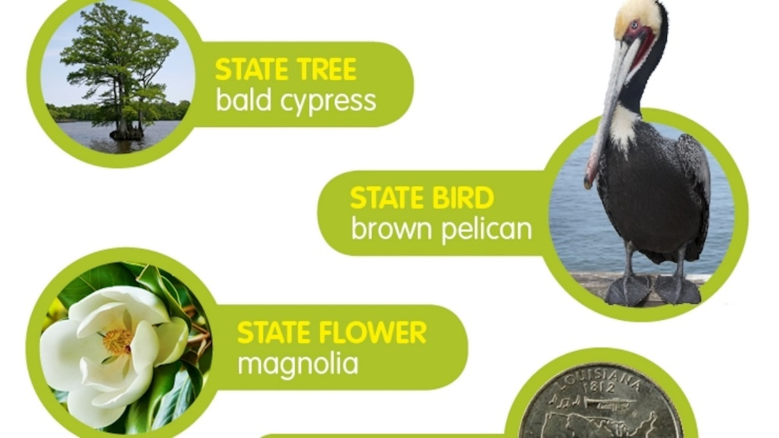
Biodiversity in the State of Louisiana
Louisiana is a state located in the southern region of the United States. It is known for its rich cultural heritage, unique cuisine, and diverse natural landscapes. The state is home to a wide variety of plant and animal species and diverse ecosystems.
Louisiana is known for its extensive wetlands, which cover around 40% of the state’s land area. These wetlands provide vital habitat for a variety of plants and animals, including alligators, nutria, and numerous bird species.
The state also has several major rivers, including the Mississippi, Red, and Atchafalaya Rivers, which support a diverse array of aquatic species.

Slide 8
In addition to wetlands and rivers, Louisiana has a variety of other ecosystems, including forests, grasslands, and coastal areas. The state’s forests are primarily composed of hardwoods such as oak, hickory, and maple, and support a variety of wildlife, including deer, squirrels, and birds. The grasslands of Louisiana are found primarily in the northern part of the state and are home to a variety of grasses, wildflowers, and small mammals.
The coastal areas of Louisiana are also ecologically diverse, with sandy beaches, marshes, and swamps. These areas are home to a variety of plant and animal species, including sea turtles, dolphins, and a variety of fish and shellfish.
Overall, Louisiana’s environmental diversity is due to its unique geography and climate, as well as its history of human settlement and land use. While the state faces many environmental challenges, including coastal erosion and pollution, efforts are underway to protect and preserve its diverse ecosystems for future generations.

Slide 9
Biodiversity: Aligning Economics with Nature
Valuing Biodiversity: Assigning economic value to biodiversity helps in recognizing its importance in economic decision-making. Methods like cost-benefit analysis and ecosystem services valuation can quantify the economic benefits derived from biodiversity.
Incentivizing Conservation: Developing economic incentives, such as payments for ecosystem services (PES), eco-tourism, and biodiversity offsetting, can encourage stakeholders to engage in conservation efforts and sustainable land use.
Regulatory Frameworks: Implementing laws and regulations that promote sustainable resource use, limit overexploitation, and penalize harmful activities can play a crucial role in aligning economic activities with biodiversity conservation.
Green Finance and Investments: Encouraging investments in environmentally sustainable projects and businesses, often referred to as green finance, can help fund biodiversity conservation efforts and promote a shift towards a more sustainable economy.

Slide 10
Sustainable Agriculture and Forestry: Encouraging practices that promote sustainable agriculture and forestry, such as agroforestry, sustainable harvesting, and reduced deforestation, can protect habitats and contribute to biodiversity conservation while supporting economic growth.
Circular Economy: Promoting a circular economy that emphasizes resource efficiency, waste reduction, recycling, and reusing can help decrease the pressure on natural resources and ecosystems, thereby promoting biodiversity conservation.
Education and Awareness: Raising awareness about the economic benefits of biodiversity conservation and the long-term costs of biodiversity loss can influence individual and societal behavior, leading to more sustainable choices.
Collaborative Partnerships: Encouraging collaboration and partnerships among governments, non-governmental organizations, businesses, communities, and academia is crucial for achieving meaningful results in aligning economics with biodiversity conservation.

Slide 11
Technology Innovation: Leveraging technological advancements, such as remote sensing, artificial intelligence, and biotechnology, can provide valuable data and tools for monitoring biodiversity, making informed decisions, and developing sustainable solutions.
Policy Integration: Ensuring that biodiversity concerns are integrated into broader economic policies and strategies, such as national development plans and trade agreements, can help mainstream biodiversity considerations into economic decision-making processes.
Aligning economics with nature is essential for achieving a sustainable and equitable future that safeguards biodiversity, supports human well-being, and ensures the longevity of our planet's ecosystems.

Slide 12
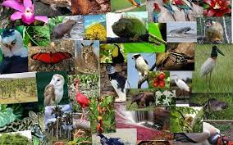
Connecting Nature with Human Identity
There are several ways in which biodiversity is intimately linked to human identity:
Cultural and Spiritual Significance:
Biodiversity is woven into the fabric of many cultures and belief systems. Various species, landscapes, and natural elements hold symbolic and spiritual significance, shaping cultural identities and rituals.
Traditional Knowledge and Wisdom:
Indigenous and traditional communities often possess profound knowledge about ecosystems, plants, animals, and their interactions. This knowledge is not only practical but deeply ingrained in their identities and ways of life.
Sense of Place and Belonging:
Biodiversity contributes to a sense of belonging and connection to a specific place or region. People often identify strongly with the natural landscapes, flora, and fauna that characterize their homes and environments.

Slide 13
Health and Well-being:
Exposure to nature and biodiversity has been linked to improved mental, emotional, and physical well-being. People often feel a sense of peace, relaxation, and happiness when immersed in natural environments, highlighting the role of biodiversity in human health.
Historical and Ancestral Ties:
Biodiversity forms an integral part of human history and ancestry. People may have historical ties to specific landscapes, species, or ecosystems that influence their sense of identity and roots.
Art, Literature, and Expression:
Biodiversity often inspires art, literature, music, and various forms of creative expression. Artists and writers frequently draw from the beauty and diversity of the natural world to convey their ideas and emotions.
Recreation and Tourism:
Biodiversity-rich areas often attract visitors seeking recreational activities and tourism experiences. These interactions with diverse ecosystems contribute to shaping the identity of both the visitors and the local communities.

Slide 14
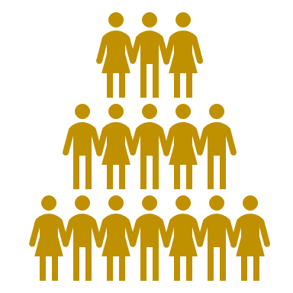
Local Traditions and Festivals:
Many traditional celebrations and festivals are centered around natural cycles, agricultural practices, or seasonal changes, showcasing the close relationship between culture, identity, and biodiversity.
Education and Awareness:
Integrating education about biodiversity and its importance into the curriculum helps in shaping the identity of younger generations, fostering a sense of responsibility and stewardship towards the environment.
Sustainable Lifestyles and Choices:
Recognizing biodiversity as part of one's identity can lead to more conscious choices, encouraging sustainable practices that respect and protect the natural world.

Slide 15
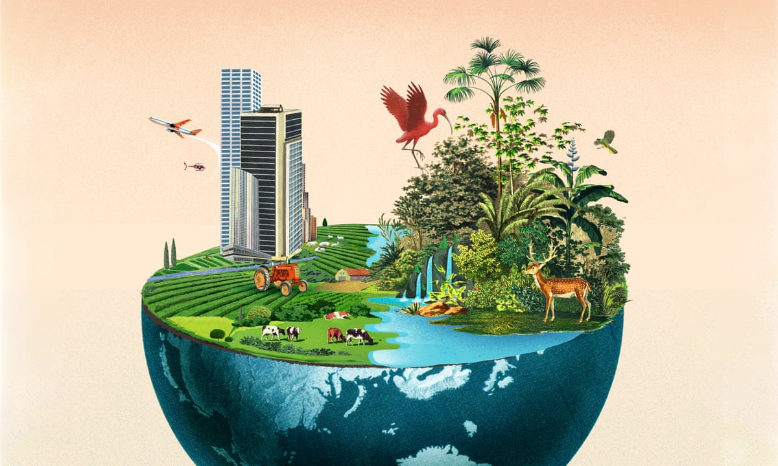
Societies and Stewards of Biodiversity
Awareness and Education:
Promote awareness and understanding of biodiversity, its importance, and the threats it faces. Education empowers individuals to make informed decisions and take action to protect biodiversity.
Advocacy and Policy Influence:
Engage in advocacy efforts to influence policies and legislation that support biodiversity conservation and sustainable development. Advocate for stronger environmental regulations and their effective implementation.
Community Engagement and Participation:
Involve local communities and indigenous peoples in decision-making processes related to land use, natural resource management, and conservation initiatives. Respect traditional knowledge and practices regarding biodiversity.

Slide 16
Sustainable Resource Use:
Encourage sustainable practices in agriculture, forestry, fisheries, and other sectors to ensure that natural resources are utilized in a way that maintains ecosystem health and biodiversity.
Habitat Restoration and Conservation:
Engage in habitat restoration and conservation initiatives to protect threatened species and restore degraded ecosystems. Participate in reforestation, wetland restoration, and other conservation efforts.
Promote Sustainable Consumption:
Encourage responsible and sustainable consumption patterns by making informed choices regarding products and services that have a lower impact on biodiversity and the environment.
Citizen Science and Monitoring:
Involve citizens in scientific monitoring and data collection initiatives, enabling a broader understanding of biodiversity and helping to track changes and trends over time.

Slide 17
Support for Protected Areas:
Advocate for and support the establishment and effective management of protected areas, national parks, marine reserves, and wildlife sanctuaries to safeguard biodiversity and provide safe habitats for wildlife.
Collaboration and Partnerships:
Foster collaboration and partnerships between governments, non-governmental organizations, businesses, academic institutions, and civil society to pool resources, expertise, and efforts for biodiversity conservation.
Promote Eco-friendly Practices:
Encourage eco-friendly practices in urban planning, infrastructure development, and business operations to minimize ecological footprints and reduce negative impacts on biodiversity.
Responsible Tourism:
Promote responsible and sustainable tourism practices that minimize harm to ecosystems, respect local cultures, and contribute to biodiversity conservation and community development.

Slide 18
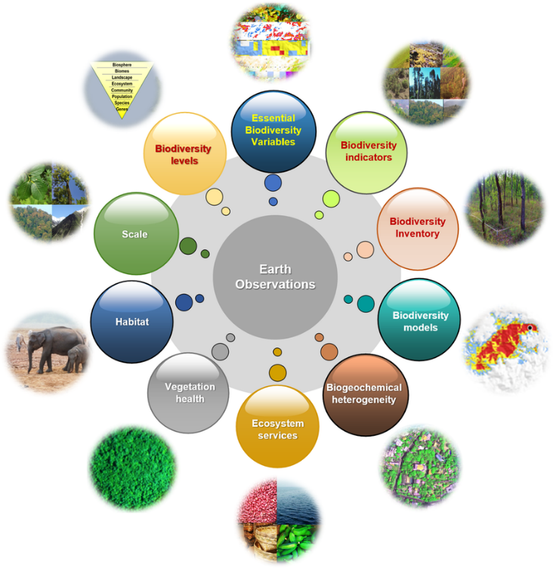
Civic Engagement and Volunteering:
Encourage citizens to actively engage in biodiversity conservation through volunteering, supporting local conservation organizations, and participating in community-led conservation initiatives.
Research Matrix and Monitoring of Biodiversity
A research matrix and monitoring system for biodiversity involves a structured approach to collecting, organizing, and analyzing data related to biodiversity and ecosystem health.
This helps in understanding biodiversity patterns, identifying threats, assessing conservation measures, and making informed decisions for sustainable resource management.
There are suggested methods to design a research matrix and monitoring system for biodiversity. The outline below provides an organized and strategic approach to conducting such a task.

Slide 19
Define Objectives and Scope
Clearly outline the goals and objectives of your biodiversity research and monitoring efforts. Define the scope, including the geographic area, ecosystems, species, and key parameters of interest.
Identify Key Biodiversity Indicators
Determine the key indicators that reflect the health and diversity of the ecosystems you're monitoring. These could include species richness, population trends, habitat fragmentation, genetic diversity, and ecosystem services.
Select Monitoring Methods and Techniques
Choose appropriate methods for data collection based on the identified indicators. This could involve field surveys, remote sensing, GIS (Geographic Information System) analysis, camera traps, acoustic monitoring, genetic sampling, and citizen science initiatives.
Design a Research Matrix
Create a matrix that outlines the different aspects of your research, including:
Indicators: List the specific biodiversity indicators you'll be monitoring.
Methodology: Describe the monitoring methods, tools, and techniques for each indicator.
Sampling Strategy: Specify the sampling design, frequency, spatial and temporal scales, and target sample size.
Data Collection Parameters: Outline the specific data points to be collected for each indicator.
Responsible Parties: Assign roles and responsibilities for data collection, analysis, and reporting.

Slide 20
Establish Baseline Data
Begin by establishing baseline data for the selected indicators. This provides a reference point for future comparisons and helps in assessing changes over time.
Implement Data Collection
Implement the data collection based on the research matrix. Train field teams, ensure standardized data collection protocols, and begin collecting data across different ecosystems and locations.
Data Analysis and Interpretation
Analyze the collected data using appropriate statistical and analytical methods. Interpret the findings and assess the status of biodiversity, trends, and potential threats.
Develop Monitoring Reports
Create regular monitoring reports summarizing the data, analysis, and interpretation of biodiversity indicators. These reports should be accessible and easily understandable for various stakeholders.
Feedback and Adaptation
Share the findings with stakeholders, policymakers, and the public. Gather feedback and use this information to refine the research matrix, monitoring methods, and future data collection strategies.
Long-Term Monitoring and Iteration
Establish a long-term monitoring program to track changes in biodiversity over time. Regularly revisit and update the research matrix based on new knowledge, changing conservation priorities, and technological advancements.
Integration and Collaboration
Foster collaboration and integration with other biodiversity monitoring efforts, both regionally and globally, to create a comprehensive understanding of biodiversity and its dynamics.

