Slide 1
The Renaissance Period

Slide 3
The Renaissance Spirit
The term Renaissance literally means “rebirth.” As a historical and artistic era in Western Europe, the Renaissance spanned from the late 1400s to the early 1600s. The Renaissance was a time of waning political power in the church, somewhat because of the Protestant Reformation. Also, during this period, the feudal system slowly gave way to developing nation-states with centralized power in the courts. This period was one of intense creativity and exploration. It included such luminaries as Leonardo da Vinci, Christopher Columbus, Ferdinand Magellan, Nicolaus Copernicus, and William Shakespeare. The previous medieval period was suppressive, firmly established, and pious. The Renaissance however, provided the thinkers and scholars of the day with a revival of Classical (Greek and Roman) wisdom and learning after a time of papal restraint. This “rebirth” laid the foundation for much of today’s modern society, where humans and nature rather than religion become the standard for art, science, and philosophy.
The Renaissance period (1450-1600)
French for “rebirth”

Slide 4
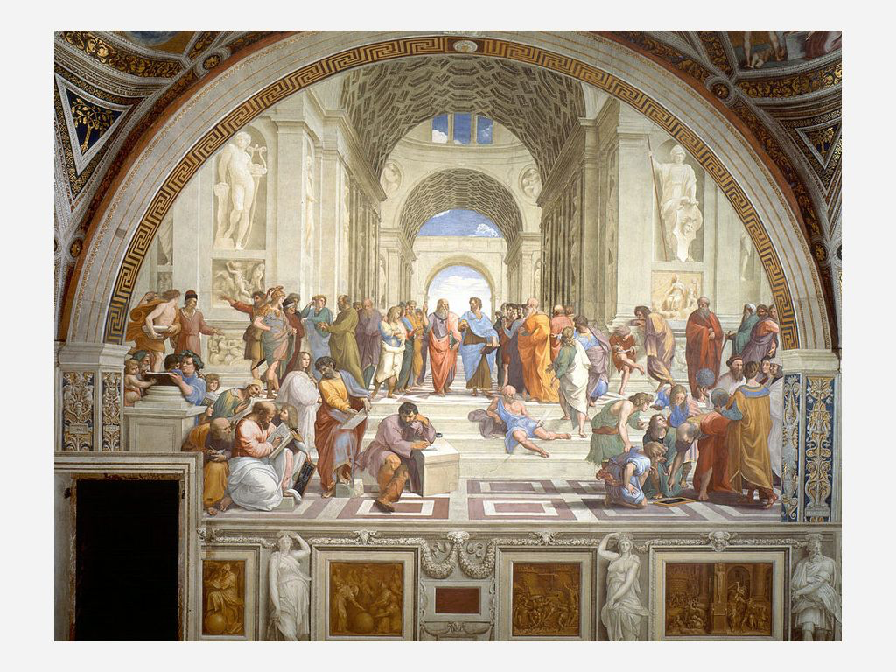
The School of Athens, by Raphael demonstrates the strong admiration, influence, and interest in previous Greek and Roman culture. The painting depicts the Greek philosophers Aristotle and Plato (center), with Plato depicted in the likeness of Leonardo da Vinci
The School of Athens
Author: Raphael
Source: Wikimedia Commons
License: Public Domain

Slide 5
The Arts in the Renaissance
More secular feel to life than a religious emphasis
Reason and scientific inquiry vs. faith and mysticism (Middle Ages)
Philosophers, artists, writers, musicians, etc. revered much like Church Fathers and saints had been in Medieval era.

Slide 6
Inventions
Gunpowder - ex-ed out knighthood
Compass - made voyages and advanced discovery possible
Printing - Gave a heightened sense to architecture, painting, and sculpture.

Slide 8
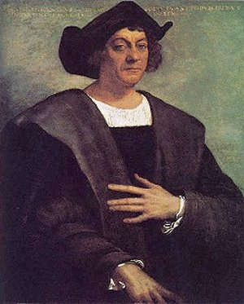
Voyagers
Christopher Columbus
Italian
Said to have discovered North America in 1492

Slide 9
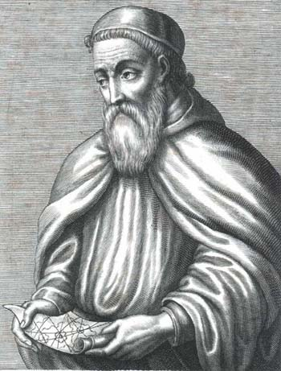
Voyagers
Amerigo Vespucci
Italian
Made initial voyages along the South American coastline

Slide 10
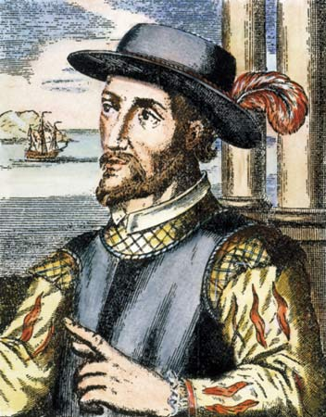
Voyagers
Juan Ponce de Leon
Spanish
Made 2nd voyage with Columbus and stepped foot onto Florida
1st governor of Puerto Rico

Slide 11
Classicism
Refers to the culture of the ancient Greeks and Romans. This was a more orderly, stable, and balanced lifestyle.

Slide 12
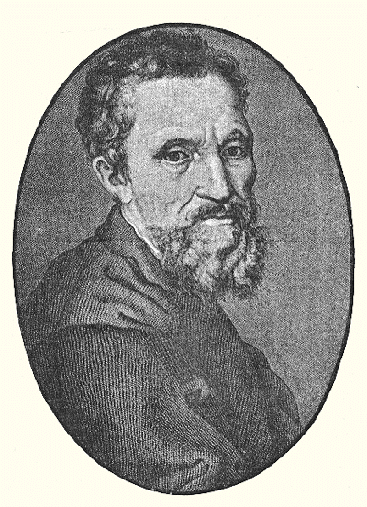
Artists
Michelangelo (Italian)
Sculpture of “David” (realism)
Painted the Sistine Chapel

Slide 13
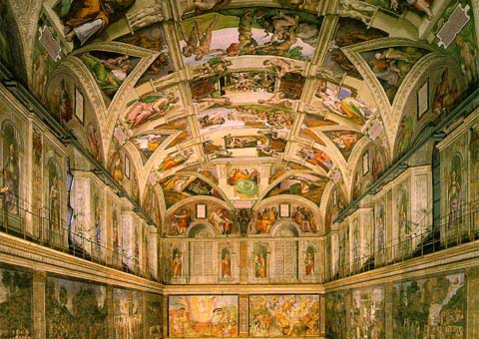
Sistine Chapel
Notes:
Sistine Chapel

Slide 14
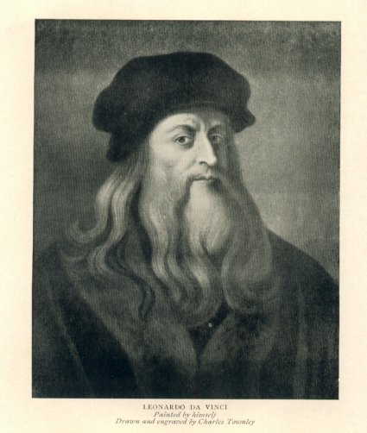
Artists
Leonardo da Vinci
“Mona Lisa” painting (realism)
“The Last Supper” painting
“Vitruvian Man” drawing (human form)

Slide 15
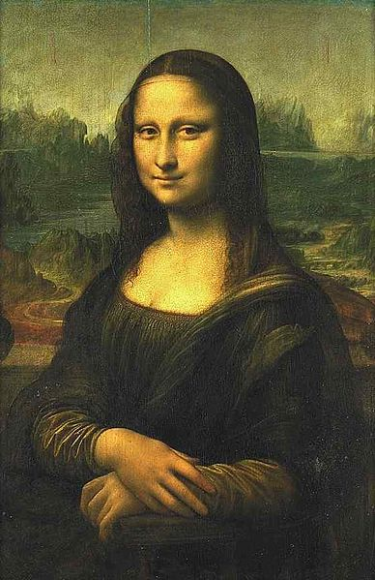
The Mona Lisa is a half-length portrait painting by Italian artist Leonardo da Vinci.
The most read about
The most written about
The most parodied work of the art in the world.
Notes:
Mona Lisa

Slide 16
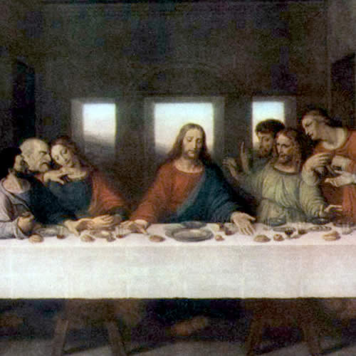
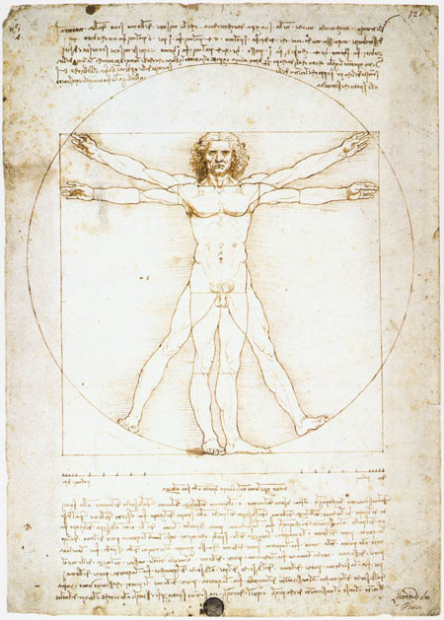
Notes:
The Last Supper / Vitruvian Man

Slide 18
Musicians
Made a living by working in the church, city, state, and royal and aristocratic courts
Employed as choirmasters, instrumentalists, copyists, composers, teachers, etc.

Slide 19
Musical Style
Golden age of “a cappella”
Church music (a cappella) / Secular music (divided between a cappella and accompanied music)
Added intervals of 3rds and 6ths versus the 5th and octave style of harmony introduced in the Middle Ages

Slide 20
Musical Style
Word painting quite used in secular music
Music reflected the meaning of the words
The word “death” could have clashing chords or the word “heaven” may have stringed instruments attached to the musical performance

Slide 21
Musical Style
Cantus firmus
Polyphonic
Similar to but not the same as organum
Organum had two voices and is usually done with intervals of 4ths, 5ths, unisons, or octaves
Cantus firmus uses other intervals in addition to the previously mentioned and can have more than two voices

Slide 22
Renaissance Sacred Music

Slide 23
The Renaissance Motet
Motet was no longer just sacred as was the case during the Middle Ages
Majority of motets were for the Virgin Mary

Slide 24
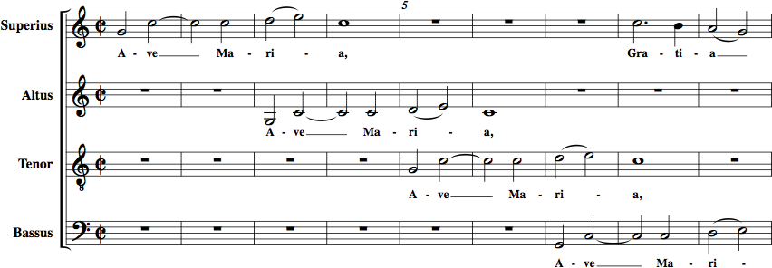
THE MOTET
The motet, a sacred Latin text polyphonic choral work, is not taken from the ordinary of the mass. A contemporary of Leonardo da Vinci and Christopher Columbus, Josquin des Prez was a master of Renaissance choral music. Originally from the region that is today’s Belgium, Josquin spent much of his time serving in chapels throughout Italy and partly in Rome for the papal choir. Later, he worked for Louis XII of France and held several church music directorships in his native land. During his career, he published masses, motets, and secular vocal pieces, and was highly respected by his contemporaries. Josquin’s “Ava Maria …Virgo Serena” (“Hail, Mary … Serene Virgin”) ca. 1485 is an outstanding Renaissance choral work. A four-part (Soprano, Alto, Tenor, Bass) Latin prayer, the piece weaves one, two, three and four voices at different times in polyphonic texture.
Opening Line of “Ave Maria”
Author: Josquin Des Prez
Source: Wikimedia Commons
License: Public Domain

Slide 25
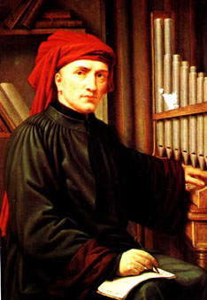
Josquin des Prez
(ca. 1450-1521)
Music was rich in feeling, serenely beautiful, and expressive in harmony
Composed more than 100 motets, 17 Masses, and numerous secular pieces
“Ave Maria…virgo serena”

Slide 26
The Renaissance Mass
Five main sections
Kyrie
A-B-A form
(3) Kyrie eleisons (Lord, have mercy)
(3) Christe eleisons (Christ, have mercy)
(3) Kyrie eleisons (Lord, have mercy)

Slide 27
THE PROTESTANT REFORMATION
In the Middle Ages, people were thought to be parts of a greater whole: members of a family, trade guild, nation, and church. At the beginning of the Renaissance, a shift in thought led people to think of themselves as individuals, sparked by Martin Luther’s dissent against several areas and practices within the Catholic Church. On October 31, 1517, Luther challenged the Catholic Church by posting The Ninety-Five Theses on the doors of the Castle Church in Wittenberg, Germany. The post stated Luther’s various beliefs and interpretations of Biblical doctrine which challenged the many practices of the Catholic Church in the early 1500s. Luther felt that educated/literate believers should be able to read the scriptures and become individual church entities themselves. With the invention of the Gutenberg Press, copies of the scriptures and hymns became available to the masses which helped spread the Reformation. The empowerment of the common worshiper or middle class continued to fuel the loss of authority of the church and upper class.

Slide 28
The Renaissance Mass
Gloria (Glory be to God in the Highest)
Credo (I believe in God the Father Almighty)
Sanctus (Holy, holy, holy)/Hosanna (Hosanna in the highest)
Agnus Dei (Lamb of God, who takes away the sins of the world)

Slide 29
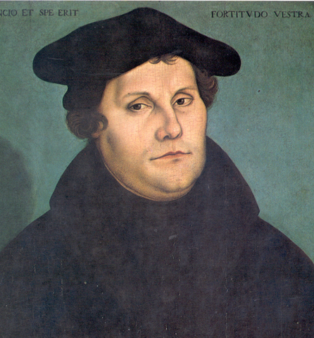
The Late Renaissance Mass
Martin Luther (1483-1546)
Leader of the Protestant Reformation
Sought to reform the Catholic church in Western Europe
95 Theses
Nature of penance
Authority of pope
Usefulness of indulgences

Slide 30
Late Renaissance Mass
Counter-Reformation
From within the Catholic church
Dealt with the deliberations made by the Council of Trent

Slide 31
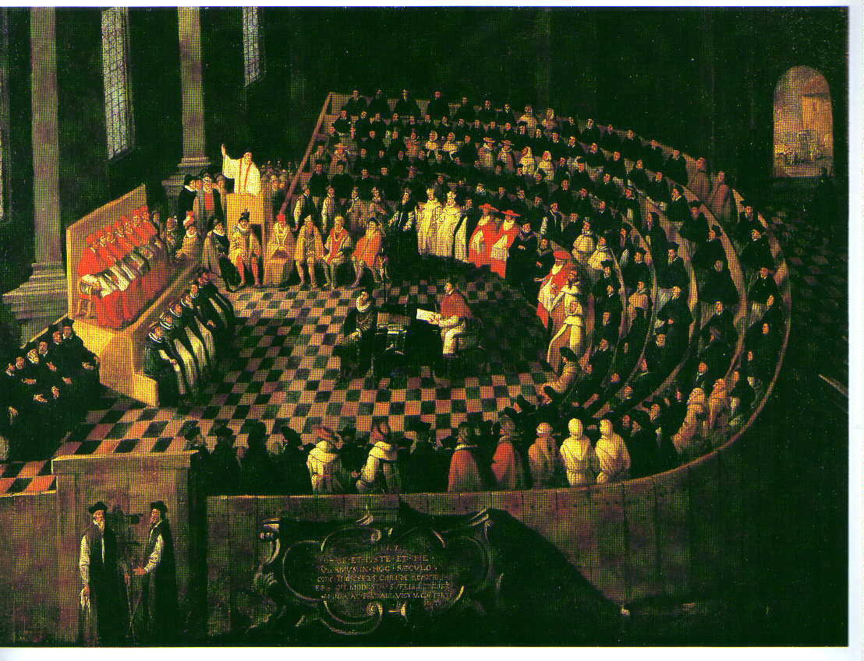
Late Renaissance Mass
Council of Trent
Council of the Roman Catholic Church
Met between 1545-1563 to discuss the state of the church
Objected the use of certain instruments in church services

Slide 32
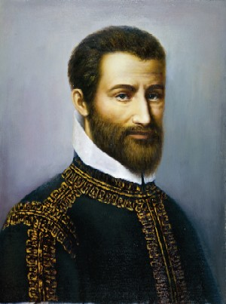
Late Renaissance Mass
Giovanni Pierluigi da Palestrina
(ca. 1525-1594)
Organist and choirmaster
Was appointed by Pope Julius III as choirmaster at the Sistine Chapel
Dismissed by different pope because of his marital status
Wrote over 100 Masses

Slide 33
Renaissance Secular Music

Slide 34
Secular Music Entertainment Music of the Renaissance
Royalty sought the finest of the composers to employ for entertainment. A single court, or royal family, may employ as many as ten to sixty musicians, singers, and instrumentalists. In Italy, talented women vocalists began to serve as soloists in the courts. Secular pieces for the entertainment of nobility and sacred pieces for the chapel were composed by the court music directors. Musicians were often transported from one castle to another to entertain the court’s patron, travelling in their patron’s entourage.
The Renaissance town musicians performed for civic functions, weddings, socials, and religious ceremonies/services. Due to market, that is, the supply and demand of the expanding Renaissance society, musicians experience higher status and pay unlike ever before. The Flanders, Low Countries of the Netherlands, Belgium, and northern France became a source of musicians who filled many important music positions in Italy. As in the previous era, vocal music maintained its important status over instrumental music.
Germany, England, and Spain also experienced an energetic musical expansion. Secular vocal music became increasingly popular during the Renaissance. In Europe, music was set to poems from several languages, including English, French, Dutch, German, and Spanish. The invention of the printing press led to the publication of thousands of collections of songs that were never available. One instrument or small groups of instruments were used to accompany solo voices or groups of solo voices.

Slide 35
Instrumental Dance Music
Most popular dance types:
Pavane
Saltarello (jumping dance)
Galliard (more rigorous version of saltarello)
Allemande (German dance)
Ronde (round)

Slide 36
Renaissance Dance Music
With the rebirth of the Renaissance, came a resurgence of the popularity of dance. This resurgence led to instrumental dance music becoming the most widespread genre for instrumental music. Detailed instruction books for dance also included step orders and sequences that followed the music accompaniment. The first dances started, like today’s square dances, soon evolved into more elaborate and unique forms of expression. Examples of three types of Renaissance dances include the pavane, galliard, and jig. The pavane is a more solemn stately dance in a duple meter (in twos). Its participants dance and move around with prearranged stopping and starting places with the music. Pavanes are more formal and used in such settings. The galliard is usually paired with a pavane. The galliard is in triple meter (in threes) and provides an alternative to the rhythms of the pavane. The jig is a folk dance or its tune in an animated meter. It was originally developed in the 1500s in England. The instrumental jig was a popular dance number. Jigs were regularly performed in Elizabethan theatres after the main play. William Kemp actor, song and dance performer, and a comedian, is immortalized for having created comic roles in Shakespeare. He accompanied his jig performances with pipe and tabor and snare drum. Kemp’s jig started a unique phrasing/cadence system that carried well past the Renaissance period.

Slide 37
Music in the Court and City
Professional musicians entertained nobility
Amateur musicians increased in number
Prosperous homes had lutes and keyboards
Music was studied (moreso by women) as a means of cultivation

Slide 38
MUSIC IN THE RENAISSANCE
Characteristics of the Renaissance Music include steady beat, balanced phrases (the same length), polyphony (often imitative), increasing interest in text-music relationships, Petrucci and the printing of music, and a growing merchant class singing/playing music at home. Word painting was utilized by Renaissance composers to represent poetic images musically. For example, an ascending melodic line would portray the text “ascension to heaven.” Or a series of rapid notes would represent running.
Art music in the Renaissance served three basic purposes: (1) worship in both the Catholic and burgeoning Protestant Churches, (2) music for the entertainment and edification of the courts and courtly life, and (3) dance music. Playing musical instruments became a form of leisure and a significant, valued pastime for every educated person. Guests at social functions were expected to contribute to the evening’s festivities through instrumental performance. Much of the secular music in the Renaissance was centered on courtly life. Vocal music ranged from chansons (or songs) about love and courtly intrigue to madrigals about nymphs, fairies, and, well, you name it. Both chansons and madrigals were often set for one or more voices with plucked-string accompaniment, such as by the lute, a gourd-shaped instrument with frets, raised strip on the fingerboard, somewhat like the modern guitar.

Slide 39
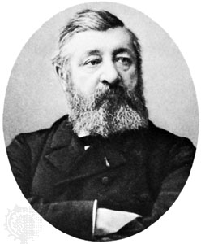
The Chanson
French song
Written for 3 or 4 voices
Set to French love poems
Roland de Lassus
Ca. 1532-1594
Wrote 150 chansons

Slide 40
A madrigal is a musical piece for several solo voices set to a short poem. They originated in Italy around 1520. Most madrigals were about love. Madrigals were published by the thousands and learned and performed by cultured aristocrats. Like the motet, a madrigal combines both homophonic and polyphonic textures. Unlike the motet, the madrigal is secular and utilizes unusual harmonies and word painting more often. Many of the refrains of these madrigals utilized the text “Fa La” to fill the gaps in the melody or to possibly cover risqué or illicit connotations. Sometimes madrigals are referred to as Renaissance Fa La songs.
A volume of translated Italian madrigals were published in London during the year of 1588, the year of the defeat of the Spanish Armada. This sudden public interest facilitated a surge of English madrigal writing as well as a spurt of other secular music writing and publication. This music boom lasted for thirty years and was as much a golden age of music as British literature was with Shakespeare and Queen Elizabeth I. The rebirth in both literature and music originated in Italy and migrated to England; the English madrigal became more humorous and lighter in England as compared to Italy.

Slide 41
The Italian Madrigal
Poetry-music written and performed by aristocrats of the Italian courts
Topics
Love and unsatisfied desire
Claudio Monteverdi (1567-1643)
Published 8 books of madrigals
A un giro from the Fourth Book of Madrigals

Slide 42
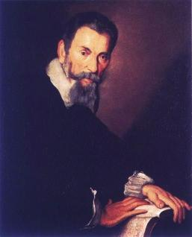
Claudio Monteverdi

Slide 43
The English Madrigal
Musica transalpina
Music from beyond the Alps
Translated from a collection of Italian madrigals
English composers preferred using English text

Slide 44
The English Madrigal
John Farmer
Ca. 1570-1605
Wrote Fair Phyllis
Music was generally cheerful and repetitious
Composer, organist
Word painting

Slide 45
Renaissance Summary
The Renaissance period was truly a time of great discovery in science, music, society, and the visual arts. The reemergence and renewed interests of Greek and Roman history/culture is still current in today’s modern society. Performing music outside of the church in courts and the public really began to thrive in the Renaissance and continues today in the music industry. Many of the master works, both sacred and secular, from the Renaissance are still appreciated and continue to be the standard for today’s music industry. Songs of love, like Renaissance chansons, are still composed and performed today. The beauty of Renaissance music, as well as the other arts, is reintroduced and appreciated in modern-day theater performances and visually in museums. The results of the Protestant Reformation are still felt today, and the struggles between contemporary and traditional church worship continues very much as it did during the Renaissance. As we continue our reading and study of music through the Baroque period, try to recall the changes and trends of the Medieval and Renaissance eras and how they thread their way through history to today. Music and the Arts do not just occur; they evolve and remain the same.

Slide 46
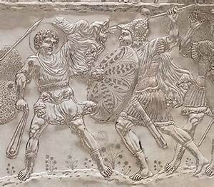
Rendition of David Fighting Goliath found on a Medieval Cast plate; 613-630
Author | Unknown Source |
Met Museum
License | OASC

Slide 47
Renaissance Glossary/Vocabulary
Anthem – a musical composition of celebration, usually used as a symbol for a distinct group, particularly the national anthems of countries. Originally, and in music theory and religious contexts, it also refers more particularly to short sacred choral work and still more particularly to a specific form of Anglican
Church Music – Sacred music written for performance in church, or any musical setting of ecclesiastical liturgy, or music set to words expressing propositions of a sacred nature, such as a hymn. Church Music Director is a position responsible the musical aspects of the church’s activities.
Chanson – is in general any lyric-driven French song, usually polyphonic and secular. A singer specializing in chansons is known as a “chanteur” (male) or “chanteuse” (female); a collection of chansons, especially from the late Middle Ages and Renaissance, is also known as a chansonnier.
Chapel Master – Director of music, secular and sacred, for the courts’ official functions and entertainment. Consort – A renaissance consort is a group of renaissance instrumentalists playing together. A whole consort is an ensemble performing with instruments from the same family. A broken consort is an ensemble comprised of instruments from more than one family.

Slide 48
Counter-Reformation – The preservation movement or “Counter-Reformation” against the protestant reform led to the development of the Jesuit order (1540) and the later assembling of the Council of Trent (1545-1563) which considered issues of the church’s authority and organizational structure.
Dance Music [WM1] – is music composed specifically to facilitate or accompany dancing Frets – is a raised strip on the neck of a stringed instrument.
Frets usually extend across the full width of the neck and divide the string into half steps for most western musical instruments. Most guitars have frets.
Galliard – was a form of Renaissance dance and music popular all over Europe in the 16th century.
Jig – is the accompanying dance tune for an energetic fold dance usually in a compound meter.
Madrigal – a musical piece for several solo voices set to a short poem. They originated in Italy around 1520. Most madrigals were about love.
Motet – is a highly varied sacred choral musical composition. The motet was one of the pre-eminent polyphonic forms of Renaissance music.

Slide 49
Pavanne – is a slow processional dance common in Europe during the 16th century Renaissance.
Reformation – was a succession and division from the practices of the Roman Catholic Church initiated by Martin Luther. Led to the development of Protestant churches.
Word painting – was utilized by Renaissance composers to represent poetic images musically. For example, an ascending melodic line would portray the text “ascension to heaven.” Or a series of rapid notes would represent running.

Slide 50
THE END

