Slide 1
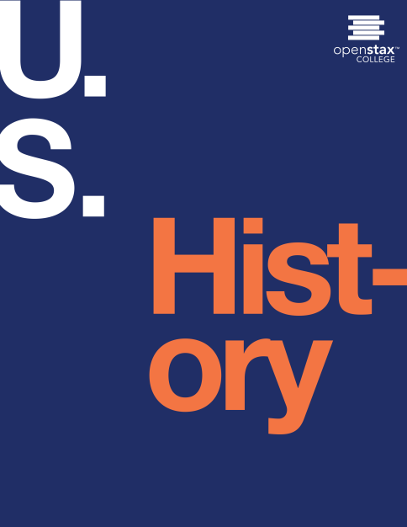
U.S. HISTORY
Chapter 15 The Civil War, 1860–1865
PowerPoint Image Slideshow

Slide 2
Figure 15.1
This photograph by John Reekie, entitled, “A burial party on the battle-field of Cold Harbor,” drives home the brutality and devastation wrought by the Civil War. Here, in April 1865, African Americans collect the bones of soldiers killed in Virginia during General Ulysses S. Grant’s Wilderness Campaign of May–June 1864.

Slide 3
Figure 15.2
(credit “1865”: modification of work by “Alaskan Dude”/Wikimedia Commons)

Slide 4
Figure 15.3
Crittenden’s Compromise would protect slavery in all states where it already existed. More importantly, however, it proposed to allow the western expansion of slavery into states below the Missouri Compromise line.

Slide 5
Figure 15.4
Georgia’s Ordinance of Secession and those of the other Deep South states were all based on that of South Carolina, which was drafted just a month after Abraham Lincoln was elected.

Slide 6
Figure 15.5
The Confederacy’s attack on Fort Sumter, depicted here in an 1861 lithograph by Currier and Ives, stoked pro-war sentiment on both sides of the conflict.

Slide 7
Figure 15.6
This map illustrates the southern states that seceded from the Union and formed the Confederacy in 1861, at the outset of the Civil War.

Slide 8
Figure 15.7
The First Battle of Bull Run, which many Northerners thought would put a quick and decisive end to the South’s rebellion, ended with a Confederate victory.

Slide 9
Figure 15.8
The Confederacy started printing paper money at an accelerated rate, causing runaway inflation and an economy in which formerly well-off people were unable to purchase food.

Slide 10
Figure 15.9
As this cartoon indicates, the fighting strategy at the beginning of the war included watchful waiting by the leaders of the North and South.

Slide 11
Figure 15.10
Rampant inflation in the 1860s made food too expensive for many Southerners, leading to widespread starvation.

Slide 12
Figure 15.11
The Union began printing these paper “greenbacks” to use as legal tender as one of its strategies for funding the war effort.

Slide 13
Figure 15.12
The Union tried to provide additional incentives for soldiers, in the form of bounties, to enlist without waiting for the draft, as shown in recruitment posters (a) and (b).

Slide 14
Figure 15.13
The race riots in New York showed just how divided the North was on the issue of equality, even as the North went to war with the South over the issue of slavery.

Slide 15
Figure 15.14
In this illustration, Union gun boats fire on Vicksburg in the campaign that helped the Union take control of the Mississippi River.

Slide 16
Figure 15.15
As this map indicates, the battlefield at Gettysburg was the farthest north that the Confederate army advanced. (credit: Hal Jesperson)

Slide 17
Figure 15.16
This 1865 daguerreotype illustrates three of the Union’s distinct advantages: African American soldiers, a stream of cannons and supplies, and an extensive railroad grid. (credit: Library of Congress)

Slide 18
Figure 15.17
African American and white soldiers of the Union army pose together in this photograph, although in reality, black soldiers were often kept separate and given only menial jobs.

Slide 19
Figure 15.18
Anti-Lincoln sentiment in the North ran high in 1864, and many believed he would not be reelected president that year.

Slide 20
Figure 15.19
Vastly outnumbered by the Union army, the Confederate general Robert E. Lee (seated at the left) surrendered to Ulysses S. Grant at Appomattox Courthouse. (credit: “Alaskan Dude”/Wikimedia Commons)

