Slide 1
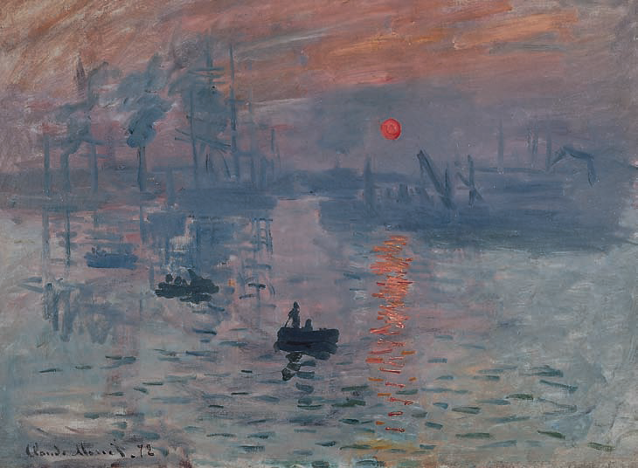
Impressionism and the Early Twentieth Century

Slide 2
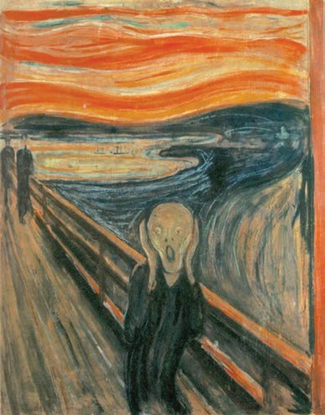
MUSIC OF THE TWENTIETH CENTURY AND BEYOND
The Scream\
Author | Edvard Munch
Source | Wikimedia Commons
License | Public Domain

Slide 3
OVERVIEW OF 20TH CENTURY MUSIC

Slide 4
MUSIC OF THE 20TH CENTURY AND BEYOND
Music, like the other arts, does not occur in a vacuum. Changes brought on by advances in science, and inventions resulting from these advances, affected composers, artists, dancers, poets, writers, and many others at the turn of the twentieth century. Inventions from the late Romantic era had a great impact on economic and social life in the twentieth century. These inventions included the light bulb, the telephone, the automobile, and the phonograph. Thomas Edison invented the phonograph in 1877 and patented it in 1878. While researching means to improve the telegraph and telephone, Edison developed a way to record sound on tinfoil-coated cylinders. He would speak into a mouthpiece and the recording needle would indent a groove into the cylinder. The playing needle would then follow the groove, and the audio could be heard through a horn speaker (in the shape of a large cone). Edison improved his invention and formed the Edison Speaking Phonograph Company to market the invention. Edison’s phonograph had an especially great influence on the spread of music to larger audiences; he also advertised the device’s usefulness for dictation and letter writing, recording books for the blind, recording, and archiving family members’ voices, music boxes, toys, and clocks that verbally announce the time with prerecorded voices. In 1917, such audio phonograph devices were purchased by the U.S. Army for $60 each and used to make troops feel closer to home during World War I.

Slide 5
MUSIC OF THE 20TH CENTURY AND BEYOND
What defines twentieth-century music? Clearly, the twentieth century was a time of great upheaval in general, including in music. The sense of rapid change and innovation in music and art of this period reflects the dramatic changes taking place in the world at large. On a political level, the twentieth century was one of the bloodiest and most turbulent periods in history. While wars are a constant throughout all human history, the global nature of twentieth-century politics resulted in conflicts on a scale never seen; World War II alone is widely regarded as the deadliest conflict in human history in terms of total deaths, partly due to advancements in technology such as machine guns, tanks, and eventually the atom bomb.
It’s no surprise that music of this period mirrored the urgency and turmoil in the world at large. For many composers, the raw emotion and sentimentality reflected in the music of the nineteenth century had grown tiresome, and so they began an attempt to push the musical language into new areas. Sometimes, this meant bending long-established musical rules to their very limits, and, in some cases, breaking them altogether.

Slide 6
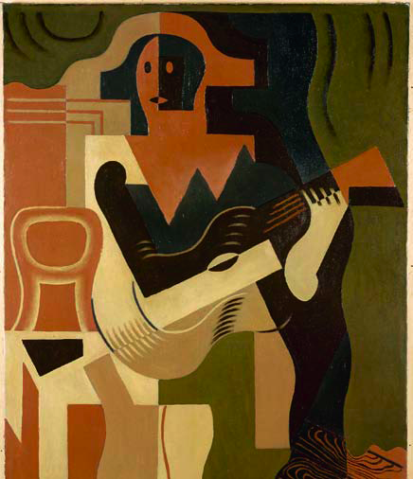
Modernism in the Arts
Impressionism
Symbolism
Dadaism
Cubism
Surrealism
Expressionism
Neoclassicism
Notes:
Arts in the early twentieth century unfolded through a variety of “isms”—for example: Impressionism, Symbolism, and Expressionism.
Each of these creative movements were marked by specific characteristics, in part, as reactions against Romanticism.
Impressionism was a French movement developed by painters focusing on play of light and color.
Symbolism was a literary response to Impressionism suggesting images and ideas.
Expressionism was represented by composers exploring new harmonic systems and extreme sonic registers.

Slide 7
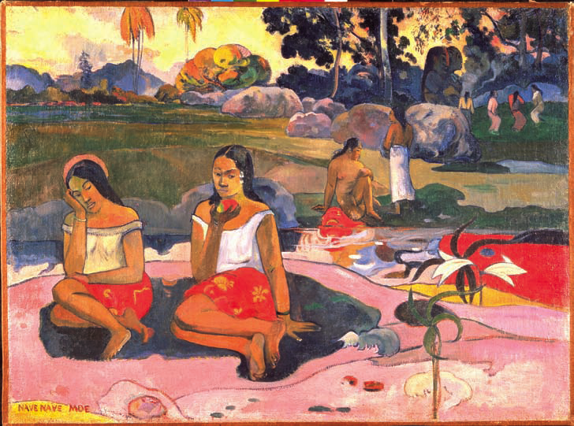
Modernism in the Arts The Reaction Against Romanticism
Escaping from refinement
– Adopted primitive, uninhibited, spontaneous style
Non-Western sources
Futurism, Dadaism
Surrealism, Cubism
Stravinsky: The Rite of Spring, “Dance of the Youths and Maidens”
Notes:
Early-twentieth-century music in the Modernist style was the product of a reaction against Romanticism.
Some Modernists sought to escape refinement and adopt a primitive uninhibited, spontaneous style. To this end, some turned toward non-Western sources (Africa, Asia, eastern Europe) for primal, powerful rhythms, and fresh concepts.
[Link to excerpt].
Futurism and Dadaism were arts movements emerging from the troubled environment surrounding World War I; these movements enabled artist to express alienation, dynamism, and the absurdity of war.
Eventually the Dad group merged into the school of Surrealism as represented by artists Salvador Dali and Joan Miró – exploring the world of dreams.
Cubism, another of the Modernist “isms” was embodied by the works of Pablo Picasso, wherein the visual world is represented in geometric patterns.

Slide 8
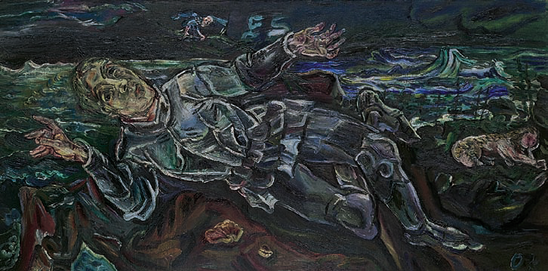
Modernism in the Arts Expressionism
Expressionism
– German response to Impressionism
– Subconscious, hallucinations, dreams
– Artists: Kandinsky, Klee, Kokoschka, Munch
Notes:
Expressionism was the counterpart to French Impressionism. While the French portrayed impressions of the outer world, Germanic inquiry explored the depths of the psyche.
Expressionism embodied ideas emergent from the subconscious mind with interest in hallucinations and dreams. This movement was influenced by the paintings of such artists as Kandinsky, Klee, Kokoschka, and Munch.

Slide 9
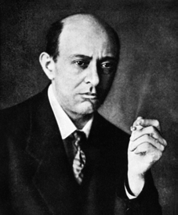
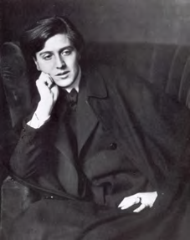
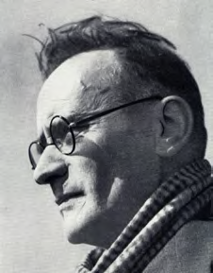
Modernism in the Arts Expressionism
Expressionist Composers
Arnold Schoenberg
Musical Characteristics Expressive harmony
Extreme ranges
Disjunct melodies
Alban Berg
Anton Webern
Notes:
Expressionist composers Arnold Schoenberg and his students Alban Berg and Anton Webern are referred to as the Second Viennese School, a title portraying the importance of their contributions to this movement and their place in Western music.
Expressionist music contains extremely expressive harmonies and extreme ranges for instruments and voices, as well as dramatically disjunct melodies.

Slide 10
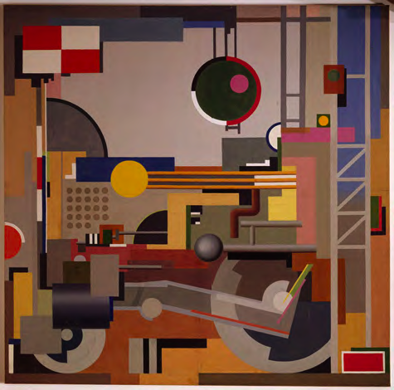
Modernism in the Arts Neoclassicism
Balance and objectivity
Formal structures
Early 1920s
Absolute music
Mechanic Rhythms (1937), Pierre
Notes:
Neoclassicism, clearly defined by the early 1920s, was a movement seeking to reject the grandiose and fantastical creations of the Romantic era. This was to be achieved through the revival of balance and objectivity in the arts.
Composers returned to formal structures of the past, such as those used by Bach and Handel, and preferred absolute music over program music. (Program music is about something—a poem, play, or painting, for example; absolute music is “music for it’s own sake”).

Slide 11
Impressionism and Post-Impressionism
“For we desire above all–nuance,
Not color but half-shades!
Ah! Nuance alone unites
Dream with dream and flute with horn.”
—Paul Verlaine
Notes:
Impressionist and Post-Impressionist music is distinguished by the use of modal and exotic scales, unresolved dissonances, and rich orchestral tone colors.
With Debussy representing Impressionism, and Ravel as Post-Impressionist, the distinction between these labels is vague and refers primarily to the chronology of the styles. Further, Post-Impressionist music, or “late Impressionism” is a bit more dissonant and angular.

Slide 12
Impressionism and Post-Impressionism
The two major composers associated with the Impressionist movement are Claude Debussy and Maurice Ravel. Both French-born composers were searching for ways to break free from the rules of tonality that had evolved over the previous centuries. Impressionism in music, as in art, focused on the creator’s impression of an object, concept, or event.
Claude Debussy
Claude Debussy was a French composer and pianist. Clearly talented at a young age, Debussy was admitted into the Paris Conservatory of Music at only 11-years-old, where he would remain for the next 12 years. Some of his most famous piano works were created in his later years. Debussy's piano preludes are often compared to those of Chopin.
Debussy, La Mer
https://www.youtube.com/watch?v=hlR9rDJMEiQ
Impressionist composers also liked using sounds and rhythms that were unfamiliar to most Western European musicians. One of the most famous compositions by Maurice Ravel is entitled Bolero. A Bolero is a Spanish dance in three-quarter time, and it provided Ravel with a vehicle through which he could introduce differ
Maurice Ravel
Maurice Ravel, Bolero
https://www.youtube.com/watch?v=A2BYkJS8GE0
Notes:
Impressionist and Post-Impressionist music is distinguished by the use of modal and exotic scales, unresolved dissonances, and rich orchestral tone colors.
With Debussy representing Impressionism, and Ravel as Post-Impressionist, the distinction between these labels is vague and refers primarily to the chronology of the styles. Further, Post-Impressionist music, or “late Impressionism” is a bit more dissonant and angular.

Slide 13
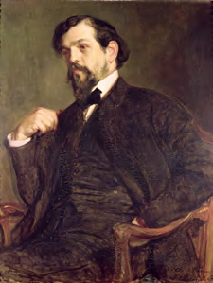
Impressionism and Post-Impressionism Debussy and Impressionism
French Impressionist Painters
– Monet
– Light and color
Claude Debussy
Notes:
Impressionism as a French movement in painting is represented by Claude Monet’s Impression: Sun Rising. Here, the painter captures changes in appearances of light and color.
Sound paintings created by composers such as Claude Debussy incorporated parallel movement of chords, exotic scales, and tone colors, as well as fluid rhythms to evoke the Impressionist spirit.

Slide 14
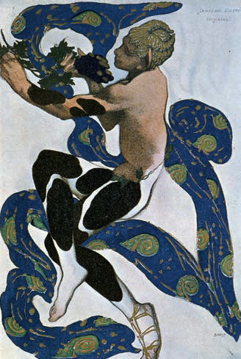
Impressionism and Post-Impressionism The Symbolist Poets
“Symbolism. . . . The secret of this movement is nothing other than this. . . . We were nourished on music, and our literary minds only dreamt of extracting from language virtually the same effects that music caused on our nervous system.”
—Paul Valéry
Literary response to Impressionism
– Charles Baudelaire
– Stéphane Mallarmé
– Paul Verlaine
– Arthur Rimbaud
Sound of a word as well as its meaning
Notes:
Symbollism is the literary movement that complements Impressionist painting and music.
This Symbolist style is represented by poets who were equally interested in the sound of a word, as well as its meaning. Leading Symbolist writers include Frenchmen Charles Baudelaire (1821–1867) and Stéphane Mallarmé (1842–1848)—who created the famous poem “The Afternoon of a Faun.”

Slide 15
Impressionism and Post-Impressionism Impressionism in Music
Impressionistic music characterized by:
– Ancient scales (church modes of the Middle Ages)
– Exotic scales (chromatic, whole tone)
– Unresolved dissonances
– Parallel chords, ninth chords
– Orchestral color
– Free rhythm
– Short lyric forms
Machaut: modally based
Debussy:“Voiles” (whole tone scales)
Debussy:“La cathédrale engloutie” (parallel scales)
Faure: Pelleas et Mélisande, “Sicilienne”
Notes:
Impressionism in music is characterized by technical innovation, mirroring that used in painting and literature.
Techniques include usage of modal and exotic scales, frequent unresolved dissonance, parallel chords, colorful orchestration, and free rhythm. [link to excerpts].
Impressionists turned away from large forms and preferred short lyric forms such as preludes, nocturnes, and arabesques.

Slide 16
Claude Debussy (1862–1918)
Impressionism and Post-Impressionism
– French composer
– Impressionist
– Paris Conservatory
– Prix de Rome
– Opera Pelléas and Mélisande (1902)
Debussy: Pélleas et Mélisande, Act I, Scene 3
“I am more and more convinced that music is not, in essence, a thing which can be cast into a traditional and fixed form. It is made up of color and rhythms.”
Notes:
Claude Debussy was perhaps the most important French composer of Impressionist music. He studied at the Paris Conservatory and at age 22 won the prestigious Prix de Rome.
Debussy’s opera Pelléas and Mélisande (1902) is based on a Symbolist drama and stands out as one of his great achievements. (Link to excerpt.)

Slide 17
Debussy’s output:
Impressionism and Post-Impressionism
Orchestral works:
– La mer
– Prelude to “The Afternoon
of a Faun”
Piano works:
– Clair de lune
– Evening in Granada
– Reflections in the Water
– The Sunken Cathedral
French songs
Chamber music
Notes:
Debussy composed slowly and thus produced a relatively small output.
His most recognized orchestral works are The Sea (La mer) and Prelude to “The Afternoon of a Faun,” each piece evoking Impressionist sensibilities.
His beloved piano works include colorful titles, such as Clair de lune, Evening in Granada, Reflections in the Water, and The Sunken Cathedral.
In addition, Debussy composed beautiful French songs and chamber music, such as the melodious String Quartet in G minor, as well as sonatas for cello and piano, violin and piano, and flute, viola, and harp—favorite instrumentations for the Impressionists.

Slide 18
Debussy: Prelude to “The Afternoon of a Faun”
Mallarmé pastoral poem
Mythological faun
Free ternary form
Chromatic melody
Notes:
Debussy’s popular Prelude to “The Afternoon of a Faun” is based on a Symbolist poem by Mallarmé —painting the pastoral story of a mythological faun, a man with the ears, horns, and hind legs of a goat.
A free ternary—three-part—form and chromatic melody contribute to the evocative mood of the piece.

Slide 19
Early Modern Musical Style The Early Twentieth Century
“To study music, we must learn the rules. To create music, we must break them.”
—Nadia Boulanger
Notes:
Nadia Boulanger (1887–1979) was a composer, conductor, and teacher holding influence on American music through such diverse students as Aaron Copland, Quincy Jones, and Philip Glass.

Slide 20
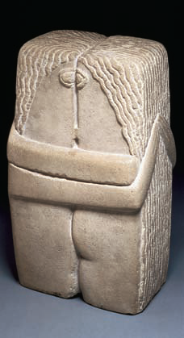
Early Modern Musical Style
The new rhythmic complexity
The new melody
The new harmony
Orchestration
New conceptions of form
Notes:
Early twentieth-century composers treated rhythm, melody, and harmony in new ways, expanding the palette of sound for musicians and audiences.
Furthermore, new sounds were elicited from the modern orchestra through careful instrumentation, while older, Baroque and Classical compositional forms were revived and revisited.

Slide 21
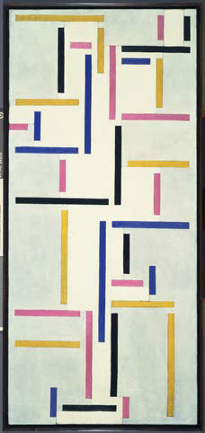
Early Modern Musical Style The New Rhythmic Complexity
Revitalization of rhythm
– Polyrhythm
– Polymeter
– Changing meters
– Irregular meters
Stravinsky: The Rite of Spring,
“Sacrifical Dance of the Chosen One”
Stravinsky: The Soldier’s Tale, I, “Soldier’s March”
Notes:
Composers of the early twentieth century sought to revitalize rhythm through use of polyrhythm and polymeter, as well as changing and irregular meters.
These techniques had not been explored to such a large extent in preceding style periods.
Igor Stravinsky (1882–1971) was a leader in rhythmic exploration during this time. [Link to excerpts.]

Slide 22
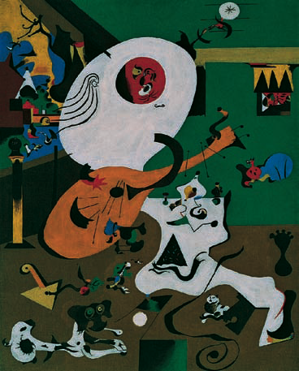
Early Modern Musical Style The New Melody
Symmetrical structure abandoned
Instrumental character
Wide leaps and dissonant intervals
Notes:
Twentieth-century composers embraced asymmetrical, angular phrases that contrasted particularly with the balanced phrases and repetitions of earlier music.
Melodies composed in the modern style exhibited an instrumental character in that wide leaps and dissonant intervals became more common, even in vocal music.

Slide 23
Early Modern Musical Style The New Harmony
Larger chords
Polyharmony
New conceptions of tonality
Twelve-tone method
Emancipation of dissonance
Notes:
New harmony found in early-twentieth-century music clearly sets apart the sounds of this era from earlier times. Where triads were the basic sound of traditional harmony, modern composers frequently utilized chords containing five, six, or seven notes.
The idea of expanded chords evolved into polyharmony, where one stream of harmony would play at the same time as a completely independent and often dissonant contrasting harmony.

Slide 24
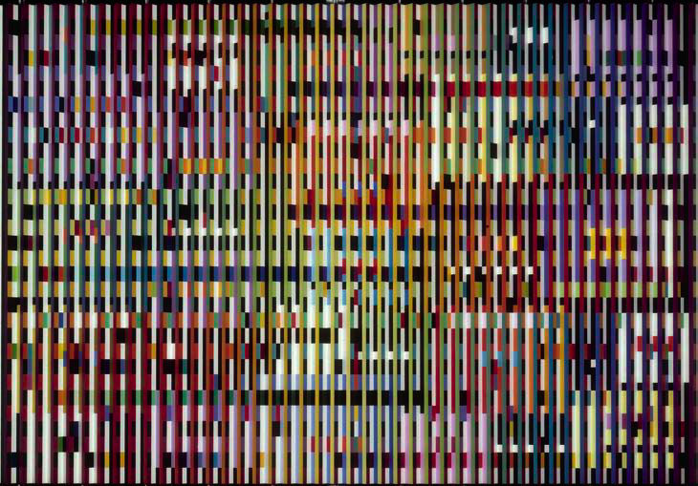
Early Modern Musical Style New Conceptions of Tonality
Major-minor system expanded and abandoned
Drive toward the tonic weakened
Church modes and non-Western music
Polytonality
Atonality
Notes:
New conceptions of tonality led composers to stretch or even abandon the major-minor system in favor of new systems, and the eventual “emancipation of dissonance.”
Earlier tonal music—particularly from the Baroque, Classical, and Romanic styles—created tension that usually would resolve. In the new music this perceived drive toward the tonic is weakened. This weakening of a central pitch was accomplished by several means, including increased interest in and application of church modes and non-Western music, and later, new systems of pitch organization.
In polytonality two or more simultaneous keys are sounded, creating new sonorities.
Eventually, atonality -- an abandonment of tonality – sounded in a way that all 12 tones are equal in importance. This technique is known as the twelve-tone method.

Slide 25
Early Modern Musical Style The Twelve-Tone Method
Serialism or dodecaphonic
Devised by Arnold Schoenberg
Strict, based on and unified by tone row
Tone row
Transposed
Inverted
Retrograde
Retrograde inversion
Notes:
The twelve-tone method, devised by Arnold Schoenberg (1874–1951), is alternately known as serialism or dodecaphonic music.
This strict system is based on the tone row—a specific arrangement of al 12 chromatic notes. In a highly formalized compositional technique, the chosen row can then be altered by transposition, inversion, retrograde, or retrograde inversion.
This means the original row can appear at a new pitch level—higher or lower—(transposition); upside-down (inversion), backward (retrograde), or backward and upside-down (retrograde inversion).

Slide 26
The Twelve-Tone Method
Original Row
#
#
#
#
#
Inversion
b
b
b
b
b
b
b
b
b
b
b
b
b
b
b
Retrograde
#
#
#
#
#
Retrograde Inversion
b
b
b
b
b
b
b
b
b
b
b
b
b
b
b
Notes:
This example demonstrates tone row and three of the permutations—or related rows—are derived, using the twelve-tone method.
Each of these new rows now become source material for the composer to create new melodies and harmonies.
The symmetrical relationships between the new rows are evident just by looking at the melodic contour on this score.

Slide 27
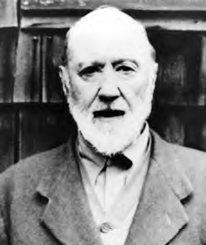
Early Modern Musical Style The Emancipation of Dissonance
Extreme dissonances
No obligation to resolve
“Every dissonance doesn’t have to resolve if it doesn’t happen to feel like it, any more than every horse should have its tail bobbed just because it’s the prevailing fashion.”
—George Ives, to his son Charles
Charles Ives
Notes:
The emancipation of dissonance was achieved by twentieth-century composers. This means that dissonant sonorities or sounds that required resolution in previous eras were gaining acceptance as sounds in their own right, without obligation to resolve to a consonance.
At the same time, extreme dissonances, through devices such as polyharmony and rich orchestration, were employed as part of the new musical language.

Slide 28
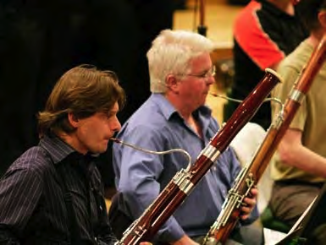
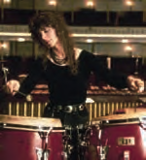
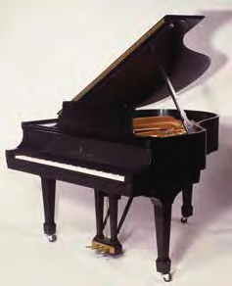
Early Modern Musical Style Orchestration
Percussion to the foreground
“Darker” timbre instruments
trombone
bassoon
viola
Piano as an orchestral instrument
Notes:
In response to the rich sonorities of nineteenth-century orchestration, early-twentieth-century music was often presented through a leaner, smaller orchestra.
The string section was no longer the “heart” of the orchestra, and many composers favored the darker instruments, such as the viola, bassoon, and trombone.
Emphasis on rhythm brought the percussion to the foreground, and the piano transcended solo-instrument status to a place in the orchestral ensemble.

Slide 29
Early Modern Musical Style New Conceptions of Form
Neoclassicism: Classical virtues
Absolute music
Older forms (fugue, toccata, concerto grosso, etc.)
Organization and succinctness
Formalism
Notes:
While the sonic palette expanded through new tonal organization, a return to Classical virtues shaped the formal structures of early-twentieth-century music.
Absolute music, or music-for-music’s-sake, re-emerged after the frequent appearance of program music in the Romantic era. Older forms from the Baroque and Classical periods returned, including fugues and concerto grosso, while traditional forms such as symphonies and concertos remained vibrant.
Composers sought organization and succinctness through balance and objectivity.
The value of orm over expression is known as formalism, a sensibility employed by many Modernist composers.

Slide 30
Music of the Early Modernists
“I hold that it was a mistake to consider me a revolutionary. If one only need break habit in order to be labeled a revolutionary, then every artist who has something to say and who in order to say it steps outside the bounds of established convention could be considered revolutionary.”
—Igor Stravinsky
Notes:
Early Modernism in music was embodied chiefly in the works of Stravinsky, Schoenberg, and Berg.
While each had an outstanding, unique expression, they shared innovative Modernist sensibilities, including complex rhythms and textures, as well as angular melodies and unprecedented use of dissonance.

Slide 31
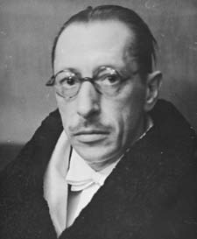
Music of the Early Modernists Stravinsky and the Revitalization of Rhythm
Igor Stravinsky (1882–1971)
Russian composer
Embodied the most significant impulses of his time
Studied with Rimsky-Korsakov
Serge Diaghilev and Russian Ballet
– Firebird (1910)
– Petrushka (1911)
– The Rite of Spring (1913)
near riot
Stravinsky: The Rite of Spring, “Sacrificial Dance of the Chosen One”
Notes:
Russian composer Igor Stravinsky (1882–1971) embodied the most significant impulses of his time. For half a century his work reflected the main currents of twentieth-century music.
Stravinsky studied music with Nicolai Rimsky-Korsakov at the University of St. Petersburg.
Early in Stravinsky’s career, the legendary impresario of the Ballets Russes , Serge Diaghilev, commissioned 3 ballets: The Firebird (1910),
Petrushka (1911), The Rite of Spring (1913).
During opening night of The Rite of Spring a near riot broke out due to the audience reaction to this dramatic, innovative music. [Link to excerpt]

Slide 32
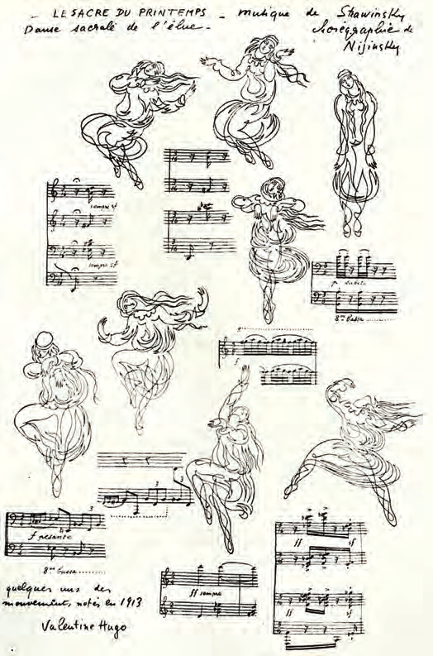
Music of the Early Modernists Stravinsky and the Revitalization of Rhythm
1920: France
1939: U.S.—Los Angeles
1945: Became an American citizen
Died in 1971 at the age of 89
Stravinsky: The Soldier’s Tale, I, “Soldier’s March”
Notes:
In 1920, Stravinsky settled in France and remained for nearly 20 years. During this time he travelled throughout Europe performing on piano and conducting his own music.
At the outbreak of World War II, he settled in Southern California outside of Los Angeles, and in 1945, became an American citizen.
Stravinsky died in New York on April 6, 1971 at the age of 89.
(Pictured is Valentine Hugo’s (1887–1968) sketches of the Sacrificial Dance from the ballet The Rite of Spring, choreographed by Nijinsky.)

Slide 33
Music of the Early Modernists Stravinsky’s Music
Changing trends
– Post-Impressionism
– Neoclassicism
– Serialism, etc.
Revitalization of rhythm
Neoclassical period
– Oedipus Rex
– Symphony of Psalms
– The Rake’s Progress (Hogarth)
Twelve-tone music
– Threni: Lamentations of the Prophet Jeremiah
Notes:
Changes in Stravinsky’s music parallels changing trends during the twentieth century. For example, at various times he composed post-Impressionism, neoclassicism, and serialism.
Stravinsky was a leader in the revitalization of rhythm, as evident in compositions such as The Rite of Spring, and was considered one of the great orchestrators, due to his innovative sonic creations.
His early works demonstrate nationalism, where folk melodies and lore permeate The Firebird and Petrushka—a Russian story about a puppet come to life.
Works emerging from Stravinsky’s Neoclassical period include Oedipus Rex, an opera-oratorio based on a Greek tragedy, and Symphony of Psalms for chorus and orchestra, a chief work of his mature period.
Late in life, Stravinsky composed twelve-tone music as in his choral work Threni: Lamentations of the Prophet Jeremiah.

Slide 34
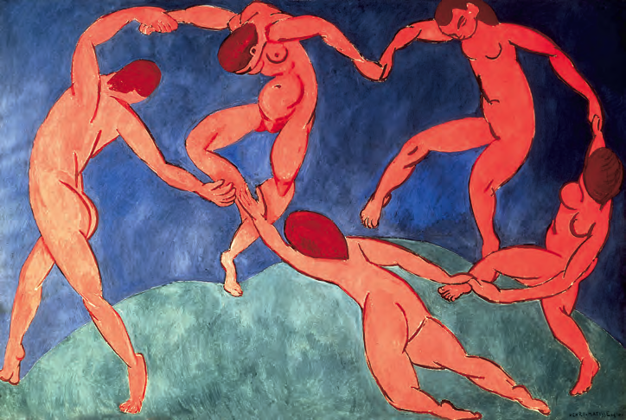
Music of the Early Modernists Stravinsky: The Rite of Spring
Scenes of Pagan Russia
Expanded ensemble
Russian folk songs
Primitivistic theme and rhythm
Liberated from metric regularity
Notes:
Stravinsky’s ballet The Rite of Spring is a fine example of his revitalization of rhythm.
This work, subtitled Scenes of Pagan Russia, boasts an expanded ensemble (eight French Horns, five trumpets, five of each woodwind, a battery of percussion), all contributing to a new musical language, including dissonance, polyrhythm, and polytonality.
Throughout the composition, melodies modeled after Russian folk songs are heard, occasionally in original form, but often fragmented, or varied, evoking primitivistic themes and rhythms.
Innovative accents and energetic rhythms interact in ways that liberate Stravinsky's music from the traditional constraints of Western music’s metric regularity.

Slide 35
Music of the Early Modernists Stravinsky: The Rite of Spring
“Mild protests against the music could be heard from the very beginning of the performance. . . . The uproar continued, however, and a few minutes later I left the hall in a rage. . . . I have never again been that angry. The music was so familiar to me; I loved it, and I could not understand why people who had not yet heard it wanted to protest in advance.”
Stravinsky: The Rite of Spring, “Dance of the Youths and Maidens”
Notes:
In an interesting reaction, some audience members at the opening night of The Rite of Spring were so shocked and surprised by what they heard that mild protests gradually escalated to an uproar.
Stravinsky left the building in a rage, unable to comprehend this response, especially before the audience had heard the entire score.
Today The Rite of Spring is regarded as an undisputed masterpiece of the twentieth century.
[Link to Excerpt]

Slide 36
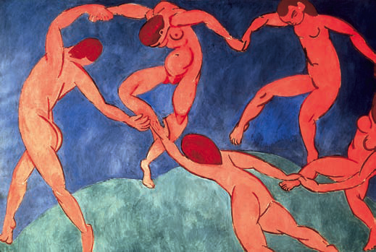
Music of the Early Modernists Stravinsky: The Rite of Spring
Adoration of the Earth
– Bassoon melody
The Dance of the Youths and Maidens
– Dissonant chords, elemental pounding, polytonal harmonies
Game of Abduction
– Syncopated accents
– Loud chords and sustained trill end the movement
Notes:
Listen to excerpts from Part I of The Rite of Spring.
The opening section, Adoration of the Earth begins with bassoon melody in the uppermost range.
In the ensuing Dance of the Youths and Maidens, strings play dissonant chords, and an elemental pounding is heightened by the use of polytonal harmonies.
Later, in the section called Game of Abduction a frenetic and primitive melody is established at a fast tempo through quickly shifting instrumental colors.
[Link to Listening Guide]

Slide 37
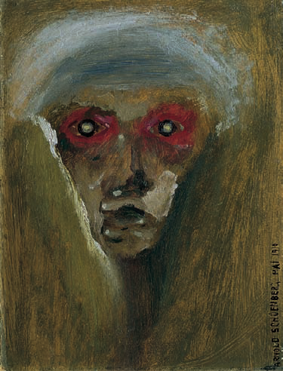
Music of the Early Modernists Schoenberg and the Second Viennese School
German Expressionism – Arnold Schoenberg and his followers
Second Viennese School
– Schoenberg
– Alban Berg
– Anton Webern
Notes:
Composer Arnold Schoenberg (1874–1951) became influenced by Expressionist painters, such as Edvard Munch and Wasilly Kandinsky, who were interested in delving into the depths of the mind—and expressing innermost workings.
The Expressionist style in music was spearheaded by Schoenberg and his students, Alban Berg and Anton Webern, who collectively are referred to as the Second Viennese School, on account of their creative endeavors in early-twentieth-century Vienna.

Slide 38
Music of the Early Modernists Arnold Schoenberg (1874–1951)
Austrian composer, conductor, teacher, artist
Largely self-taught
Atonality and serial composition
Teacher of Alban Berg, Anton Webern
Emigration to the United States
Los Angeles: USC and UCLA
Notes:
Arnold Schoenberg (1874–1951), active composer, conductor, teacher, artist, was largely self-taught, and after exploring atonality, became the founder of serial or twelve-tone composition.
His famous students include Alban Berg and Anton Webern, who, with Schoenberg, are known as The Second Viennese School (the First Viennese School was Haydn, Mozart, and Beethoven).
After Hitler came to power in Germany, Schoenberg emigrated to the United States in 1933, where he joined the faculty of USC and was later appointed professor of composition at UCLA in Los Angeles.

Slide 39
Music of the Early Modernists Arnold Schoenberg (1874–1951)
Many of the early works of Austrian-born Arnold Schoenberg (1874-1951) exemplified an expressionistic musical style. He is most famous for his experiments with atonality, that is, music without a tonal center. His music was highly dissonant and sounded quite radical when compared to earlier music, which utilized dissonance only to eventually return to the stasis of consonance. However, Schoenberg saw dissonance not to an end, but as the end itself. His music invited the listener to revel in various levels of dissonance, and many listeners were never able to adjust.
Schoenberg famously developed a system whereby the twelve notes of the chromatic scale were randomly organized into scale units that he called the twelve-tone row. These rows could then be further “serialized” (organized in random fashion) by several different techniques. This idea of assigning values to musical information is called serialism.
Notes:
Arnold Schoenberg (1874–1951), active composer, conductor, teacher, artist, was largely self-taught, and after exploring atonality, became the founder of serial or twelve-tone composition.
His famous students include Alban Berg and Anton Webern, who, with Schoenberg, are known as The Second Viennese School (the First Viennese School was Haydn, Mozart, and Beethoven).
After Hitler came to power in Germany, Schoenberg emigrated to the United States in 1933, where he joined the faculty of USC and was later appointed professor of composition at UCLA in Los Angeles.

Slide 40
Schoenberg’s ideas were further developed by his two famous students, Alban Berg, and Anton Webern. Together, the three came to be known as the Second Viennese School, in reference to the first Viennese School, which consisted of Haydn, Mozart, and Beethoven. Born in Vienna, Alban Berg began studying with Schoenberg at the age of 19 and soon became known for his unique compositional style, which fused post-romantic concepts with Schoenberg’s cutting-edge twelve-tone techniques. Heavily influenced by Richard Wagner, Berg held on to techniques such as the leitmotif and sought to couch his harmonic ideas in tried-and-true forms such as the sonata and fugue. Although he composed many famous pieces, such as his Violin Concerto and his unfinished opera Lulu, he initially made his fame with Wozzeck, an opera based on the drama Woyzeck by German playwright Georg Buchner. Berg served during World War I, and much of Wozzeck was composed in 1917, during a period of leave from the Austro-Hungarian Army. The opera consists of three acts, each with five scenes organized around the variations of a musical idea, such as the variations of a theme, a chord, or a rhythmic pattern. Berg himself adapted the libretto from Buchner’s original play.
The story of the opera centers on the title character Wozzeck. Like the main character in many romantic operas, he is a tragic figure. However, whereas the operas of the nineteenth century often depicted gods and mythical figures, the story of Wozzeck is couched in a sense of realism and addresses the type of societal problems that Berg may himself have encountered during World War I, problems such as apathy and human cruelty. The character of Wozzeck is that of a pitiful and unremarkable soldier who is tormented by his captain and used for and subjected to medical experiments by a sadistic doctor. Wozzeck, who is often given to hallucinations, eventually goes mad and kills his love interest, Marie, who has been unfaithful. The opera ends after Wozzeck drowns trying to clean the murder weapon in a pond and wading out too far.

Slide 41
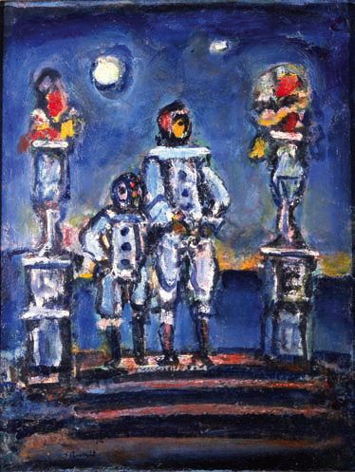
Schoenberg: Pierrot lunaire
Song cycle
Albert Giraud (German translation)
Sad clown obsessed with the moon
Voice and varied chamber ensemble
Atonal work
No distinction between consonance and dissonance
Sprechstimme
Klangfarbenmelodie
Notes:
Schoenberg’s song cycle from 1912, Pierrot lunaire features texts by Albert Giraud. It is the tale of a sad clown obsessed with the moon, which captures the expressive distortion and exaggeration of the Expressionist style.
Pierrot lunaire is an atonal work for voice and chamber ensemble, whose tonal language is lost between consonance and dissonance: there is no home key.
Schoenberg incorporated new compositional devices in this work: Sprechstimme—a spoken-voice style—and Klangfarbenmelodie —a technique where the individual pitches of the melody are passed rapidly from one instrument to another—create a tone-color melody.

Slide 42
“The Moon-fleck”
Voice and five instruments
Contrapuntal and dissonant
Atonality expresses frustration
Sprechstimme notation
Notes:
Pierrot lunaire (Moonstruck Pierrot) is comprised of 21 short songs.
No. 18, “The Moonfleck,” is contrapuntal and dissonant, written for voice and five instruments (piccolo, clarinet, violin, cello, and piano).
Pierrot’s frustration caused by a fleck of moonlight on his black jacket is expressed in the atonality of the melody, and the Sprechstimme applied to the recitation of the text. [Link to Listening Guide]

Slide 43
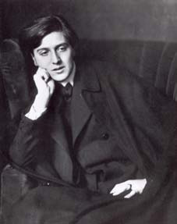
Music of the Early Modernists Berg and Early-Twentieth-Century Opera
Berg humanized atonality and serialism
Alban Berg (1885–1935)
Student of Schoenberg
Austrian composer and teacher
Served in the military during World War I
Second Viennese School
Hitler banned the works of 12-tone composers
Died at 50 (insect bite)
Notes:
Alban Berg (1885–1935), a leading student of Schoenberg, was an Austrian composer and teacher. He was drawn to Expressionist themes and humanized the abstract methods of atonality and serialism by infusing them with feeling.
Berg’s military service during World War I, combined with his ardent support of composition techniques of the Second Viennese School, led to a creative, sometimes dark, outpouring of music in tune with the Expressionist sensibilities.
Just as Berg reached artistic maturity, Hitler banned the works of 12-tone composers in Germany.
Retreating to the country to recover from the exhaustive work on his famous Violin Concerto, Berg died an unfortunate death at 50 of blood poisoning from an insect bite.
Berg’s opera Lulu remained unfinished at his death and was completed by the Austrian composer Friedrich Cerha. It was premiered by conductor Pierre Boulez in Paris in 1979.

Slide 44
Music of the Early Modernists Berg’s Music
“When I decided to write an opera, my only intentions . . . were to give the theater what belongs to the theater. . . . The music was to be so formed as consciously to fulfill its duty of serving the action at every moment.”
—Alban Berg
German Romanticism
Formal patterns of the past
Atonality and serialism of Schoenberg
Lyric Suite
Two operas:
– Wozzeck
– Lulu
Notes:
While Berg’s music is rooted in German Romanticism, leaning towards formal patterns of the past, he eventually adopted the atonality and serialism of Schoenberg.
Berg’s best- known works include the Lyric Suite (a work in six movements), Violin Concerto, and two operas: Wozzeck and Lulu.

Slide 45
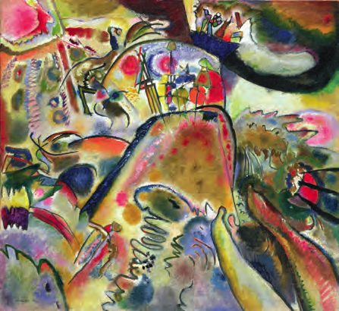
Berg: Wozzeck
Expressionist play by Georg Büchner
Berg wrote the libretto
Atonal harmony, leitmotifs, Sprechstimme
Scene 4 of Act III
– Wozzeck returns to scene of crime, hallucinates, commits suicide
Eerie mood created by unusual instrument combinations
Notes:
Berg’s opera Wozzeck is based on an Expressionist play by Georg Büchner, inspired by real-life events. Berg himself wrote the libretto, which was a large undertaking for the composer.
As the plot unfolds, Wozzeck’s unhappy love affair and resulting tragic events are portrayed with atonal harmony, use of leitmotifs, and incorporation of Sprechstimme.
In Scene 4 of Act III, Wozzeck returns to the scene of the crime, hallucinates, and commits suicide. An eerie mood is created by celeste and unusual instrument combinations, as well as colorful orchestral effects.
Artwork: Expressionist painter Wassily Kandinsky (1886–1944) defied notions of beauty in order to define the artist’s inner self. Small Pleasures (1913).

Slide 46
European National Schools
England
Russia
France
Germany
Spain
Scandinavia
Hungary
“ Folk songs bind the nation, bind all nations and all people with one spirit, one happiness, one paradise.”
—Leoš Janáček
Notes:
National “schools” of composition developed in France, Russia, England, Germany, Spain, Scandinavia, and Hungary.
The twentieth-century nationalists used authentic folk and traditional elements in their music.
Ethnomusicologists, those who study music in its cultural context, recorded authentic folk performances. In turn, these folk elements permeate the national music of the twentieth century.

Slide 47
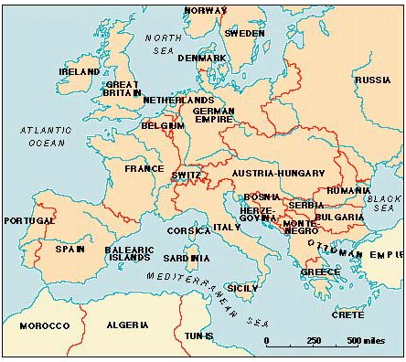
European National Schools
England:
Elgar
Delius
Vaughan Williams
Britten
Notes:
The modern English school is represented by Benjamin Britten (1913–1976).
His key works include Variations and Fugue on a Theme of Purcell (The Young Person’s Guide to the Orchestra), and operas, Billy Budd (1951) and Peter Grimes (1945).

Slide 48
European National Schools
Russia:
Prokofiev
Shostakovich
Prokofiev: Op 25, III
Notes:
The Russian school is represented by Sergei Prokofiev (1891–1953), with works such as Peter and the Wolf and his film score to Lieutenant Kijé, and composer Dimitri Shostakovich (1917–1991) whose symphonies and operas established his international reputation.

Slide 49
European National Schools
France: Les Six
Satie
Milhaud
Honegger
Tailleferre
Poulenc
Auric
Notes:
The French group known as Les Six (The Six) promoted new concepts of harmony with Neoclassical ideals.
These six composers are Darius Milhaud, Francis Poulenc, Eric Satie, Arthur Honegger, Georges Auric, and the only female member of Les Six, Germaine Tailleferre.

Slide 50
European National Schools
Germany:
Hindemith
Orff
Weill
Notes:
In Germany, composers Paul Hindemith (1895–1963), Carl Orff (1895–1982), and Kurt Weill (1900–1950) embodied German nationalism.

Slide 51
European National Schools
Hungary:
Bartók
Kodály
Notes:
In Hungary, Béla Bartók (1881–1945) and Zoltán Kodály (1882–1967) travelled the countryside of Eastern Europe in search of national musics to record on the early cylinder machine—one of the first portable recording devices.
It was this folk music that inspired many of the melodies and rhythms in Bartók’s music.

Slide 52
PRIMITIVISM IN MUSIC
The brilliant Igor Stravinsky (1882-1971) was truly a cosmopolitan figure, having lived and composed in Russia, France, Switzerland, and the United States. His music influenced numerous composers, including the famed French composition teacher Nadia Boulanger. Stravinsky caused quite a stir when the ballet entitled The Rite of Spring premiered in Paris in 1913. He composed the music for a ballet that was choreographed by Sergei Diaghilev, and it was so new and different that it nearly caused a riot in the audience. The orchestral version (without the dancing) has become one of the most admired compositions of the twentieth century. Stravinsky’s use of “primitive” sounding rhythms to depict several pagan ritual scenes makes the term “primitivism” seem appropriate. Use the listening guide below to follow Stravinsky’s The Rite of Spring.
For audio, go to: https://www.youtube.com/watch?v=s7pV2cX0qxs
NEOCLASSICISM
In the decades between World War, I and World War II, many composers in the Western world began to write in a style we now call Neoclassicism. When composing in a neoclassic manner, composers attempted to infuse many of the characteristics of the classic period into their music, incorporating concepts like balance (of form and phrase), economy of material, emotional restraint, and clarity in design. They also returned to popular classical forms like the Fugue, the Concerto Grosso, and the Symphony. Numerous well-known composers incorporated neoclassic techniques and philosophy into their compositions. Stravinsky was among them, and his ballet entitled Pulcinella (1920) is an early example of neoclassical style. It was based on music that Stravinsky originally thought was written by the Baroque composer Giovanni Pergolesi. Music historians later deduced that the compositions were written by contemporaries of Pergolesi and not by Pergolesi himself. Stravinsky borrowed specific themes from these earlier works and combined them with more modern harmonies and rhythms.

Slide 53
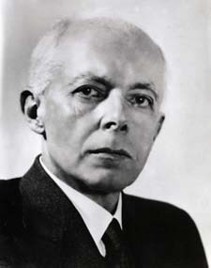
European National Schools Béla Bartók and the Eastern European Tradition
Béla Bartók (1881-1945)
Hungarian composer
Studied folklore
Emigrated to United States in 1940
Leukemia
ASCAP
Died in New York City at 64
Notes:
Béla Bartók (1881–1945) was a Hungarian composer who rejected the late Romanic tradition in search of a personal musical language.
As a nationalist composer, Bartók demonstrated interest in folklore and travelled to remote villages of the country to collect native songs.
He emigrated to the United States in 1940 to avoid the trouble of World War II.
While suffering from leukemia, Bartók received help from the American Society of Composers, Authors, and Publishers (ASCAP), during which time he composed some of his greatest works.
Bartók died in New York City at age 64.

Slide 54
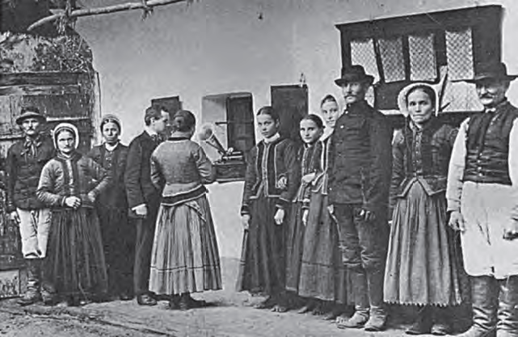
Bartók’s Music
Logic and beauty of Classical form
Musical language based on Eastern European traditional music
New scales, polytonal harmonic language
“Tyrannical rule of the major and minor keys”
Rhythmic innovator, changing meters, syncopations
Notes:
Bartók’s Music adhered to the logic and beauty of Classical form, while pioneering a new musical language based on Eastern European traditional music.
New scales and polytonal harmonic language freed his compositions of the “tyrannical rule of the major and minor keys.”
Bartók was a rhythmic innovator, incorporating frequently changing meters and extreme syncopations.

Slide 55
Bartók: Concerto for Orchestra
Boston Symphony Orchestra
Five movements
I: Introduction, sonata-allegro, pentatonic scale
II: Game of Pairs, pairs of winds
III: Elegia, nocturne
IV: Interrupted Intermezzo, theme from Shostakovich’s Symphony No. 7
V: Sonata-allegro form
Notes:
Bartók’s masterpiece Concerto for Orchestra was commissioned by the Boston Symphony Orchestra.
The work, set in five movements, is called a concerto because he treated “the single orchestral instruments in a concertante or soloist manner.”
I: Introduction, sonata-allegro, use of folk-like pentatonic scale
II: Game of Pairs, featuring different pairs of winds
III: Elegia, contemplative and rhapsodic nocturne
IV: Interrupted Intermezzo, one theme borrowed from Shostakovich’s Symphony No. 7
V: Sonata-allegro form

Slide 56
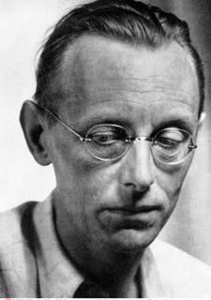
European National Schools The German Composer Carl Orff
Carl Orff (1895–1982)
German composer, educator
Continued music activity in Nazi Germany
Interest in early music, medieval Latin lyrics, German folk song
Vigorous rhythmic style, folk-like nature, dissonant but tonal
Output: Stage works, trilogy of cantatas, Lieder, orchestral music
Notes:
Carl Orff (1881–1945) was a German composer and educator.
Although his school for music and dance was closed by the Nazis in 1944, he continued to be musically active in Nazi Germany.
Orff demonstrated specific interest in early music, such as operas by Monteverdi, along with a focus on Latin lyrics.
His music is flavored with German folk songs with vigorous rhythm, while his harmonic vocabulary is largely tonal.
Orff’s output includes stage works, a trilogy of cantatas, Lieder, and orchestral music.

Slide 57
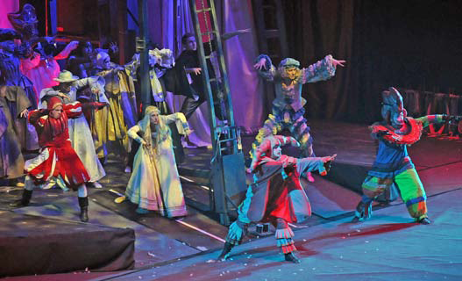
Orff’s O fortuna from Carmina burana
Orff’s Carmina burana (1936)
secular cantata in 5 scenes
chorus, soloists, and large orchestra
O fortuna, from Carmina burana
– three large strophes, highly repetitive
– evokes Fortuna, goddess of luck
– persistent, asymmetrical offset accents
– strong, primeval rhythmic drive throughout
Notes:
Orff’s Carmina burana is a secular cantata in 5 scenes, completed in 1936.
This work for chorus, soloists, and large orchestra features racy medieval lyrics with moralizing and satirical themes.
Listening Guide 45 outlines O fortuna, from Carmina burana. This section is driven by three large, highly repetitive strophes (stanzas).
This movement evokes Fortuna, the goddess of luck, beginning with a dramatic choral opening that evokes archaic music.
Next, a persistent chant emerges, with asymmetrical offset accents; unceasing pedal point and a strong, primeval rhythmic drive.
This piece has become a cliché for action scenes in movie trailers because of it’s effective dramatic nature.

Slide 58
American Modernism in Music
Outgrowth of British military band
Wind bands: First as Revolutionary War regimental bands
U.S. Marine Band, founded in 1798
Civil War regiments marched to brass bands
John Philip Sousa (1854–1932)
“Armies of men… have turned to a better life by first hearing the sounds of a Salvation Army Band. The next time you hear a Salvation Army Band, no matter how humble, take off your hat.” —John Philip Sousa
Notes:
Wind bands, popular throughout the United States in the eighteenth century, were an outgrowth of British military bands. The U.S. Marine Band, founded in 1798, was the most famous of these bands.
During the Civil War era (1861– 65), military regiments marched to brass-band music.
John Philip Sousa (1854 – 1932) was the most famous bandmaster and conductor of the U.S. Marine Band. Known as “The March King,” Sousa composed over 130 marches including “The Stars and Stripes Forever.”

Slide 59
American Modernism in Music The Modernist Charles Ives
Charles Ives (1874–1954)
Connecticut-born composer, businessman
Studied composition at Yale
Entered insurance business, composed in spare time
Delayed recognition, Pulitzer Prize in 1947
Notes:
Charles Ives (1874–1954), a Connecticut-born composer, was the son of a U.S. Army Civil War band leader.
Although Ives did study composition at Yale, he entered the insurance business as a profession and composed in his spare time.
At first his music not well-received, and so he privately printed and distributed select works.
After years of composing in his own style, Ives eventually earned public recognition and won the Pulitzer Prize in 1947 for his Third Symphony.

Slide 60
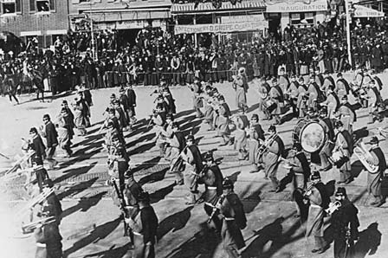
American Modernism in Music The Modernist Charles Ives
Innovative use of familiar tunes
Polytonality, polyharmony, polyrhythm
Ideas derived from clashing marching bands
Orchestral music, more than 100 songs, chamber and piano music
Notes:
As a modernist composer, Ives made innovative use of familiar tunes from his childhood, such as patriotic songs and marches.
He embellished these familiar tunes with the new polytonality, polyharmony, and polyrhythm.
His ideas came from growing up in New England, where he would often hear one band playing while a different marching band passed by. He was inspired to write the sound of two contrasting compositions occurring simultaneously. This naturally created dissonance and chaos.
During his lifetime, Ives composed orchestral music, more than 100 songs, as well as chamber music and piano music.

Slide 61
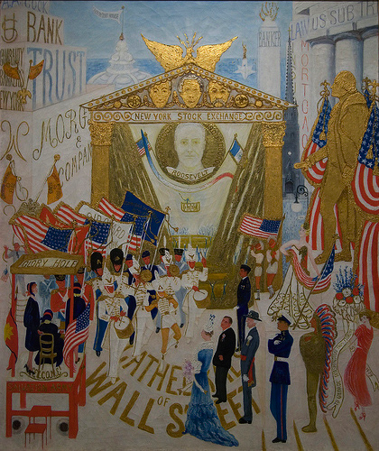
American Modernism in Music The Modernist Charles Ives
Ives’s Country Band March
– Work for large wind ensemble
– Realism of amateur band
– Nostalgic American tunes quoted
Notes:
Ives’s Country Band March, a work for large wind ensemble, demonstrates his uniquely American approach to modernism.
In this forceful march, Ives imitates the realism of an amateur band by composing out-of-tune passages, bad entrances, and wrong notes.
As typical in a number of works by Ives, nostalgic American tunes are quoted within the Country Band March. He includes fragment of melodies, such as Yankee Doodle, in addition to tunes from several Sousa marches.

Slide 62
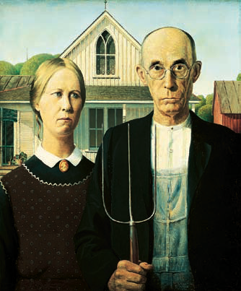
The Modernist Charles Ives
Ives’s Country Band March (1903)
Harshly dissonant
Polytonal
Humorous
Notes:
While Ives’ Country Band March (1903) is essentially a forceful march, much of the harmony is harshly dissonant and polytonal.
In spite of the serious harmonic vocabulary, Ives creates a humorous expression by simulating the sound of an authentic, amateur country band, while infusing nostalgic American tunes.
Ives eventually earned the affectionate title “grand old man” of American music.
[Link to Listening Guide]

Slide 63
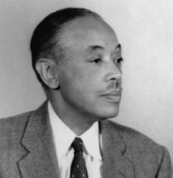
Nationalism in the Americas
William Grant Still and Harlem Renaissance
Aaron Copland—America
Silvestre Revueltas—Mexico
Mexican mariachi ensemble
“A nation creates music—the composer only arranges it.”
—Mikhail Glinka
Notes:
Three unique composers representing nationalism in the Americas are William Grant Still, Aaron Copland, and Silvestre Revueltas.
African-American composer William Grant Still is representative of the Harlem Renaissance movement.
Aaron Copland, a most prolific American composer, used early American song to create music for a famous ballet.
The music of Mexican composer Silvestre Revueltas is nationalistic, incorporating folk rhythms and melodies set in a dissonant idiom.

Slide 64
Nationalism in the Americas William Grant Still: African-American Composer
William Grant Still (1895–1978)
African-American composer, violinist
Studied composition with Edgar Varèse
Most important musical voice of Harlem Renaissance
Afro-American symphony (1930)
150 compositions span most genres
Notes:
William Grant Still (1895–1978), an African-American composer and violinist, studied music with French expatriate Edgar Varèse.
The cultural movement of the 1920s and ‘30s celebrating African-American arts is called the “Harlem Renaissance.”
Because he broke artistic and racial barriers, Still is perhaps the most important musical voice to emerge from the Harlem Renaissance.
Still’s Symphony No. 1, Afro-American (1931), is the first large work composed by an African-American and performed by major American orchestra.
With over 150 compositions spanning most genres, Still’s music is infused with elements of spirituals, blues, and jazz.

Slide 65
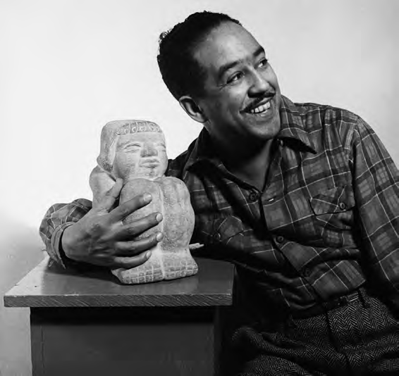
Nationalism in the Americas William Grant Still: Suite for Violin and Piano
Three movements, each inspired by African-American sculptures
Bluesy, modal harmonies
Syncopations and Harlem stride piano
Resembles jazz
Notes:
Stills’s Suite for Violin and Piano is a work in three movements, each inspired by African-American sculptures.
The tone of the piece is bluesy, with modal harmonies and a flashy syncopated violin line.
Infused with Harlem stride piano, this piece resembles jazz improvisation.
(Pictured: African-American poet Langston Hughes (1902–1967)

Slide 66
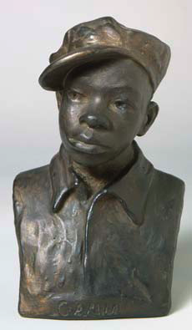
William Grant Still: Suite for Violin and Piano
Stills’s Suite for Violin and Piano
Third Movement (1943)
– Gamin by Augusta Savage
–“Rhythmically and humorously”
– Quick meter, syncopated chords
– Violin effects
Notes:
Stills’s Suite for Violin and Piano, Third Movement, (1943) was inspired by the sculpture Gamin by Augusta Savage, an important Harlem Renaissance artist.
Notations “rhythmically and humorously” are marked in the music by the composer in order to express the character of the boy depicted by the sculpture.
The quick meter, with highly syncopated offbeat chords, creates a jazzy effect.
The timbre of this movement is colored with violin effects such as glissandos and trills.
Pictured: Gamin, a sculpture by Augusta Savage (1900–1962).

Slide 67
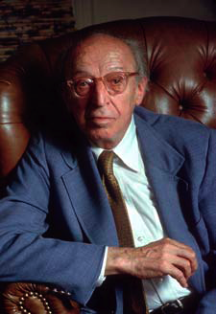
Nationalism in the Americas Aaron Copland: American Nationalist
Aaron Copland (1900–1990)
American composer
Paris, Nadia Boulanger
Jazz idioms
Neoclassicism and 12-tone composition
Piano pieces, orchestral works, ballets, film scores
Notes:
American composer Aaron Copland (1900–1990) studied in Paris with Nadia Boulanger during his early twenties. He was her first American student.
After his return from Paris, Copland Incorporated jazz idioms in his works, culminating in his brilliant Piano Concerto.
Later, he experimented in Neoclassicism with works such as Statements for Orchestra, and 12-tone composition in Connotations for Orchestra.
Copland’s prolific catalog of music includes piano pieces, orchestral works, ballets, and film scores.

Slide 68
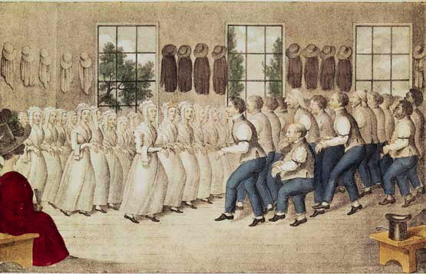
Nationalism in the Americas Aaron Copland: Appalachian Spring, excerpts
Copland’s Appalachian Spring (1945)
Composed for ballet, performed as a suite
Pioneer celebration in spring
Quotes Shaker melody, Simple Gifts
Notes:
Copland’s Appalachian Spring (1945) was composed as a ballet, which was the basis for this popular orchestral suite.
The story takes place in the early nineteenth century, in rural Pennsylvania, and portrays a pioneer celebration in Spring.
In tribute to early American music, Copland quotes the Shaker melody, Simple Gifts.

Slide 69
Aaron Copland: Appalachian Spring, excerpts
Section 1:
– Very slow, tranquil
– Solos in various woodwinds and trumpet
Section 7:
– Theme (Simple Gifts) and five variations
– Calm and flowing duple meter
– Variations: Individual instruments featured
Notes:
Excerpts for Copland’s Appalachian Spring (1945) are built on themes and variations.
In Section 1, a very slow, tranquil rhythm features solo clarinet, then a flute with an ascending motive, portraying daybreak over the vast horizon.
Throughout the section individual instruments are featured over a polychordal harmony.
In Section 7, the theme Simple Gifts is presented by solo clarinet and followed by five variations, featuring individual instruments.
Here the harmony moves between various keys, evoking colorful landscapes.
By the time the fifth variation arrives, the full orchestra makes a majestic statement of the theme before gradually dying away.

Slide 70
Nationalism in the Americas Art Music Traditions in Mexico
Mexico colonized by Spain, 1519
1910 Mexican Revolution stirred patriotism
Post-Revolutionary, “Aztec Renaissance”
Composers evoke native music: Carlos Chávez (1899–1978), Amerindian flavor
Mestizos: People of Spanish and Amerindian ancestry
Notes:
Mexico was colonized by Spain in 1519 and developed 300 years of Hispanic culture by the time they achieved independence in 1921.
The Mexican Revolution of 1910 ushered in a period of strong patriotism, which was reflected in twentieth-century art and music.
During this post-Revolutionary era, known as the “Aztec Renaissance,” composers sought evoke native music.
The works of composer Carlos Chávez (1899–1978) are rich in Amerindian and mestizo flavor.
Mestizos are people of Spanish and Amerindian ancestry.

Slide 71
Nationalism in the Americas Silvestre Revueltas (1899–1940)
“ From an early age I learned to love [the music of] Bach and Beethoven. . . . I can tolerate some of the classics and even some of my own works, but I prefer the music of my people that is heard in the provinces.” —Silvestre Revueltas
Notes:
“ From an early age I learned to love [the music of] Bach and Beethoven. . . . I can tolerate some of the classics and even some of my own works, but I prefer the music of my people that is heard in the provinces.” —Silvestre Revueltas

Slide 72
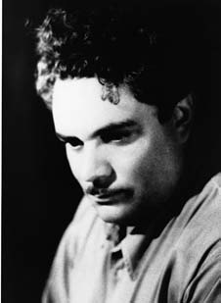
Nationalism in the Americas Silvestre Revueltas: Mexican Nationalist
Mexican composer, conductor (1899–1940)
Child prodigy (violin)
Studies in Mexico and the United States
Spanish Civil War (Loyalist)
Returned to Mexico in 1937
Died at age 40
Music is colorful and folkloric
Notes:
Silvestre Revueltas (1899–1940) was a Mexican nationalist composer, conductor, and violin prodigy.
Revueltas studied composition in Mexico City and the United States, eventually becoming assistant conductor of the Orquesta Sinfónica de Mexico.
His work is representative of “mestizo realism”—a movement that drew on elements of Mexican contemporary culture.
In the late 1930s, during the Spanish Civil War, Revueltas went to Spain and worked for the Loyalist government, composing anti-Fascist works.
He returned to Mexico in 1937, where he died at the age of 40.
Revueltas’s music exhibits Mexican folk elements, with polyrhythms, ostinatos, and colorful chromaticism. His works include orchestral music, film scores, string quartets, ballets, and songs.

Slide 73
Silvestre Revueltas: Homage to Federico García Lorca
Third Movement, Son (1937)
Sectional, rondo-like form
Evokes mariachi ensemble
A section: Seven-note melodic turns, highly syncopated
B section: Piano and string ostinato, chromatic trumpet solo
C section: Mexican dance theme (son), muted trumpets in parallel thirds
Coda: Cluster chord in piano; fast, loud, frenetic
Notes:
Revueltas’s Homage to Federico García Lorca was completed in 1937.
The Third Movement, Son, is a sectional, rondo-like form, which evokes a mariachi ensemble.
The A section is highly syncopated and presents seven-note melodic turns. In the B section, a piano and string ostinato supports the chromatic trumpet solo.
It is in the C section that the Mexican dance theme, or son is heard, with muted trumpets in parallel thirds.
The Coda is launched with a cluster chord in the piano, and then becomes fast, loud, and frenetic.

Slide 74
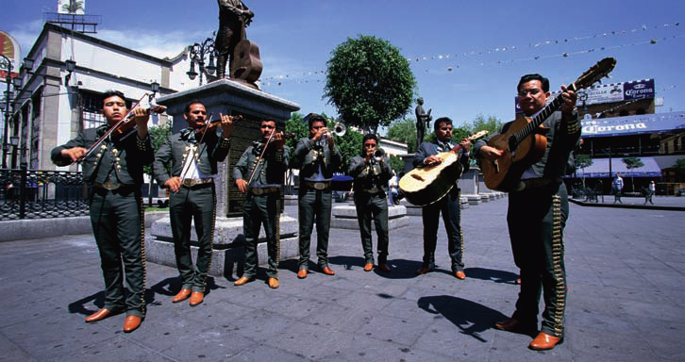
Nationalism in the Americas Music from the Mariachi Tradition
Originated mid-nineteenth century, western Mexico
String orchestra with bowed and plucked instruments
Guitarrón—large, acoustic bass guitar
Viheula—rounded-back folk guitar
1930s, urban sound, addition of trumpets
performers wear costumes of charros, Mexican cowboys
Notes:
The traditional mariachi ensemble is a good example of early-twentieth-century Mexican nationalism.
This type of group originated in western Mexico, as a string orchestra with bowed and plucked instruments
The guitarrón is a large, acoustic bass guitar, and the viheula is a rounded-back folk guitar.
During the 1930s, mariachi ensembles took on an urban sound with the addition of trumpets.
Modern performers wear a costume of charros—Mexican cowboys.

Slide 75
Nationalism in the Americas Music from the Mariachi Tradition
El Cihualteco (The Man from Cihuatlán)
Famous dance piece in the mariachi tradition
Associated with Spanish flamenco-style: zapateado
Standard verse/chorus structure
Violins and trumpets in parallel thirds
Notes:
El Cihuatlán (The Man from Cihautlán) is a famous dance piece in the mariachi tradition.
This song is associated with the Spanish flamenco-style dance known as the zapateado and is characterized by strong syncopation and dancers’ boot stomping.
This selection follows the standard verse/chorus structure and features a melodic line with violins and trumpets in parallel thirds.

Slide 76
The Late Twentieth Century
Modern electronic inventions continue to change and shape our lives. Music has not been immune to these changes. Computers, synthesizers, and massive sound systems have become common throughout the western world. In this unit, we will touch on some of the important trends that started in the 1940s and 1950s and continue to the present. We will also look at an important genre, movie music!
Laptop Orchestras
With the development of laptop computers, a new wave of interest has sprung up world-wide in electronic music of all types. Musicians can now easily link laptops together to form ensembles; they can also link laptops in other locations, even around the globe. Software is being developed that allows for all types of musique concrète and elektronische musik compositions and combinations. The Princeton Laptop Orchestra is a leader in this area of experimental composition and performance.

Slide 77
Film Music
Although modern audiences may no longer visit the local symphony or opera house on a regular basis, they do visit the local movie theater. In this way, symphonic music lives on in our everyday lives in the form of music for film, as well as for television shows, commercials, and video games.
More than any other form of media in the twentieth century, film has made an indelible mark on our culture. The first known public exhibition of film with accompanying sound took place in Paris in 1900, but not until the 1920s did talking pictures, or “talkies,” become commercially viable. Inevitably, part of the magic of film is due to its marriage with music. After opera, film music was the next step in the evolution of music for drama. In fact, film music follows many of the same rules established by the nineteenth-century opera and before, such as the use of overtures, leitmotifs, and incidental music. Many of the most famous themes in the history of film are known throughout the world in the same way that an aria from a famous opera would have been known to the mass audiences of the previous century. For example, who of us cannot sing the theme from Star Wars?

Slide 78
Music for the New Media
Although the movies continue to flourish in the twenty-first century, new technologies bring new media, and, with it, new music. One of the fastest growing examples of new media comes in the form of video games. The music of the first commercially available video games of the 1970s was rudimentary at best. Fast-forward to the twenty-first century, and video games feature complex and original musical backdrops which complement incredibly realistic graphics and game play. These games require a cinematic style of music that can adapt to the actions of the player.
Listen to the example below from the original for the Nintendo Entertainment System. Early video game music is not unlike the music of the Renaissance in that it was limited to polyphony between a small number of voices. The original NES system put significant restraints on composers, as it was only possible to sound three to four notes simultaneously, and a great deal of effort was put into getting as rich a sound as possible within these constraints. Listen below to the two versions of the main Zelda theme (called the “Overworld Theme”). Conceived by acclaimed video game composer Koji Kondo, it is one of the most famous video game themes of all time. This theme has been featured in almost all the Legend of Zelda games. Notice how the composer uses imitative polyphony to create the illusion of a full texture. Also notice the piece’s similarity to Ravel’s Bolero, which we heard earlier in this chapter. Kondo originally planned to use his own arrangement of Ravel’s Bolero as the main theme for the game. However, in the end he chose to write instead an original piece with similar characteristics. Notice that both are built on a steady repeated percussive pattern.

