Slide 1
Chapter 9
Delivery

Slide 2
The Importance of Delivery
Delivery and its relation to the fear of public speaking
The story of Bobby & Chris
Delivery is the root of most concerns about speaking in public

Slide 3
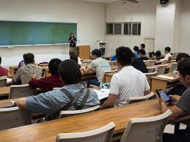
Methods of Delivery
Impromptu Speaking
a short message without advance preparation
Happens often and is typically informal
Advantages & Disadvantages
Manuscript Speaking
the word-for-word iteration of a written message
speaker maintains his or her attention on the printed page except when using visual aids
Advantages & Disadvantages

Slide 4
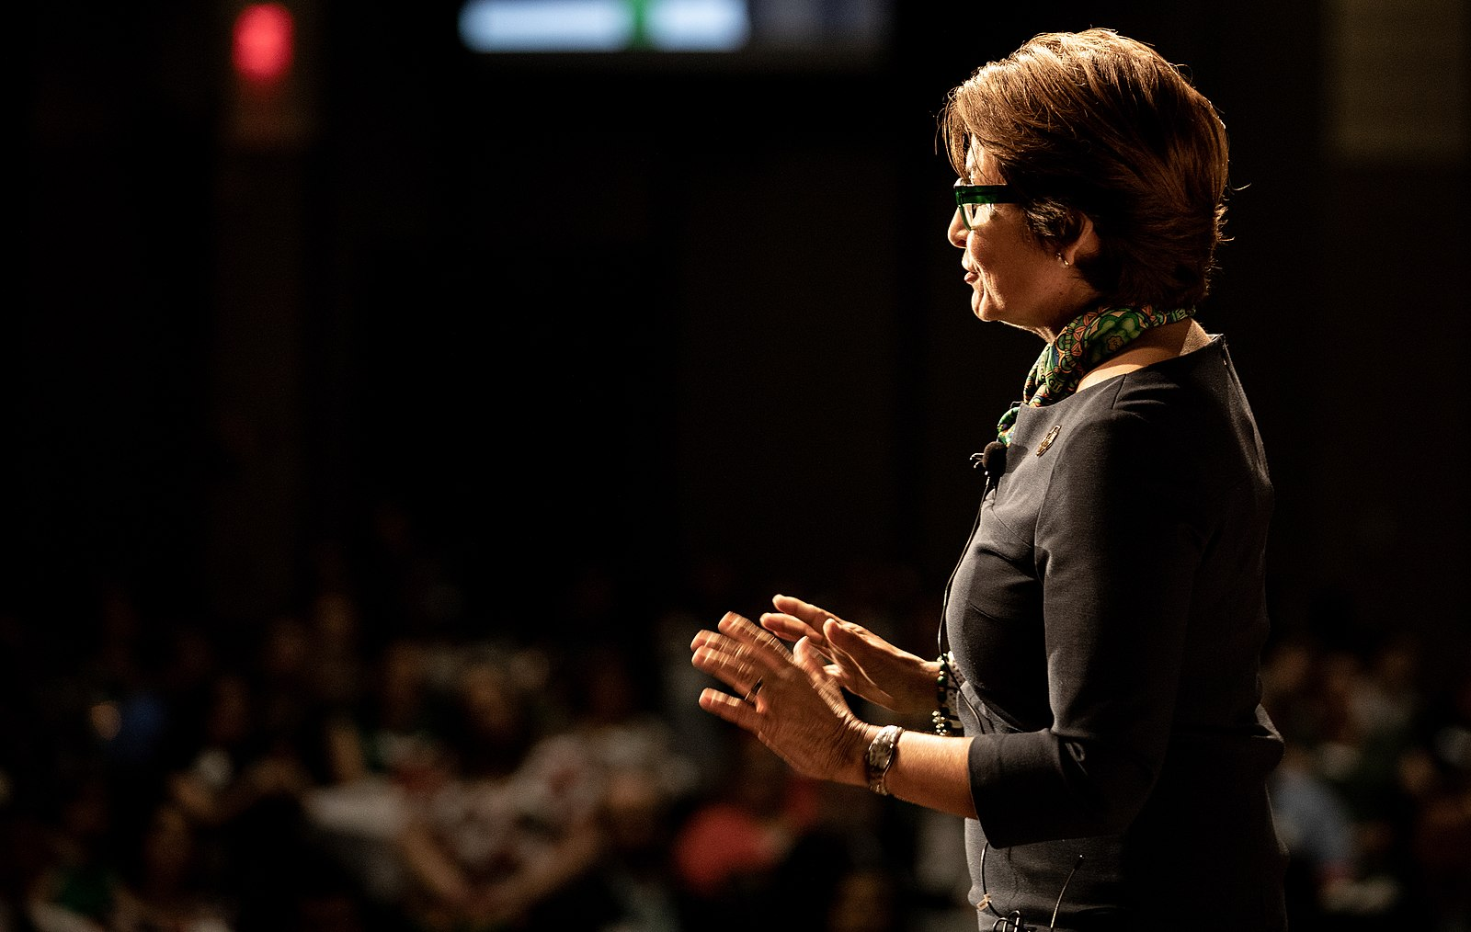
Methods of Delivery
Extemporaneous Speaking
the presentation of a carefully planned and rehearsed speech, spoken in a conversational manner using brief notes
Advantages & Disadvantages
Memorized Speaking
the rote recitation of a written message that the speaker has committed to memory
Advantages & Disadvantages

Slide 5
Preparing for Your Delivery
Using Lecterns
Indoor Space Size
Outdoor Spaces
Using a Microphone
Audience Size

Slide 6
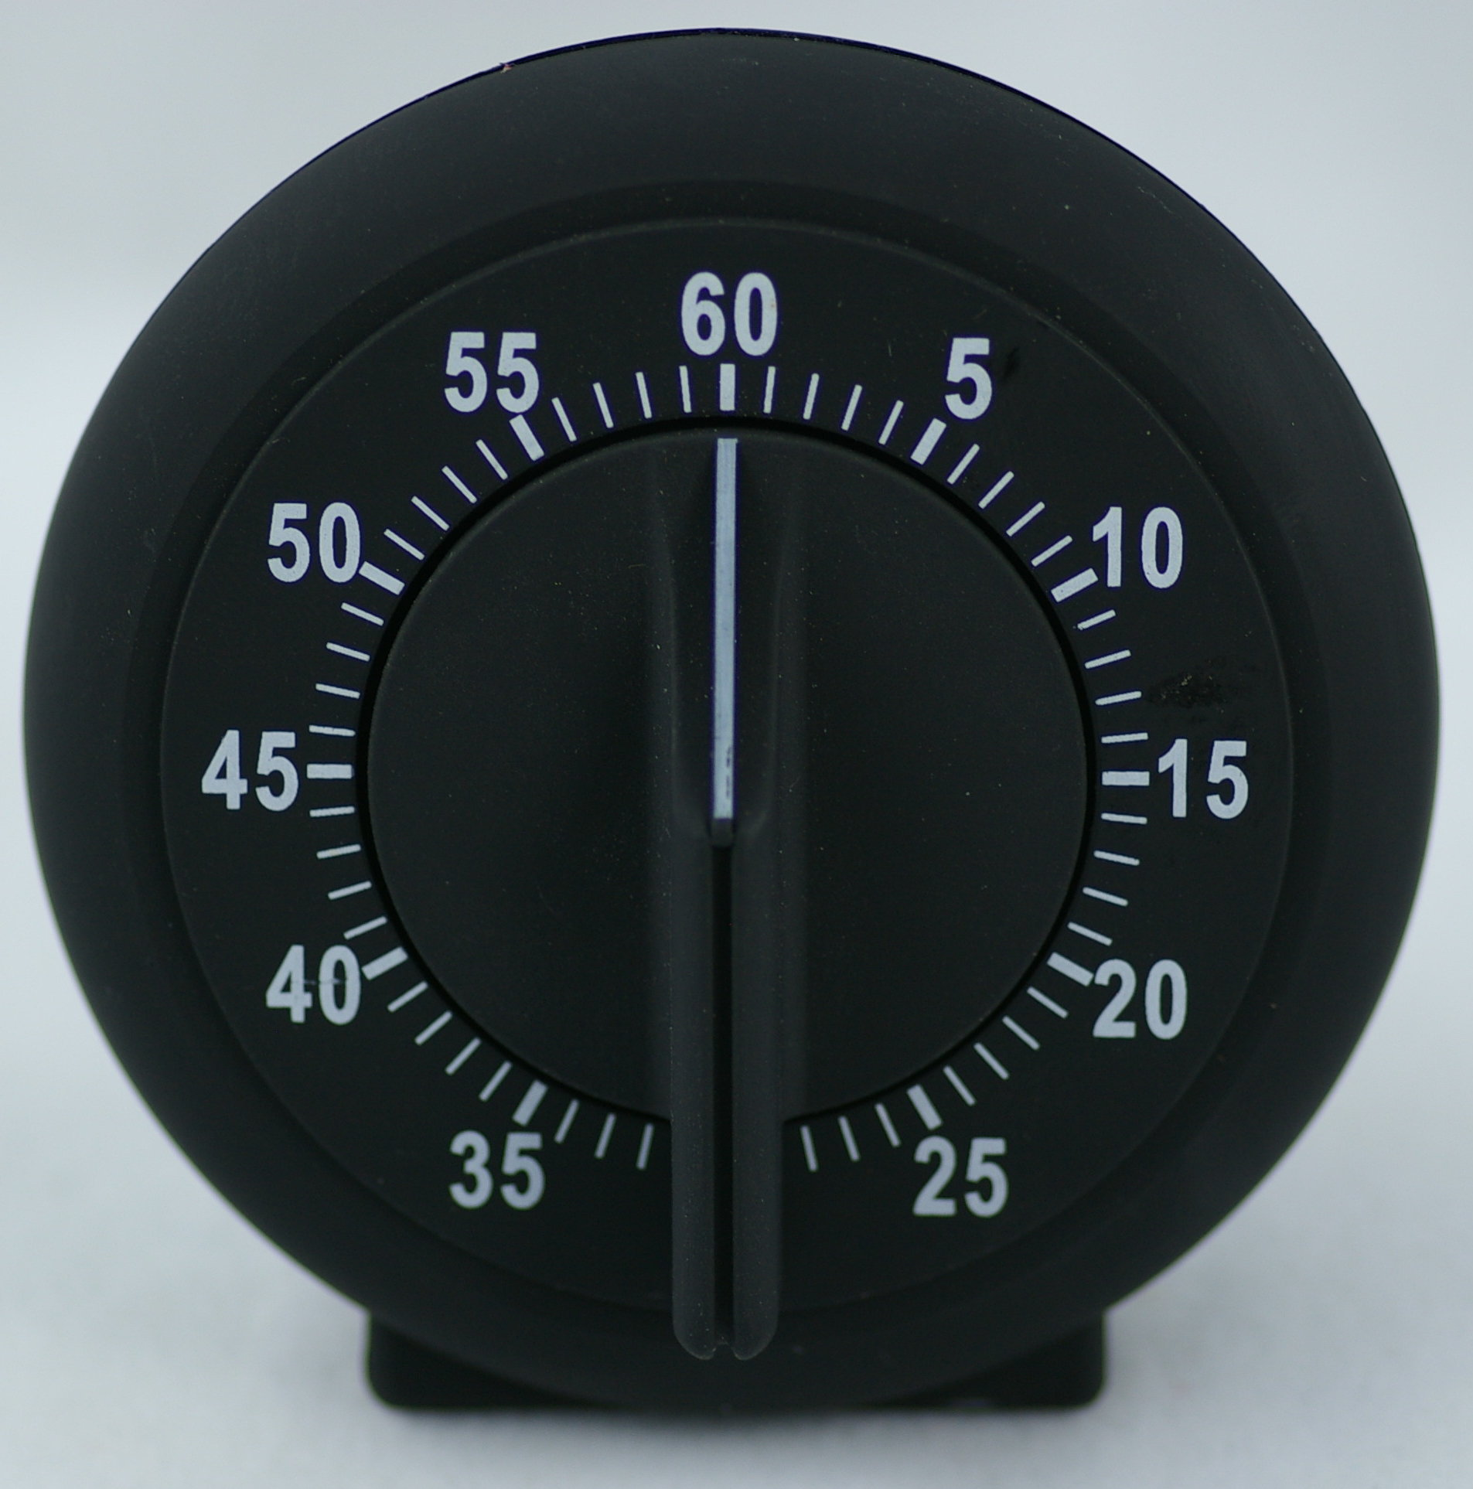
Practicing Your Delivery
There is no “one size fits all” delivery plan
Practice
Out Loud
Standing Up
With a Lectern
With an Audience
While Keeping Time
By Recording Yourself

Slide 7
What to do When Delivering Your Speech
Verbal & Nonverbal Elements
Hands
Feet
Objects
The Lectern & Posture
Eye Contact

Slide 8
What to do When Delivering Your Speech
Vocal Considerations
Volume
Pitch
Rate
Pauses
Vocalized Pauses

Slide 9
Expert Advice on Delivery
What does Mr. Chad Daniel, Lecturer in Theatre at Dalton State College say about delivery?
Overall, Good delivery is meant to augment your speech and help convey your information to the audience

