Slide 1
The Sensory Systems
General Biology II
Notes:
All text in these slides is taken from https://courses.lumenlearning.com/wm-biology1/ where it is published under one or more open licenses.
All images in these slides are attributed in the notes of the slide on which they appear and licensed as indicated.
Cover Image: "Peacock Feathers." Authored by: Andre Mouton. Provided by: Unsplash. Located at: https://unsplash.com/photos/_d3sppFprWI. Content Type: CC Licensed Content, Shared Previously. License: CC0: No Rights Reserved.

Slide 2
Human Special and General Senses
Special senses have sensory organ
Olfaction
Gustation
Equilibrium
Hearing
Vision
General Senses
Somatosensation

Slide 3
Sensory System
Exteroceptors
Vision
Hearing
Touch (thermoception, nociception)
Vibration (mechanoreception)
Proprioception
Equilibrium
Chemoreception:
Gustation
Olfaction
Interoceptors
blood pressure dropping
changes in glucose, pH, and carbon dioxide levels

Slide 4
Sensory Receptors
Sensory receptors are either specialized cells associated with sensory neurons or the specialized ends of sensory neurons that are a part of the peripheral nervous system
They are used to receive information about the environment (internal or external)
Each sensory receptor is modified for the type of stimulus it detects.
Each sensory receptor is responsive to stimuli within a specific region in space, which is known as that receptor’s receptive field

Slide 5
Mechanoreceptors
Notes:
Biology. Provided by: OpenStax CNX. Located at: http://cnx.org/contents/185cbf87-c72e-48f5-b51e-f14f21b5eabd@10.8. License: CC BY: Attribution. License Terms: Download for free at http://cnx.org/contents/185cbf87-c72e-48f5-b51e-f14f21b5eabd@10.8

Slide 6
From Sensory Signal to Electrical Signal
The most fundamental function of a sensory system is the translation of a sensory signal to an electrical signal in the nervous system

Slide 7
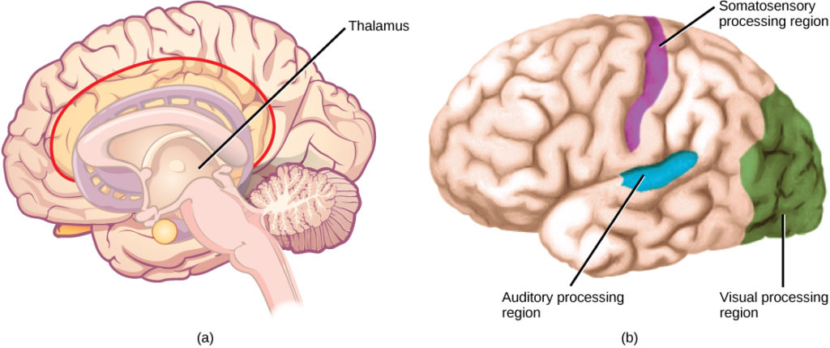
Sensory Signals are Processed in the Brain
In humans, with the exception of olfaction, all sensory signals are routed from the (a) thalamus to (b) final processing regions in the cortex of the brain
Notes:
(credit b: modification of work by Polina Tishina) in Biology. Provided by: OpenStax CNX. Located at: http://cnx.org/contents/185cbf87-c72e-48f5-b51e-f14f21b5eabd@10.8. License: CC BY: Attribution. License Terms: Download for free at http://cnx.org/contents/185cbf87-c72e-48f5-b51e-f14f21b5eabd@10.8
Previous

Slide 8
Just-Noticeable Difference
Just-noticeable difference (JND) is the amount something must be changed in order for a difference to be noticeable, or detectable at least half the time (absolute threshold). Measured in physical units, we have:
ΔI/I=k
where I is the original intensity of the particular stimulation, ΔI is the addition to it required for the change to be perceived (the JND), and k is a constant.

Slide 9
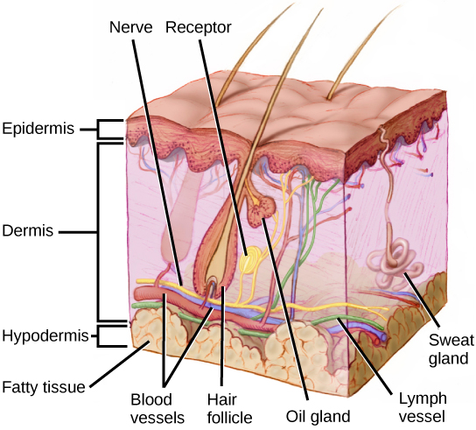
Somatosensory Receptors
Mammalian skin has three layers: an epidermis, a dermis, and a hypodermis
Notes:
(credit: modification of work by Don Bliss, National Cancer Institute) in Biology. Provided by: OpenStax CNX. Located at: http://cnx.org/contents/185cbf87-c72e-48f5-b51e-f14f21b5eabd@10.8. License: CC BY: Attribution. License Terms: Download for free at http://cnx.org/contents/185cbf87-c72e-48f5-b51e-f14f21b5eabd@10.8
Previous

Slide 10
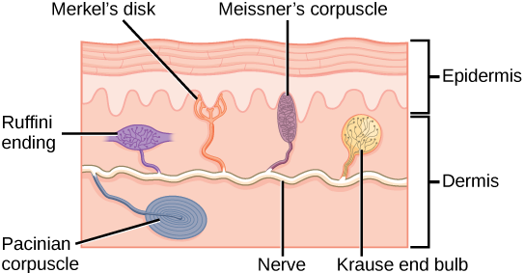
Mechanoreceptors in Human Skin
Merkel’s disks - light touch
Meissner’s corpuscles - touch and low-frequency vibration
Ruffini endings - stretch, deformation within joints, and warmth
Pacinian corpuscles - transient pressure & high-frequency vibration
Krause end bulbs - cold
Notes:
Biology. Provided by: OpenStax CNX. Located at: http://cnx.org/contents/185cbf87-c72e-48f5-b51e-f14f21b5eabd@10.8. License: CC BY: Attribution. License Terms: Download for free at http://cnx.org/contents/185cbf87-c72e-48f5-b51e-f14f21b5eabd@10.8
Previous

Slide 11
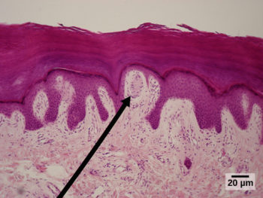
Meissner Corpuscles
Meissner corpuscles in the fingertips, such as the one viewed here using bright field light microscopy, allow for touch discrimination of fine detail
Notes:
(credit: modification of work by “Wbensmith”/Wikimedia Commons; scale-bar data from Matt Russell)Biology. Provided by: OpenStax CNX. Located at: http://cnx.org/contents/185cbf87-c72e-48f5-b51e-f14f21b5eabd@10.8. License: CC BY: Attribution. License Terms: Download for free at http://cnx.org/contents/185cbf87-c72e-48f5-b51e-f14f21b5eabd@10.8
Previous

Slide 12
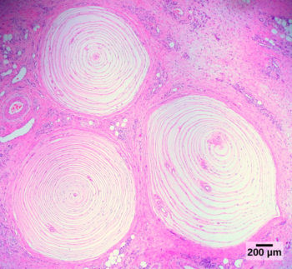
Pacinian Corpuscles
Pacinian corpuscles, such as these visualized using bright field light microscopy, detect pressure (touch) and high-frequency vibration.
Notes:
(credit: modification of work by Ed Uthman; scale-bar data from Matt Russell)Biology. Provided by: OpenStax CNX. Located at: http://cnx.org/contents/185cbf87-c72e-48f5-b51e-f14f21b5eabd@10.8. License: CC BY: Attribution. License Terms: Download for free at http://cnx.org/contents/185cbf87-c72e-48f5-b51e-f14f21b5eabd@10.8
Previous

Slide 13
Pain and Temperature
Thermoception or thermoreception is the sense by which an organism perceives temperatures
Pain is the name given to nociception, which is the neural processing of injurious stimuli in response to tissue damage

Slide 14
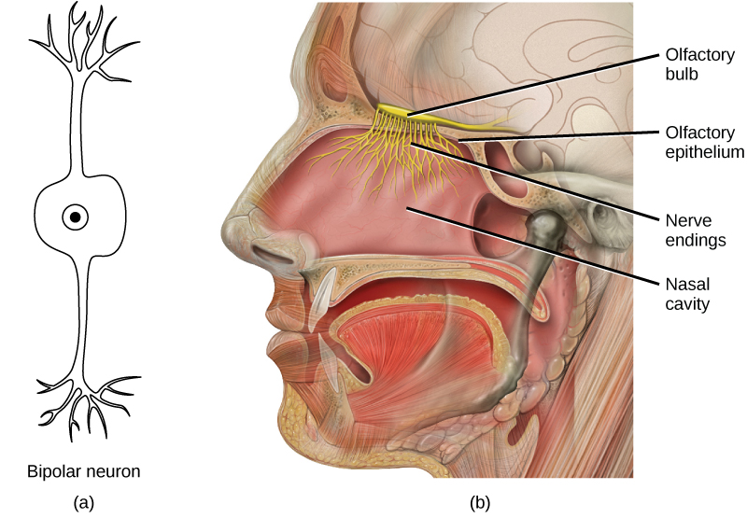
Human Olfactory System
In the human olfactory system, (a) bipolar olfactory neurons extend from (b) the olfactory epithelium, where olfactory receptors are located, to the olfactory bulb
Notes:
(credit: modification of work by Patrick J. Lynch, medical illustrator; C. Carl Jaffe, MD, cardiologist) in Biology. Provided by: OpenStax CNX. Located at: http://cnx.org/contents/185cbf87-c72e-48f5-b51e-f14f21b5eabd@10.8. License: CC BY: Attribution. License Terms: Download for free at http://cnx.org/contents/185cbf87-c72e-48f5-b51e-f14f21b5eabd@10.8
Previous

Slide 15
Olfactory Bulb
The olfactory bulb is composed of neural clusters called glomeruli, and each glomerulus receives signals from one type of olfactory receptor, so each glomerulus is specific to one odorant

Slide 16
Taste in Humans
Both taste and odor stimuli are molecules taken in from the environment.
The primary tastes detected by humans are sweet, sour, bitter, salty and umami.

Slide 17
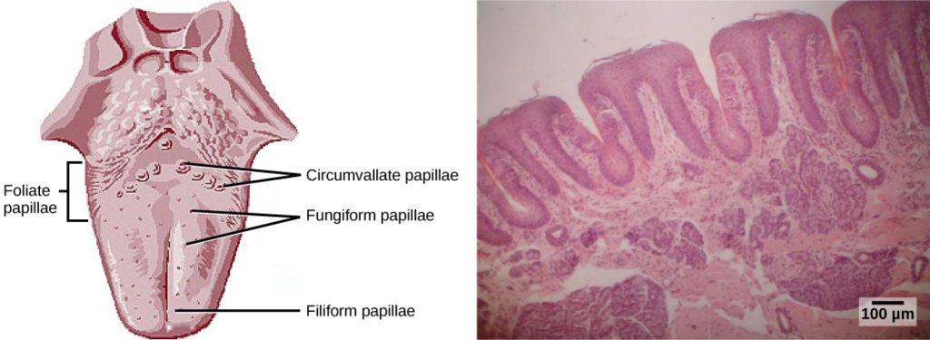
The Tongue
(a) Foliate, circumvallate, and fungiform papillae are located on different regions of the tongue. (b) Foliate papillae are prominent protrusions on this light micrograph.
Notes:
(credit a: modification of work by NCI; scale-bar data from Matt Russell) in Biology. Provided by: OpenStax CNX. Located at: http://cnx.org/contents/185cbf87-c72e-48f5-b51e-f14f21b5eabd@10.8. License: CC BY: Attribution. License Terms: Download for free at http://cnx.org/contents/185cbf87-c72e-48f5-b51e-f14f21b5eabd@10.8
Previous

Slide 18
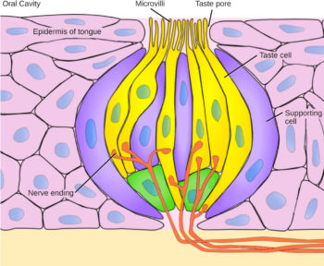
Taste Pores
Pores in the tongue allow tastants to enter taste pores in the tongue
Notes:
(credit: modification of work by Vincenzo Rizzo) in Biology. Provided by: OpenStax CNX. Located at: http://cnx.org/contents/185cbf87-c72e-48f5-b51e-f14f21b5eabd@10.8. License: CC BY: Attribution. License Terms: Download for free at http://cnx.org/contents/185cbf87-c72e-48f5-b51e-f14f21b5eabd@10.8
Previous

Slide 19
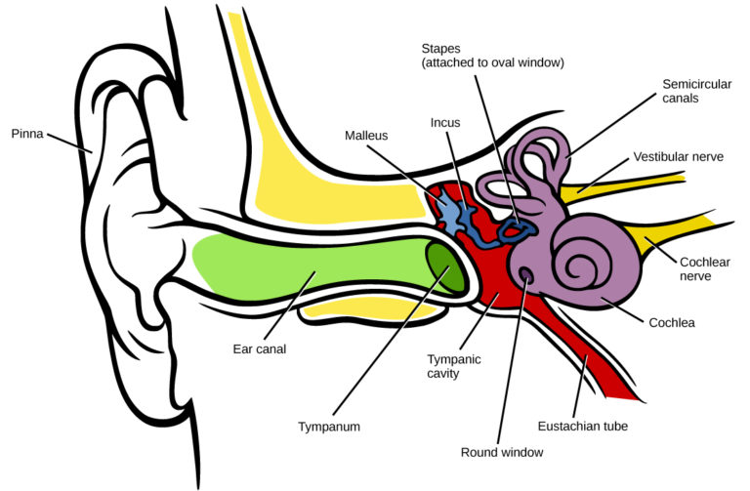
Reception of Sound
Sound travels into the middle ear, where three bones called ossicles transfer the sound wave to the oval window, the exterior boundary of the inner ear. The organ of Corti, which is the organ of sound transduction, lies inside the cochlea
Notes:
(credit: modification of work by Lars Chittka, Axel Brockmann) in Biology. Provided by: OpenStax CNX. Located at: http://cnx.org/contents/185cbf87-c72e-48f5-b51e-f14f21b5eabd@10.8. License: CC BY: Attribution. License Terms: Download for free at http://cnx.org/contents/185cbf87-c72e-48f5-b51e-f14f21b5eabd@10.8

Slide 20
Sound Waves
Notes:
For sound waves, wavelength corresponds to pitch. Amplitude of the wave corresponds to volume. The sound wave shown with a dashed line is softer in volume than the sound wave shown with a solid line. (credit: NIH)
Biology. Provided by: OpenStax CNX. Located at: http://cnx.org/contents/185cbf87-c72e-48f5-b51e-f14f21b5eabd@10.8. License: CC BY: Attribution. License Terms: Download for free at http://cnx.org/contents/185cbf87-c72e-48f5-b51e-f14f21b5eabd@10.8

Slide 21
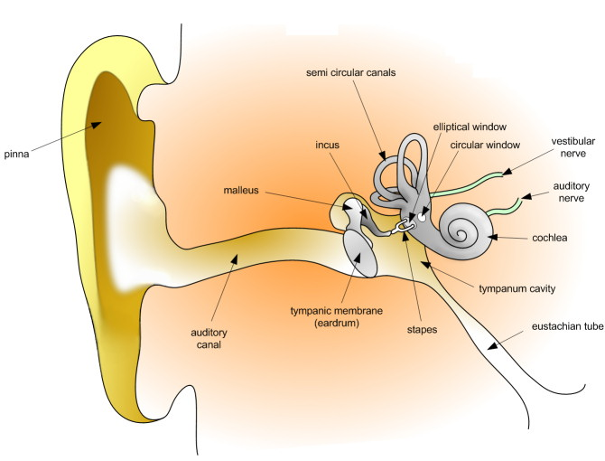
Anatomy of the Ear
Notes:
Human Physiology. Provided by: Wikibooks. Located at: https://en.wikibooks.org/wiki/Human_Physiology. License: CC BY-SA: Attribution-ShareAlike

Slide 22
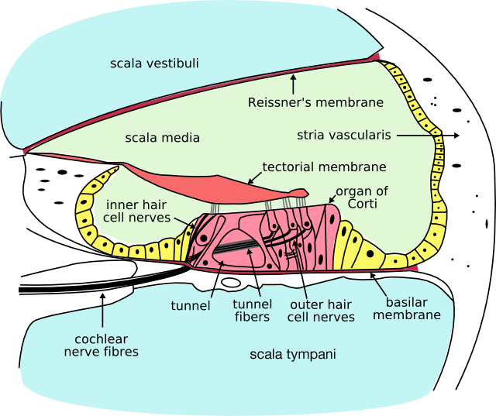
Cross Section of the Cochlea
Notes:
Human Physiology. Provided by: Wikibooks. Located at: https://en.wikibooks.org/wiki/Human_Physiology. License: CC BY-SA: Attribution-ShareAlike

Slide 23
Transduction of Sound
In the human ear, sound waves cause the stapes to press against the oval window. Vibrations travel up the fluid-filled interior of the cochlea. The basilar membrane that lines the cochlea gets continuously thinner toward the apex of the cochlea. Different thicknesses of membrane vibrate in response to different frequencies of sound. Sound waves then exit through the round window. In the cross section of the cochlea (top right previous slide), note that in addition to the upper canal and lower canal, the cochlea also has a middle canal. The organ of Corti (bottom previous slide) is the site of sound transduction. Movement of stereocilia on hair cells results in an action potential that travels along the auditory nerve.

Slide 24
Transduction of Sound (continued)
Notes:
Biology. Provided by: OpenStax CNX. Located at: http://cnx.org/contents/185cbf87-c72e-48f5-b51e-f14f21b5eabd@10.8. License: CC BY: Attribution. License Terms: Download for free at http://cnx.org/contents/185cbf87-c72e-48f5-b51e-f14f21b5eabd@10.8

Slide 25
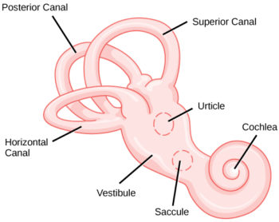
The Vestibular Labyrinth
There are five vestibular receptor organs in the inner ear: the utricle, the saccule, and three semicircular canals. Each contains hair cells which lie below a gelatinous layer, with their stereocilia projecting into the gelatin. Embedded in this gelatin are calcium carbonate crystals—like tiny rocks
Notes:
(credit: modification of work by NIH) in Biology. Provided by: OpenStax CNX. Located at: http://cnx.org/contents/185cbf87-c72e-48f5-b51e-f14f21b5eabd@10.8. License: CC BY: Attribution. License Terms: Download for free at http://cnx.org/contents/185cbf87-c72e-48f5-b51e-f14f21b5eabd@10.8

Slide 26
How does it work?
When the head is tilted, the crystals continue to be pulled straight down by gravity, but the new angle of the head causes the gelatin to shift, thereby bending the stereocilia
The bending of the stereocilia stimulates the neurons, and they signal to the brain that the head is tilted, allowing the maintenance of balance
It is the vestibular branch of the vestibulocochlear cranial nerve that deals with balance
Notes:
Biology. Provided by: OpenStax CNX. Located at: http://cnx.org/contents/185cbf87-c72e-48f5-b51e-f14f21b5eabd@10.8. License: CC BY: Attribution. License Terms: Download for free at http://cnx.org/contents/185cbf87-c72e-48f5-b51e-f14f21b5eabd@10.8

Slide 27
Light Waves
Notes:
(credit: modification of work by NASA) in Biology. Provided by: OpenStax CNX. Located at: http://cnx.org/contents/185cbf87-c72e-48f5-b51e-f14f21b5eabd@10.8. License: CC BY: Attribution. License Terms: Download for free at http://cnx.org/contents/185cbf87-c72e-48f5-b51e-f14f21b5eabd@10.8

Slide 28
Anatomy of the Eye
Notes:
Biology. Provided by: OpenStax CNX. Located at: http://cnx.org/contents/185cbf87-c72e-48f5-b51e-f14f21b5eabd@10.8. License: CC BY: Attribution. License Terms: Download for free at http://cnx.org/contents/185cbf87-c72e-48f5-b51e-f14f21b5eabd@10.8

Slide 29
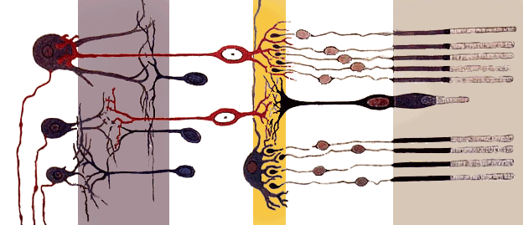
Vision: Retina’s Simplified Axial Organization
Notes:
Human Physiology. Provided by: Wikibooks. Located at: https://en.wikibooks.org/wiki/Human_Physiology. License: CC BY-SA: Attribution-ShareAlike

Slide 30
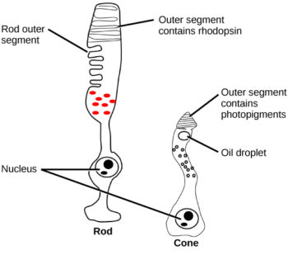
Rods and Cones
Rods and cones are photoreceptors in the retina. Rods respond in low light and can detect only shades of gray. Cones respond in intense light and are responsible for color vision.
Notes:
(credit: modification of work by Piotr Sliwa) in Biology. Provided by: OpenStax CNX. Located at: http://cnx.org/contents/185cbf87-c72e-48f5-b51e-f14f21b5eabd@10.8. License: CC BY: Attribution. License Terms: Download for free at http://cnx.org/contents/185cbf87-c72e-48f5-b51e-f14f21b5eabd@10.8

Slide 31
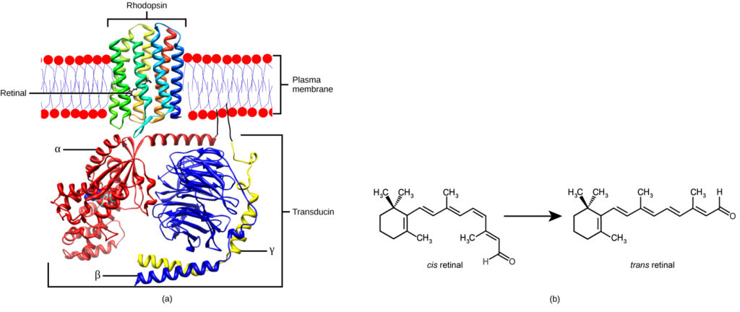
Transduction of Light: Rhodopsin
Rhodopsin, the photoreceptor in vertebrates, has two parts: the trans-membrane protein opsin, and retinal. When light strikes retinal, it changes shape from (b) a cis to a trans form. The signal is passed to a G-protein called transducin, triggering a series of downstream events.
Notes:
Biology. Provided by: OpenStax CNX. Located at: http://cnx.org/contents/185cbf87-c72e-48f5-b51e-f14f21b5eabd@10.8. License: CC BY: Attribution. License Terms: Download for free at http://cnx.org/contents/185cbf87-c72e-48f5-b51e-f14f21b5eabd@10.8

Slide 32
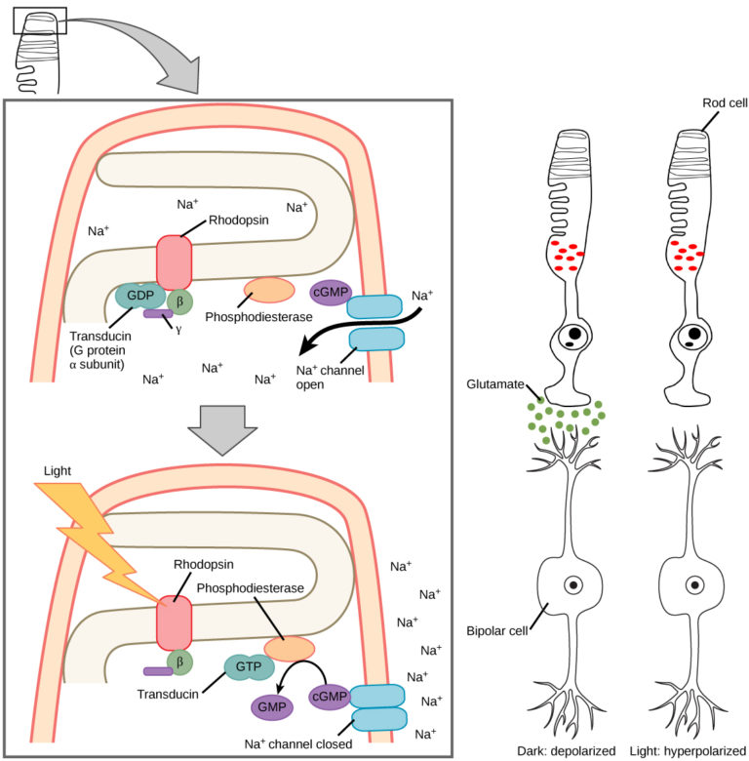
Hyperpolarization
When light strikes rhodopsin, the G-protein transducin is activated, which in turn activates phosphodiesterase. Phosphodiesterase converts cGMP to GMP, thereby closing sodium channels. As a result, the membrane becomes hyperpolarized. The hyperpolarized membrane does not release glutamate to the bipolar cell
Notes:
Biology. Provided by: OpenStax CNX. Located at: http://cnx.org/contents/185cbf87-c72e-48f5-b51e-f14f21b5eabd@10.8. License: CC BY: Attribution. License Terms: Download for free at http://cnx.org/contents/185cbf87-c72e-48f5-b51e-f14f21b5eabd@10.8

Slide 33
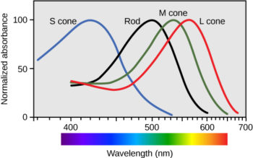
Trichromatic Coding
Human rod cells and the different types of cone cells each have an optimal wavelength. However, there is considerable overlap in the wavelengths of light detected
Notes:
Biology. Provided by: OpenStax CNX. Located at: http://cnx.org/contents/185cbf87-c72e-48f5-b51e-f14f21b5eabd@10.8. License: CC BY: Attribution. License Terms: Download for free at http://cnx.org/contents/185cbf87-c72e-48f5-b51e-f14f21b5eabd@10.8

Slide 34
Practice Question
Beyond the five senses, what other sensory systems exist in humans?
Notes:
Vibration (mechanoreception)
Proprioception
Equilibrium
Thermoception
nociception
blood pressure dropping
changes in glucose, pH, and carbon dioxide levels

Slide 35
Quick Review
What are the general and special senses in humans?
How does somatosensation, the sense of touch, work?
How do taste and smell work together?
What is the path of sound through the auditory system to the site of transduction of sound?
What is the path of light through the eye to the point of the optic nerve?

